Slide 1
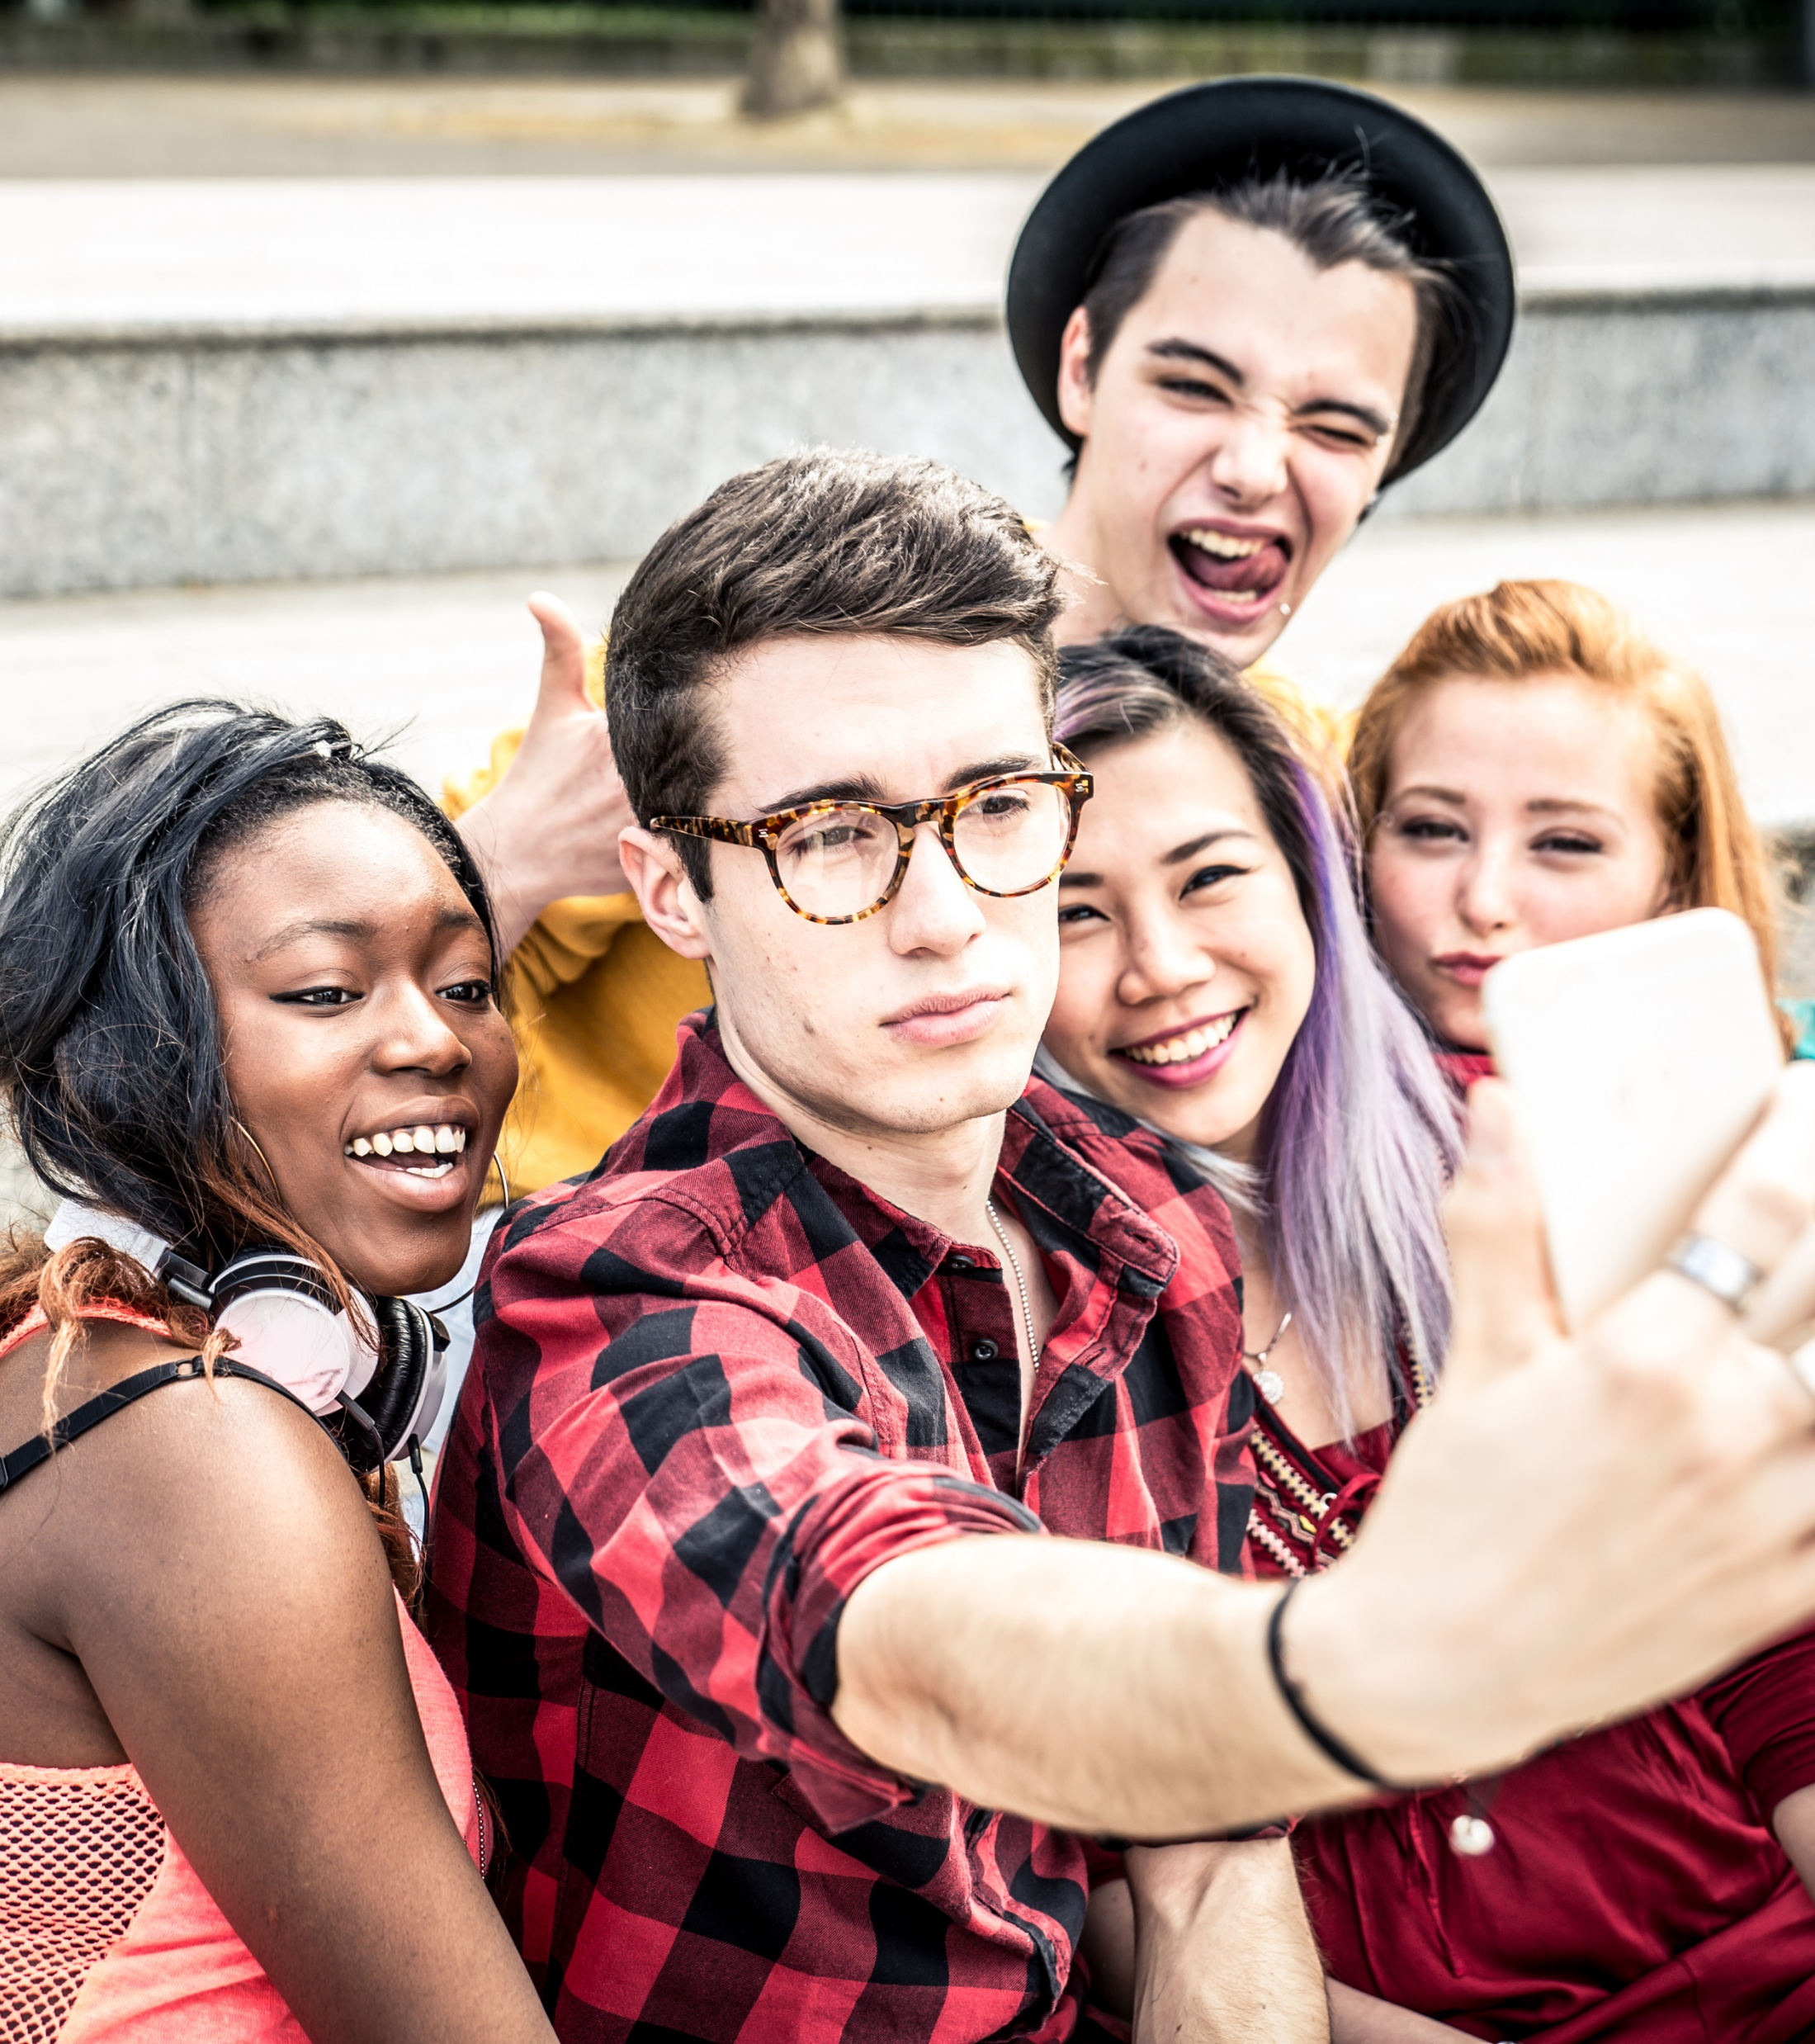
McAfee® Online
Safety Program
For Kids Ages 15-18

Slide 2
McAfee
The Device-to-Cloud Cybersecurity Company
30+ YEARS
400,000+
NEW THREATS
DETECTED EVERY DAY
250+
SECURITY INDUSTRY LEADERSHIP
RESEARCHERS
IN 30 COUNTRIES
MCAFEE LABS: RESEARCH
ORGANIZATION
PRODUCTS AVAILABLE IN OVER 120 COUNTRIES
345,000,000+
7,500+
200+
CONSUMER CUSTOMERS
EMPLOYEES
PARTNERS
Notes:
INTRODUCTION TO MCAFEE
McAfee, llc, is a global computer security software company headquartered in Santa Clara, California, and the world's largest dedicated security technology company. We have 30+ years of experience as the security industry leader.
We look at our record from many angles. Our products have an impressive history of winning awards. The dedicated employees of McAfee and the strong leadership team are a big part of our success story. And so is the global research combined with the innovations that our technical teams produce. McAfee labs is a research organization with over 250researchers in 30 countries.
We have over 200M consumer customers around the world and over 200 partners. Our products are used by the largest corporations and governments in the world. We have an impressive customer base that continues to grow because customers trust us and have confidence that we are protecting what they need protected.

Slide 3

Internet Enabled Devices
iot = Internet of Things
Laptop
Smartphone
TV
Fridge
Games Consoles
Printers
T.Jacket
Fit Bit
Nest Protect
Google glass
Tesla
Smart Cities
Notes:
What are they? We are internet enabled at an unprecedented level.
How to engage with internet of things? 5 steps according to our VP IOT Philip Moynagh
1 Select a thing, a light bulb a car, sth that matters to you
2 Now add a brain to that thing we need that thing to be smart to think for itself
3 Need the thing to communicate with the internet, add a voice, ears, need connectivity, wired usb to laptop or wireless phone connection
4 Connect to the cloud, connected to the internet
5 Make cool new things happen, driven by problems you have or opps you see this step is only limited by imagination
Personal Care → fit bit (T.Jacket by T.Ware simulates a hug to calm stressed people)
Connected Home → Nest protect CO and smoke alarm.
Intelligent Transportation → self driving car e.g. goolgle, intelligent car like Tesla
Intelligent Cities → Environmental control (traffic, lights)

Slide 4

More Devices in More Places
Global Smartphone Usage
as percentage of population
Estimated number of
Internet of Things Devices by 2020
5%
20%
40%
2009
2013
2018
26,000,000,000
Tablets are showing faster adoption rates than smartphones. It took smartphones nearly four years to reach 6% usage from when the devices first started to register on a global level. Tablets accomplished this in just two years.
6%
4
Years
2
Years
http://www.emarketer.com/Article/Worldwide-Smartphone-Usage-Grow-25-2014/1010920
http://www.businessinsider.com/smartphone-and-tablet-penetration-2013-10
http://www.gartner.com/newsroom/id/2688717
Notes:
We live in a time defined by hyper-growth of connected devices. Smart phones and tablets are growing at 10 times that of PCs. We are using those devices in more locations to do more things. By the end of 2014 there will be as many mobile devices as people on the planet.
The Internet of Things is eclipsing that of mobile and the number of connected devices is growing at an exponential rate. It is estimated that by 2020, there will be 26 billion connected devices. The types of connected devices in the home range from smart TVs, home security systems and refrigerators to home brewing machines. This volume of connected devices means that threats are also increasing.

Slide 5
244 New Malware Samples Identified Every Minute
That’s 4+ new malware samples every second!
27%
7%
PC malware
781 million
Mac malware
700 thousand
56%
44%
Mobile malware
21 million
Ransomware
12.3 million
Source: McAfee Labs Threats Report – June & December 2017; all percentages are increases since past 4 quarters except Mac malware which is growth in Q2 2017
Notes:
The total number of malware samples grew 23% in the past four quarters to almost 723 million samples
Total mobile malware grew 61% in the past four quarters to 18.4 million samples.
The total number of Mac OS malware samples increased by 4% in Q2 2017
Ransomware has grown to 10.7 million samples in the past year.
The number of total ransomware samples grew 47% in the past four quarters to 10.7 million samples.

Slide 6
Growth of Cybercrime
Every second 12 people online become a victim of cybercrime, totaling more than
1 million victims around the world every day.
$158 billion
Consumers globally lost $158 billion to cybercrime last year
Source: http://securityaffairs.co/wordpress/50680/cyber-crime/global-cost-of-cybercrime.html

Slide 7
Your Responsibility In…
STOP. THINK. CONNECT.™
Cyber Security
Cyber Safety
Cyber Ethics
What do I do to
keep my stuff safe?
What do I do to keep myself safe?
How do I treat others online?
STOP. THINK. CONNECT.™ is a trademark of STOP. THINK. CONNECT. Messaging Convention, Inc. and may only be used in accordance with the license provided at www.stopthinkconnect.org.
Notes:
“Who is responsible for what happens as a result of the time you spend online?
“It’s important to remember that, no matter what you do on the Internet, whether it’s educational or just messing around having fun, there are risks. So who has the ultimate responsibility for the safety and security of you, your stuff and the people you interact with online? It is, of course, you.
“In order to safely connect to the outside world you need to know the rules and follow them, otherwise you could be putting your computer, as well as yourself and your family, at risk.”
“In the rest of this presentation, we will be discussing ways you can keep your stuff safe and yourself safe, as well as looking at how your online behavior not only impacts the well-being of others, but can have a serious long-term impact on your reputation.
“In the end, it’s all about being a responsible cyber citizen.”
Trainers Notes:
Start off by discussing the real life meanings of Security, Safety and Ethics. Explore the definitions of these words, especially Ethics. A lot of young people will have a vague approximation of what ethics means.
I avoid correlating Ethics with consequences on this slide. Often young people will have encountered ethics in the context of “breaching” a code of ethics or behaving unethically and having punishment ensue. I try to explore the positive aspects of ethics, having self respect, maintain a positive personal reputation, being proud of yourself. Fostering some self appreciate and pride is a much more engaging angle than exploring one of negative consequences.
Once the discussion on the real world scenarios is over, introduce the “Cyber” element. Anything Cyber relates to the internet and technology generally, some light reading on that below;
http://en.wikipedia.org/wiki/Cyberspace
http://io9.com/today-cyber-means-war-but-back-in-the-1990s-it-mean-1325671487
The idea here is that their knowledge of real world skills young people have when it comes to safeguarding themselves in their everyday lives needs to start translating directly to the “Cyber-lives” i.e. their social networking profiles, the content they share and the security of their devices.

Slide 8
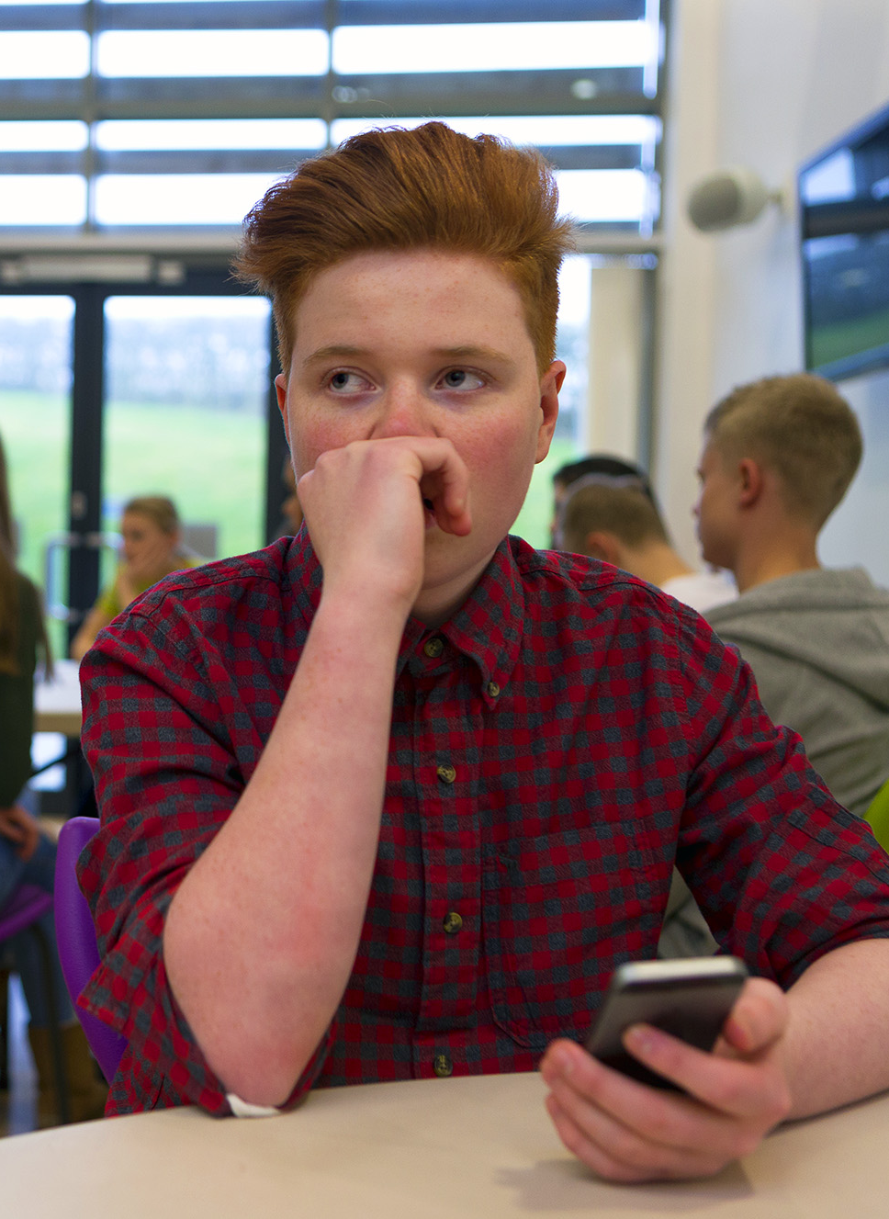

Caution
How to spot potential problems.
  Weak password
  Games, contests and downloads
  Unlocked smartphone
  Wi-Fi hotspots
  http:// vs https://
  P2P networking
  Posts and attachments
Notes:
Before you use the Internet, take time to understand the risks and learn how to spot potential problems.
Trainers Notes
Because there are so many of these, you can pick a few to discuss or ask the young people for feedback on why some of these might be considered a pitfall.
Some reading to go with each topic:
Weak Passwords
http://blogs.mcafee.com/consumer/weak-passwords
https://www.passwordday.org/uk/
Unlocked Cell Phone
This study is the basis of most of our mobile advices, it will be helpful to review same. Stats are US centric but valid for identifying trends and educational reading for terminology and mobile standards: http://www.mcafee.com/sg/resources/reports/rp-mobile-security-consumer-trends.pdf
Search Results
A lot of younger adults and teens will search for popular trends online. Fake imposter sites loaded with Malware or other viruses may be a risk. Check out this article: http://blogs.mcafee.com/consumer/superman-is-toxic-superhero
I also generally encourage the use of a free McAfee tool called Site Advisor here, it flags potentially fake sites that contain know viruses
Posts
Be careful what you post, you don’t know who’s watching or where it can be reproduced. Twitter is notorious for this as celebrities get attacked all the time by thousands for mistakes as trivial as grammar errors.
http://www.telegraph.co.uk/technology/twitter/8993204/Top-10-Twitter-faux-pas.html
In a more scary event recently, Jewish men who were oversharing pictures/locations and even phone numbers lately were singled out in an anti-semitic attack group;
http://www.algemeiner.com/2014/07/25/facebook-page-publishing-identities-of-french-jews-to-encourage-attackers-15-men-reportedly-assault-1-jew-in-paris-suburb-after-confirming-photo/
Pop-Ups
These are unsolicited windows that appear typically during browsing. They have many types, namely competitions, advertising, fake alerts etc.
http://en.wikipedia.org/wiki/Pop-up_ad
Interacting with these pop-ups is not recommended. We’ll cover this in more detail in later slide.
P2P Networking
Peer-to-Peer (P2P) networks, allow users to share any of the files on their computer with other people using the same file-sharing software. It’s the main way that young people exchange music files and movies. Malicious content, such as viruses and spyware, can also be easily spread over P2P networks. See some reading on same below and some recommendations on how to stay safe;
http://home.mcafee.com/advicecenter/?id=rs_na_fa11article3
Unsecured Wi-Fi
Links
Cyber prowlers frequently build fraudulent web sites that closely mimic legitimate banking and Wall Street sites, tricking users to turn over their online account names, passwords, Social Security numbers, and other personal information. Phishers attract users through spam or targeted emails, using embedded links hoping to get lucky and find real customers of the hijacked bank, e-retailer, or credit card company. The emails can be extremely convincing, such as a message from eBay saying that your credit card has been declined, or from Citibank saying that they have detected unauthorized activity on your account.
http://home.mcafee.com/advicecenter/?id=ad_phishing_optpopnp
http://
HyperText Transfer Protocol is a defined set of steps that an internet browser must follow in order to obtain data (websites) from a web server. Hypertext Transfer Protocol Secure (HTTPS) is a combination of the Hypertext Transfer Protocol with the SSL/TLS protocol to provide encryption and secure identification of the server.
This is important because if you are doing any sensitive work on the internet such as filling out a form or submitting bank details, you MUST ensure the URL in the browser is HTTPS and not HTTP. If you are filling out a form that requires billing information or credit card details on a site you don’t often visit and the URL is HTTP only, it is very likely this site is a fake and your credentials will be stolen.
Games
Over 60% of games and apps sampled by a McAfee security team found they were laden with malware and money stealing code charging premium rates by sending texts to numbers hidden in fake games.
http://blogs.mcafee.com/mcafee-labs/fakeinstaller-leads-the-attack-on-android-phones
Ask young people to be careful with fake games, free games or unusual variants of popular games that seems suspicious.
Friend Requests
A young persons social network is likely made up of two kinds of people: Those they actually talk to in real life and those they don't.
http://www.huffingtonpost.com/stephen-mariani/four-types-of-facebook-friends_b_5505459.html?sf3493983=1
Talk to young people about unsolicited friend requests. They should be suspicious of anyone they have not met in person. This ties into the topics of Impersonation and Anoninimty which are covered later.
Email Request for Money or Personal Information
Be cautious of emails, texts, social media messages, or chats that ask for personal information. Most banks and businesses will never message you requesting information they have no need for such as an email password. If the request seems suspicious, contact your bank first to make sure they did send you something.
http://blogs.mcafee.com/consumer/consumer-threat-notices/mobile-bankers-beware-a-new-phishing-scam-wants-your-money
Downloads
Be careful of “Free” downloads. Always do a quick search on the internet to see if the application is legitimate and not just a virus in disguise. Use antivirus software to scan anything you download.
http://home.mcafee.com/advicecenter/?id=rs_na_fa11article2
Contests
Be careful when clicking on or liking posts while taking advantage of contests, ads and special deals that you get from your "friends" that advertise the hottest holiday gifts, exclusive discounts at local stores and holiday-related job postings. Be on the lookout for your friends' accounts being hacked and sending out fake alerts to all their connections.
Criminals are getting savvier with authentic-looking social ads and deals that take consumers to legitimate-looking websites. In order to take advantage of the deals or contests, users provide personal information including their credit card number, email address, phone number and home address.
Attachments
E-mail and instant messaging (IM) are terrific forms of communication for keeping in touch with family and friends. However, using them unwisely may make you and your computer susceptible to spam, phishing scams, viruses, and other online threats. Check out some guideline below to help protect yourself:
http://home.mcafee.com/advicecenter/?id=ad_spam_t1ttpye

Slide 9

Personal Information
What do you think personal information is?
  Passwords
  Your phone number
  Where your parents work
  Where you go to school
  Where you live
  Your age
  And more…
Notes:
“So… what do you think personal information is?” [Ask the group for examples of what kind of information is personal?]
<click once to open safe >
“Personal information includes stuff like: your age, where you go to school, where your parents work, where you live, your phone number and passwords.”
“Why do you think it is a problem to share this information?” [Take some responses.]
“Cool. Here’s another example: If you post online that your family is on vacation, you’ve just let A LOT of people know (including some people who you may not know very well) that your house is empty. With just a little personal information like this, folks can use it in a variety of ways to hurt you.”
Is This Too Much Info?!
We tend to overshare online, before you click on anything watch for these TMI Red Flags;
http://www.intel.com/content/dam/www/public/us/en/apps/tmi/img/TMI-Infographic-US-Aug5.jpg

Slide 10
Security Threats
Mobile
Devices
Phishing
Malware
Sniffer

Slide 11
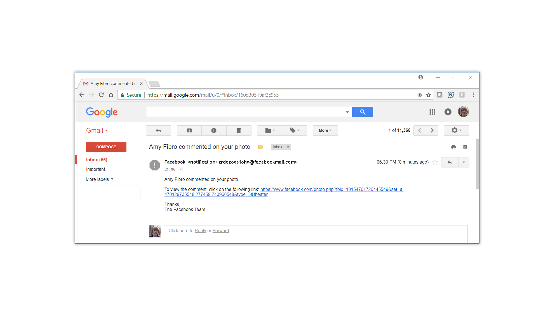
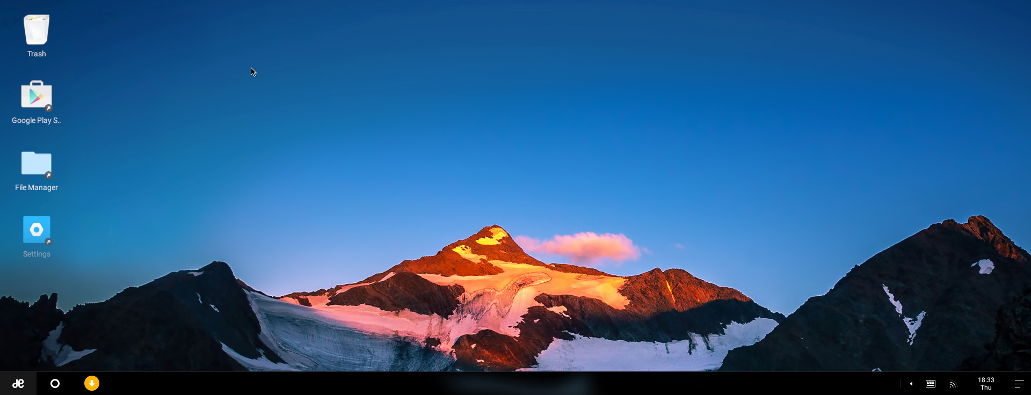
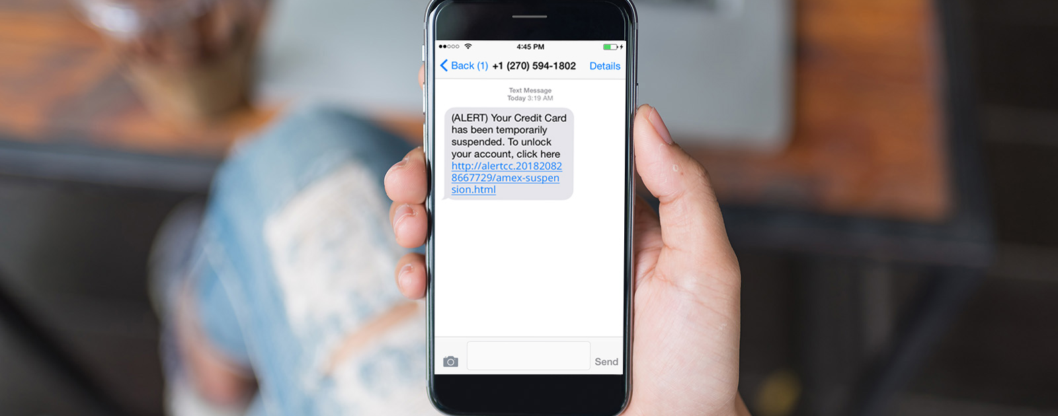
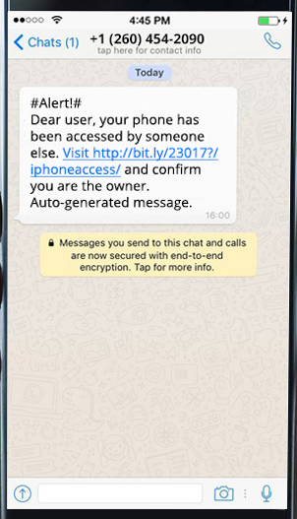

Phishing
An email request for money or personal information.
Notes:
Email Request for Money or Personal Information
Be cautious of emails, texts, social media messages, or chats that ask for personal information. Most banks and businesses will never message you requesting information they have no need for such as an email password. If the request seems suspicious, contact your bank first to make sure they did send you something.
http://blogs.mcafee.com/consumer/consumer-threat-notices/mobile-bankers-beware-a-new-phishing-scam-wants-your-money
“A phisher will masquerade as a trustworthy business or person, like Facebook for example. The ‘bait’ is in the electronic communication like this email.
Sometimes you will see clues that it’s a phony…like misspelled words, links, or buttons. If there IS a link or button…hover your cursor over it, and the actual URL will appear.
<click>
If they don’t match, as in this example, DON’T click on the link, or you could mistakenly put your device, or your personal information at risk.
Here’s another good piece of advice: If you receive an email from an organization asking YOU to reset your password, chances are, it’s a phishing attempt.”
<Click to next slide for another example.>

Slide 12
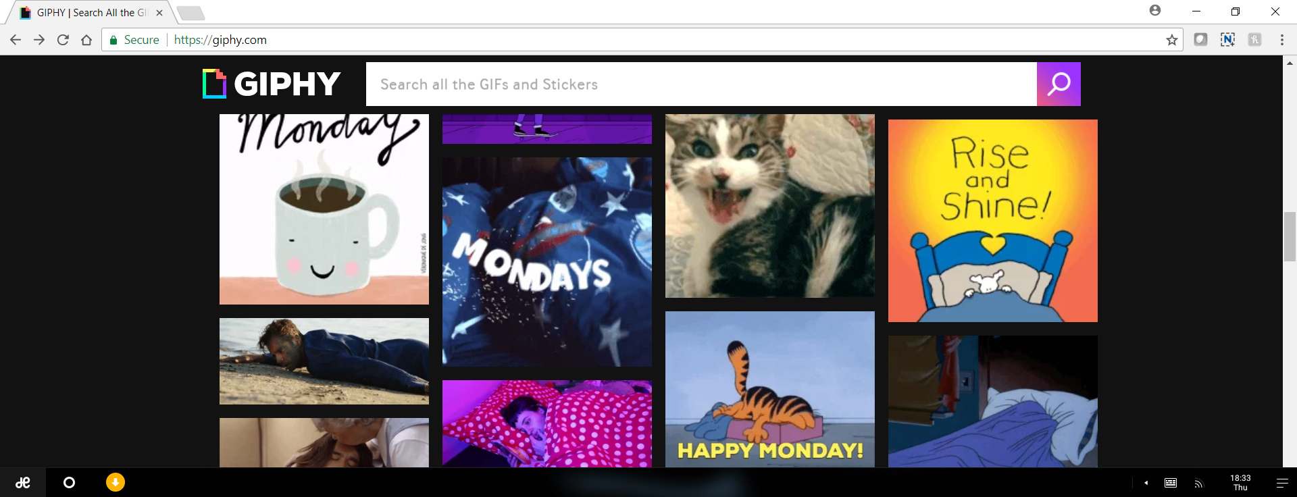
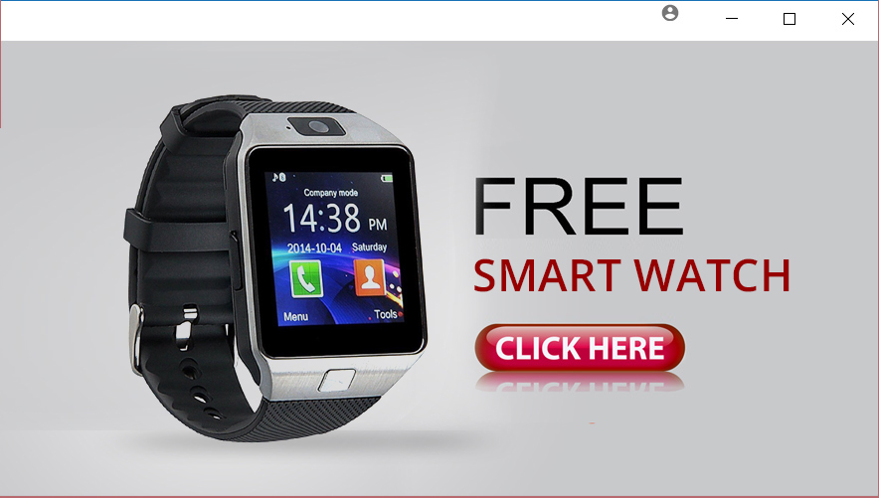
Pop-Ups
If it’s too good to be true, it probably is!
Notes:
Pop-Ups
These are unsolicited windows that appear typically during browsing. They have many types, namely competitions, advertising, fake alerts etc. http://en.wikipedia.org/wiki/Pop-up_ad. Interacting with these pop-ups is not recommended.
“It is another way online criminals can hack into your computer and steal your information is by getting you to click on a link that promises a reward.
<click>
Here’s an example of a popup that promises you a free iPad if you click on the link. How many of you have received this kind of message? Did anyone click on it? What happened?
Have you ever known anyone who got a FREE iPad just by clicking on some links?
If it sounds like it’s too good to be true – it probably is!
Never click on link from a suspicious popup or email or text. Cyber criminals are either trying to get you to go to a malicious site where they can put malware on your computer, or get you to give up your personal information.”

Slide 13

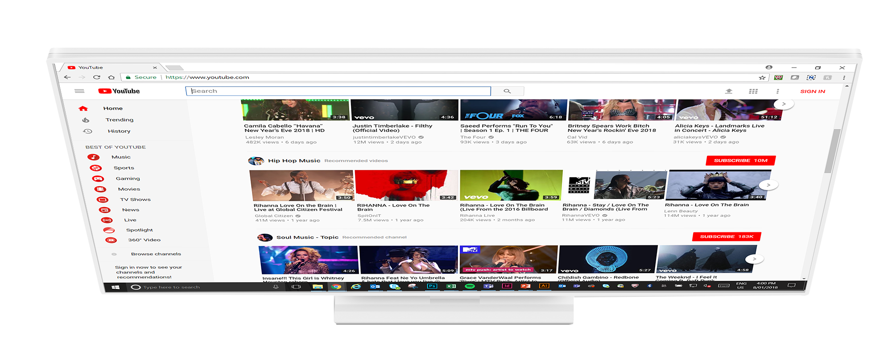


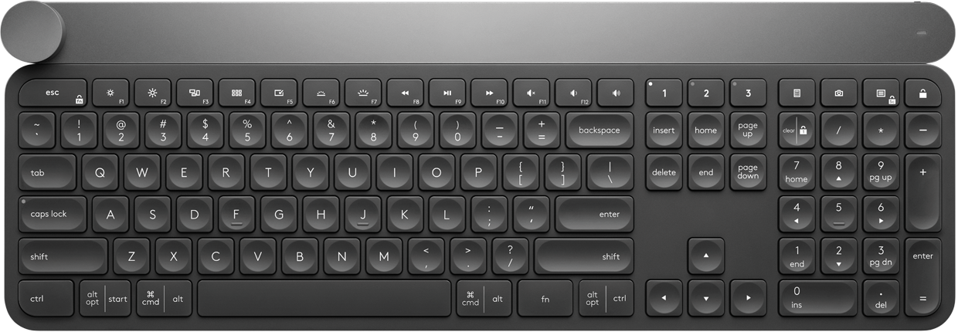
Pop-Ups
How to safely close a Pop-up window on a PC and Mac.
  PC: Alt + F4
  Mac: Command + W
Notes:
To safely close a pop-up on a PC, hold down the Alt key and press F4.
For Mac users, hold down the Command key and press W.
For mobile users Select "Advanced" from the Browser Settings menu. It's located about halfway down the options list. Check the box labelled "Block pop-ups." This will prevent popups from happening in the browser, even when you travel to a site that normally has them. If popups are happening even with them disabled in the browser, then you should check to see which app might be causing the popups.

Slide 14
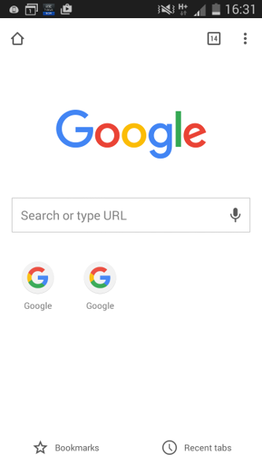
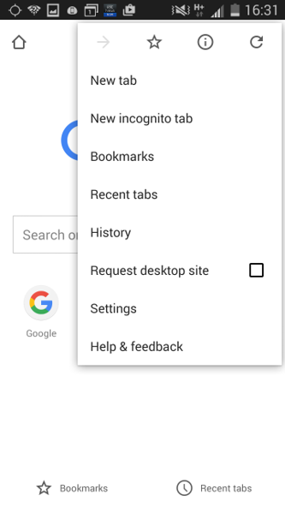
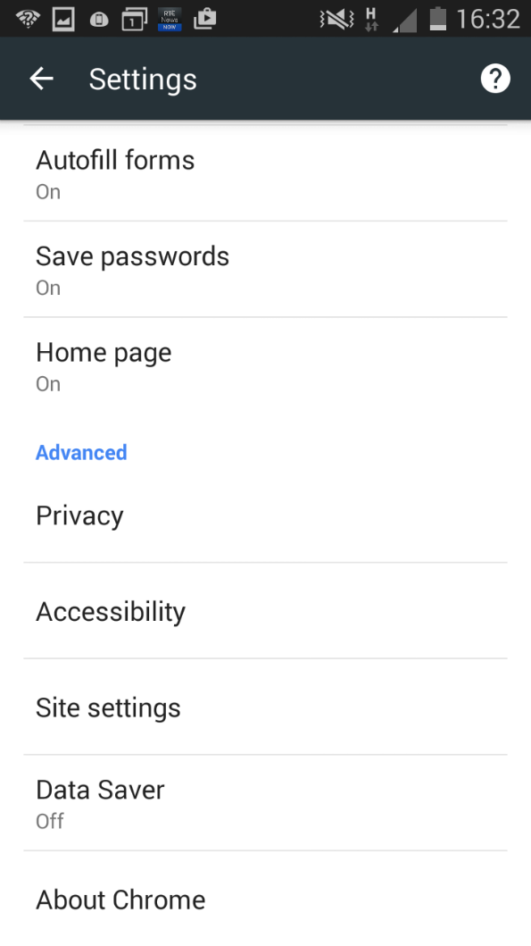
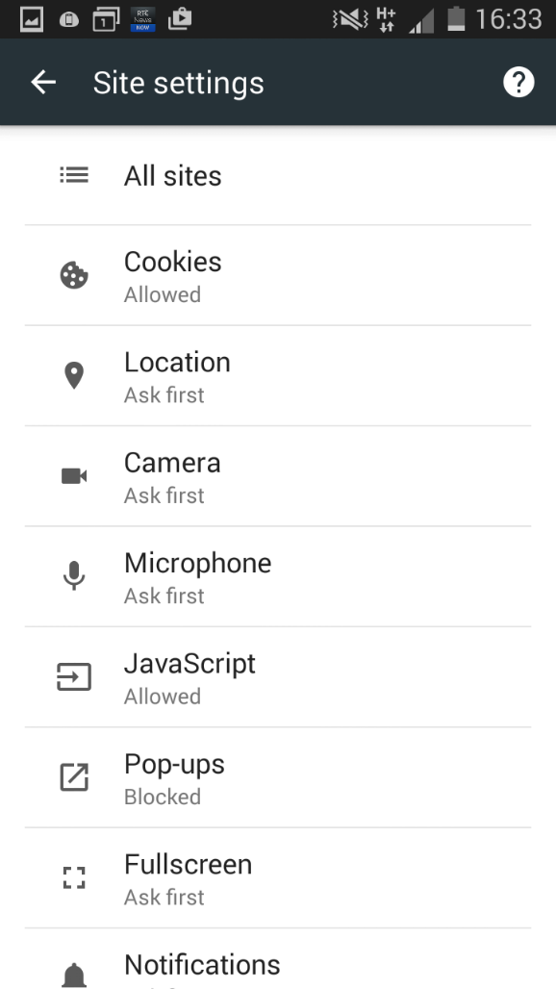
Block Popups on Your Smartphone

Slide 15
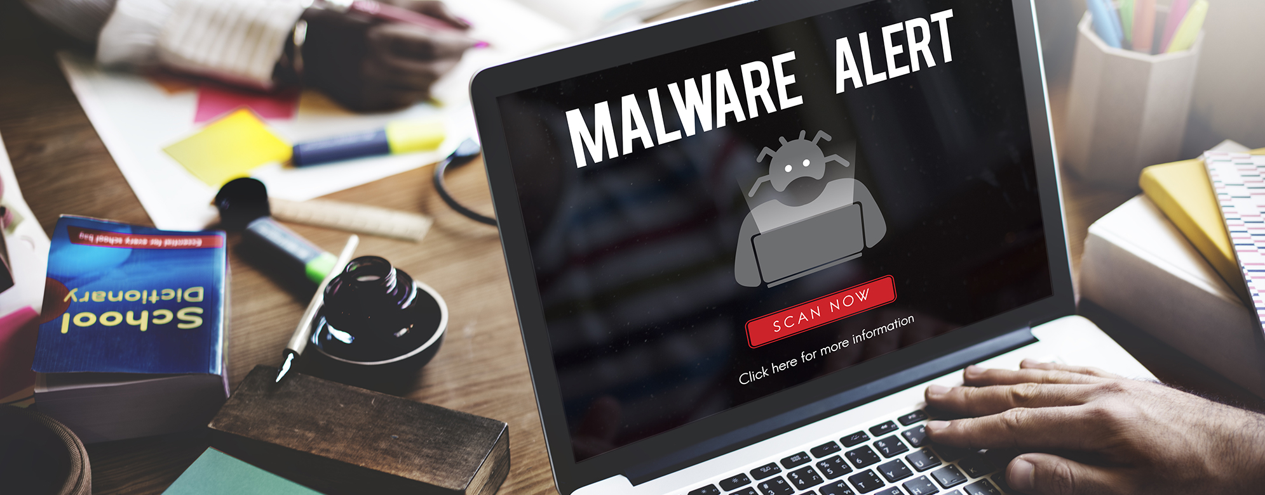
Malware
Notes:
“Malware refers to software programs designed to damage or do other unwanted actions on a computer system.
Common examples of malware include viruses, worms, Trojan horses and spyware. A good firewall and security software package can help protect against these types of threats.
Virus: computer program files capable of attaching to disks or other files and replicating repeatedly, without user knowledge or permission.
Worms: Parasitic programs that replicate, but do NOT infect other computer program files. They can send copies to other computers via a network.
Trojan Horse: A seemingly harmless program that you knowingly download. What you don’t know is that it also conceals a destructive back door that will allow attackers access to your system.
Spyware: Exploits infected computers for commercial gain, delivering unsolicited pop-up ads and monitor web browsing activity, among other things.”

Slide 16
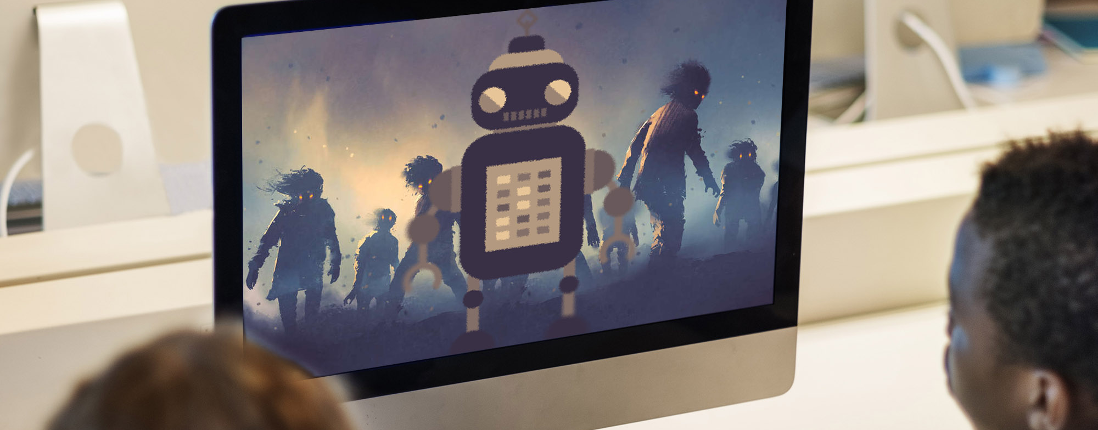
Botnet
Over 150,000 zombie computers created every day
Notes:
“When multiple computers have been infected with malware, they can become something called a ‘botnet.’ As such, these computers can be controlled by cybercriminals sending out spam and viruses to other computers on the Internet… essentially turning them into ‘zombies.’
Something as simple as opening an infected email attachment containing malware can turn a computer into a zombie. Once YOUR computer is infected, you can spread malware to all of your contacts.
Safety Tip: NEVER open suspicious email attachments. If the attachment is from someone you know, ask that person if it’s safe to open.”

Slide 17

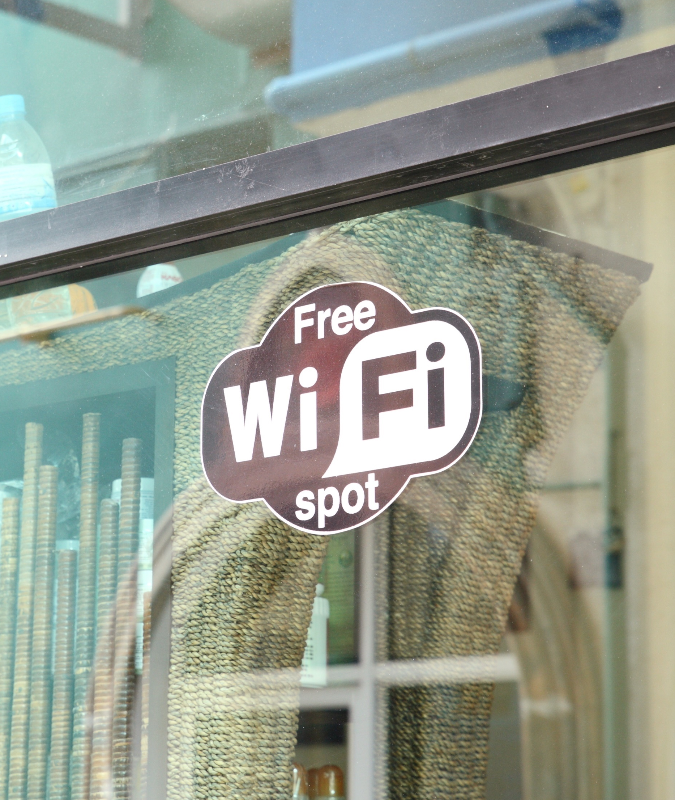

Sniffer
Notes:
“A wireless sniffer is a software program that monitors network traffic. Hackers use sniffers to capture computer data transmitted over a Wi-Fi network. (For example, at coffee houses, the airport, hotels, etc.)
<click>
The truth is, it’s impossible to tell the safe public networks from the bad ones. Here are some steps you can take to protect yourself when using public networks:
Disable or block file sharing on your computer.
Enable a firewall or install a third party personal firewall.
Use file encryption.
Use a virtual private network (VPN).
If you MUST use a public network to connect to the Internet, make sure you’re not sharing sensitive data such as passwords and banking information.”

Slide 18

Most Dangerous Celebrities
Use caution when searching for your favorite celebrities online.
  Avril Lavigne
  Bruno Mars
  Carly Rae Jepsen
  Zayn Malik
  Celine Dion
  Calvin Harris
  Justin Bieber
  Diddy
  Katy Perry
  Beyoncé
  Always use web protection software that protects
  you from risky sites.
Based on the percentage of sites identified by McAfee as 'risky' which are included in the search results for a celebrity's name and commonly associated terms.
Notes:
Trainer Notes
Hackers will actively target what young people are searching for.
They will look at Google Analytics for top searches in the month and they’ll look at what's trending on Twitter to see who what and where is popular with youth culture.
This information is then used to create fake websites related to these topics claiming to have news/gossip/pictures but in fact they are just vehicles for malware, Trojans and other viruses.
This can be a group exercise also. It would involve laptops/PCs.
McAfee offer a free tool called Web Advisor.
You can click on the McAfee Webe Advisor image to open the download page in a web browser.
It will rate the results of your search so you can see if it‘s been recently reported for malware or associated with any viruses.

Slide 19

Securing Your Mobile Devices
Lost and stolen devices are the biggest threat to mobile users.
Notes:
Lost and stolen devices continue to be the BIGGEST security threat to mobile users.
There’s a lot of personal information on your phone (such as texts, photos, contacts, emails and personal accounts). How you would feel if someone had access to all of that and made it public OR sent out texts and emails to all of your contacts while pretending to be you!?

Slide 20

Securing Your Mobile Devices
Here are some safety tips for your mobile device.
Set a passcode
Always logout of your accounts
Remember: photos are forever
Only download and install from trusted sources
Notes:
Speaker notes - comment on automatically locking
Speaker notes - lock when you expect prolonged periods of inactivity, e.g. before you leave for school or at the end of the day

Slide 21
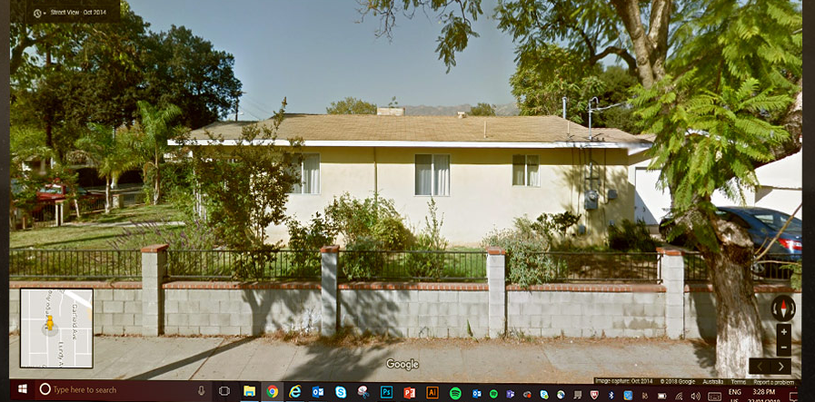
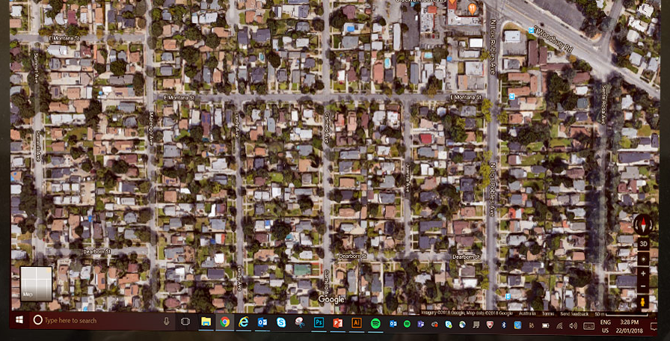

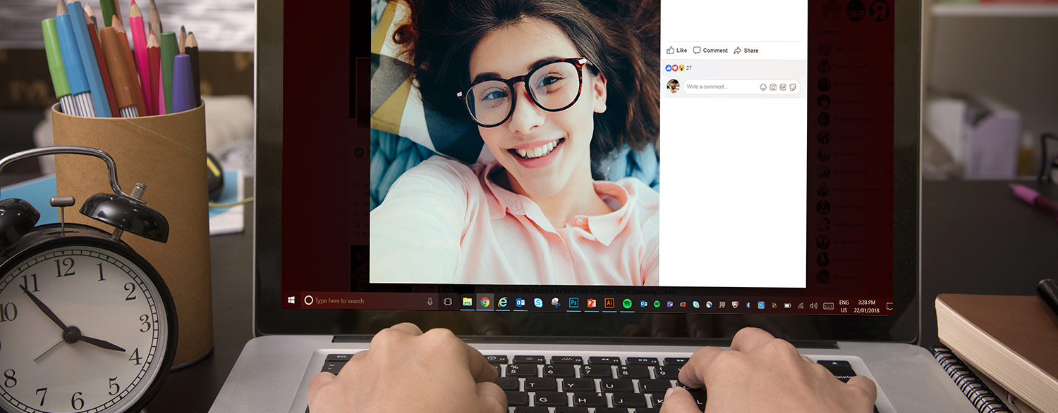
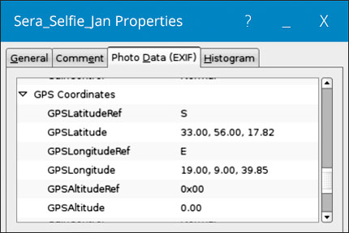
Geotagging
Notes:
“Many new phones and cameras “geotag” photos, which embeds the GPS coordinates of the location where you took the picture.
<click>
“If the geo-tagging feature is not disabled on your device, posting a picture allows anyone who sees it to figure out exactly where you were when you took the picture. This is dangerous—especially if the picture was taken at home or at school.
Check your phone’s manual for instructions on how to disable the geotag setting. But remember, even once geo-tagging is disabled on your device, be aware that your friends’ camera phone may be putting you at risk.”
Interesting paper on Geo-Tagging and related topics with triangulation and metadata can be accessed at the link below;
http://www.icsi.berkeley.edu/pubs/networking/cybercasinghotsec10.pdf

Slide 22
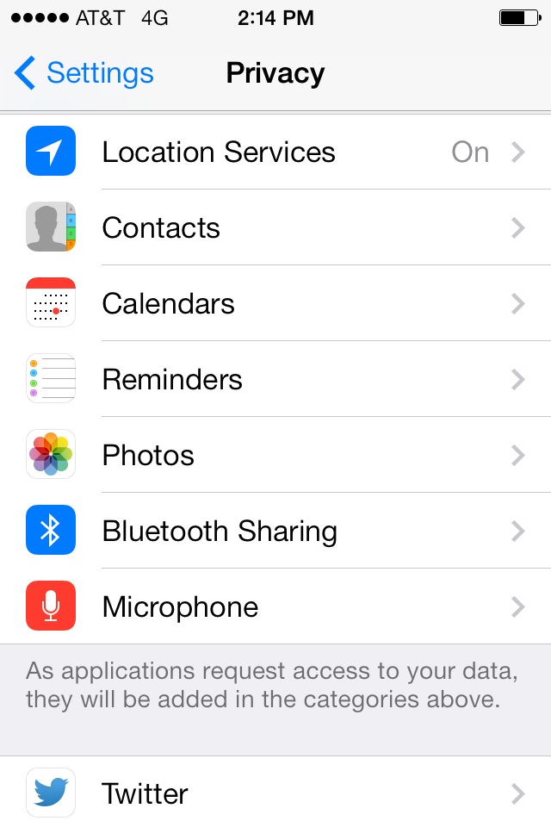
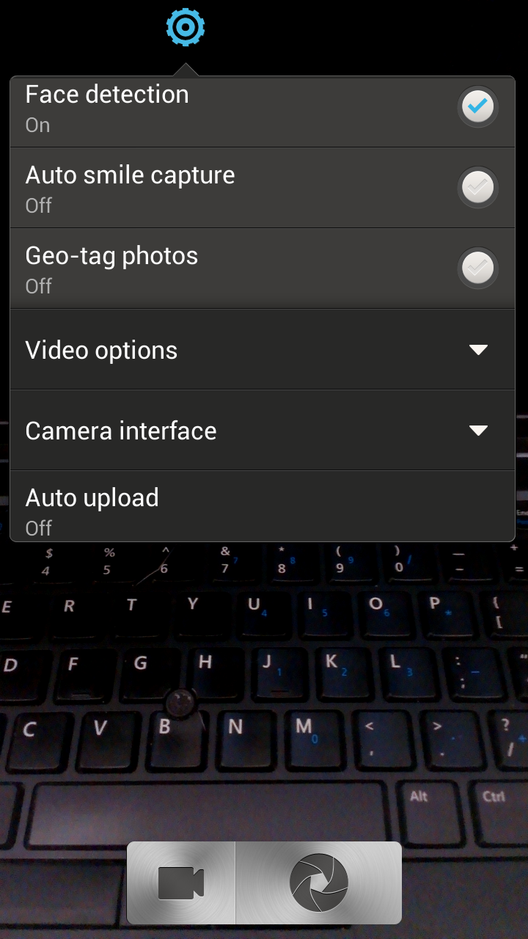
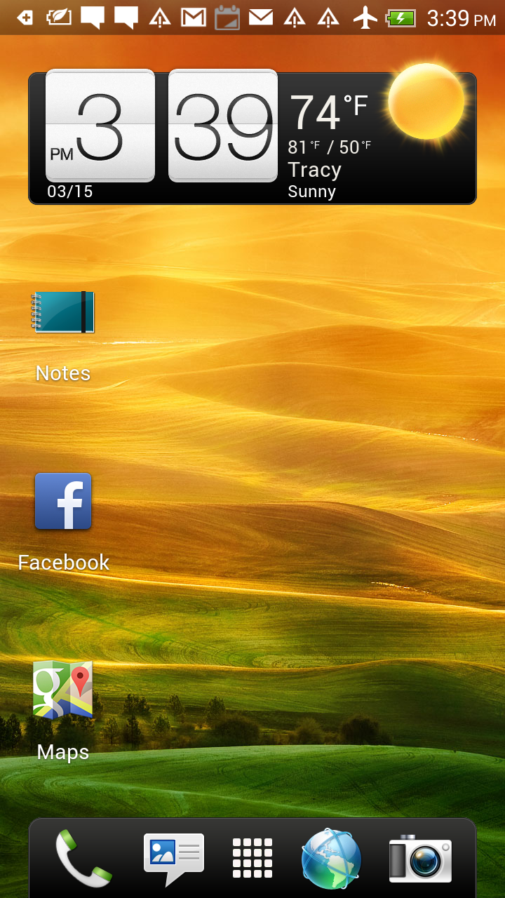
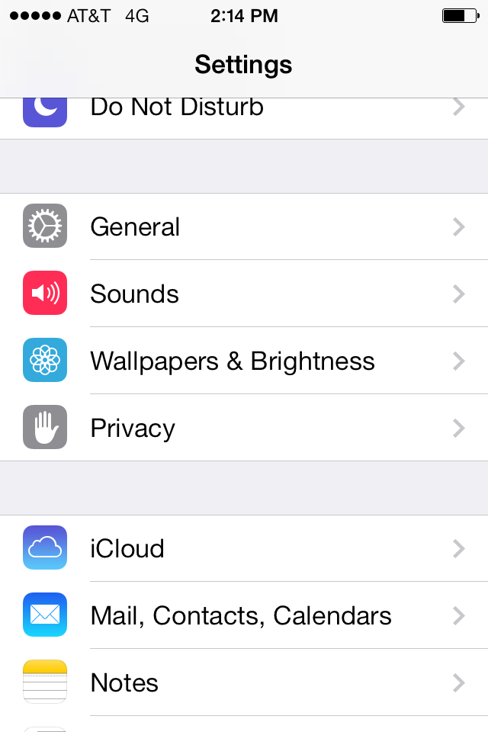
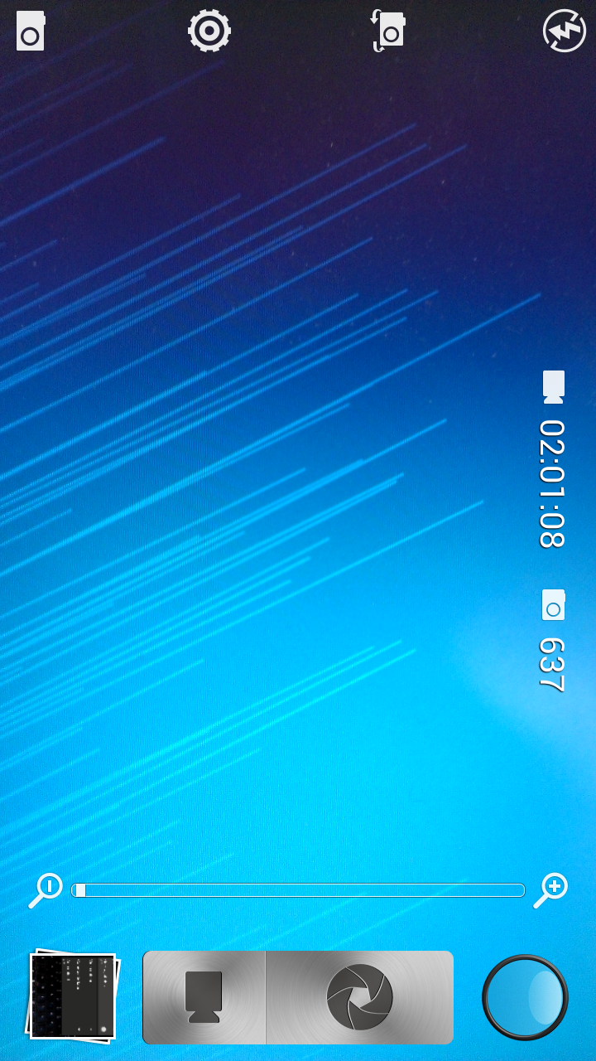
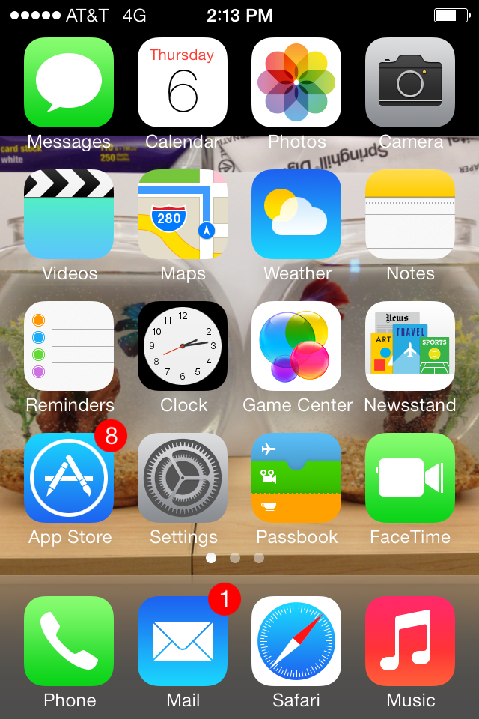
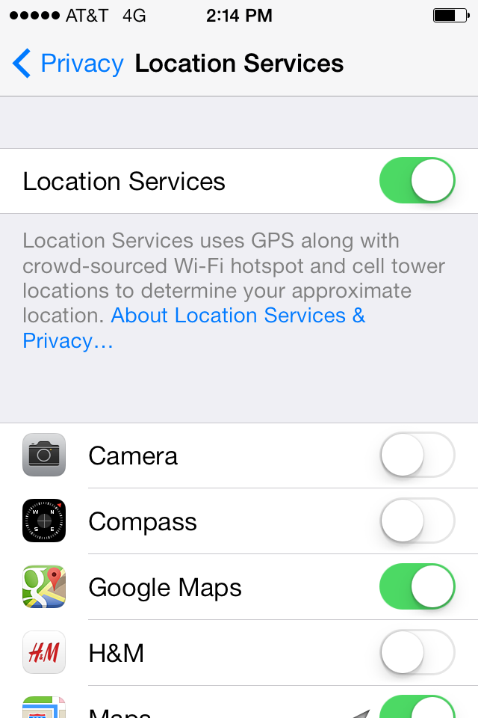
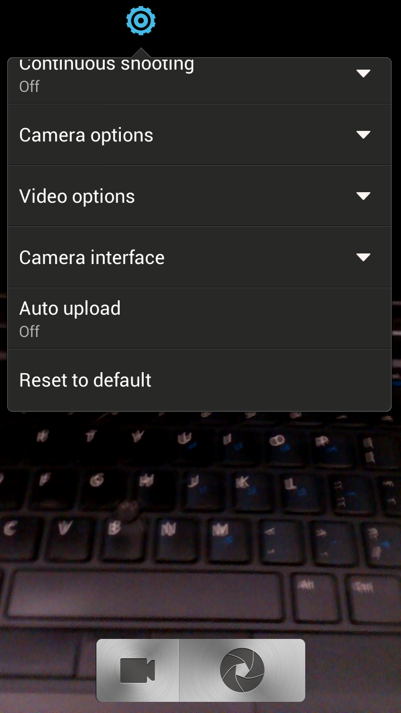
Geotagging
Notes:
To disable geotagging on an Apple device:
Go to settings <click>
Go to privacy <click>
Go to location services <click>
Go to your camera and turn it ‘off’.
<click>
To disable getoagging on an android device:
Click on the camera icon <click>
Go to settings <click>
Camera options <click>
Geotag photos OFF

Slide 23
Creating Stronger Passwords
Do you know what the most commonly used passwords are?
  123456
  Password
  12345678
  Qwerty
  12345
  123456789
  letmein
  1234567
  Football
  iloveyou
@
:
)
0
@
s
W
O
0
r
d
P
A
S
S
W
R
D
P
s
r
d
5
5
Use numbers and symbols
Add a smiley face in the middle
Use at least 8 characters
Mix UPPER and lower case
Notes:
It’s important not to share passwords and it’s just as important to know how to create really strong ones. https://www-ssl.intel.com/content/www/us/en/forms/passwordwin.html
Did you know that the most common password that people use today is the word PASSWORD? Let’s use it as an example (knowing that we would never use it for real) and make it more complex using 3 simple rules.
<click>
Use at least 8 characters
<click>
Use a mix of UPPER CASE and lower case letters
<click>
add symbols (@#$%& etc….) and numbers
And if you are really serious about making it strong, here are some more tips:
Do NOT repeat old passwords that you’ve used before
Change your passwords after a while
Don’t use real words that you would find in the dictionary
Do not use personal information like the name of your brother or your pet.
If you have a mobile phone:
You should set a passcode on it and tell your parents to set one on their phones. If you lost your phone and it was unlocked you’d lose your pictures, games, contacts and messages and you wouldn’t want that to end up in a stranger’s hands would you?

Slide 24
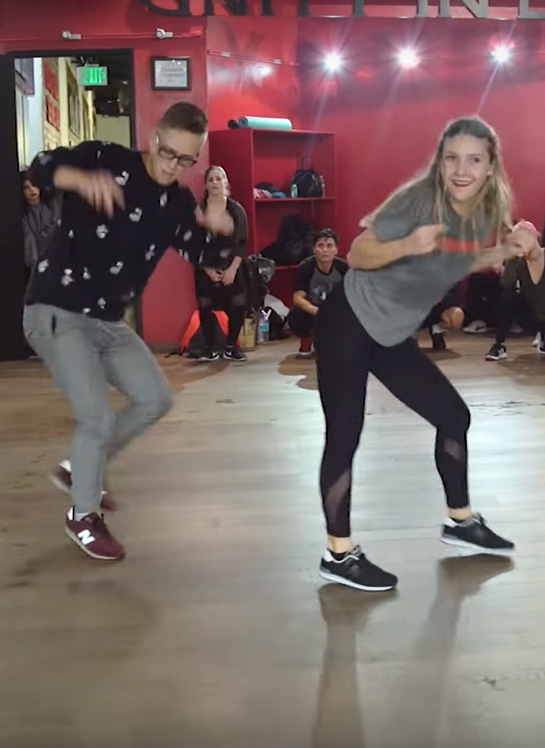
Most Viewed Viral Video in 2017
What was it?
  OVER 118 million views
  Kyle Hanagami’s “Shape of You” by Ed Sheeran routine was the most-viewed viral video on YouTube.
  How would you feel if it was a bad picture of you or something that you didn’t want anyone to know?

Slide 25


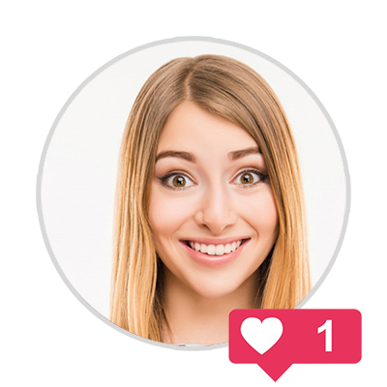
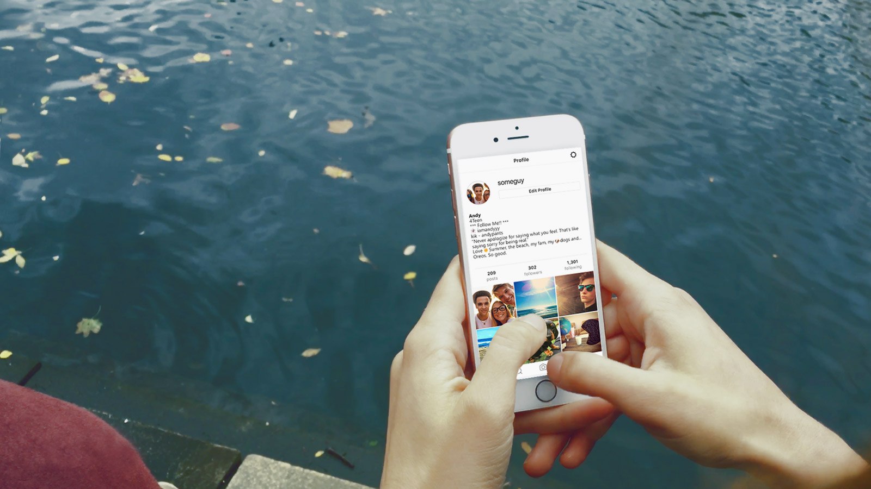

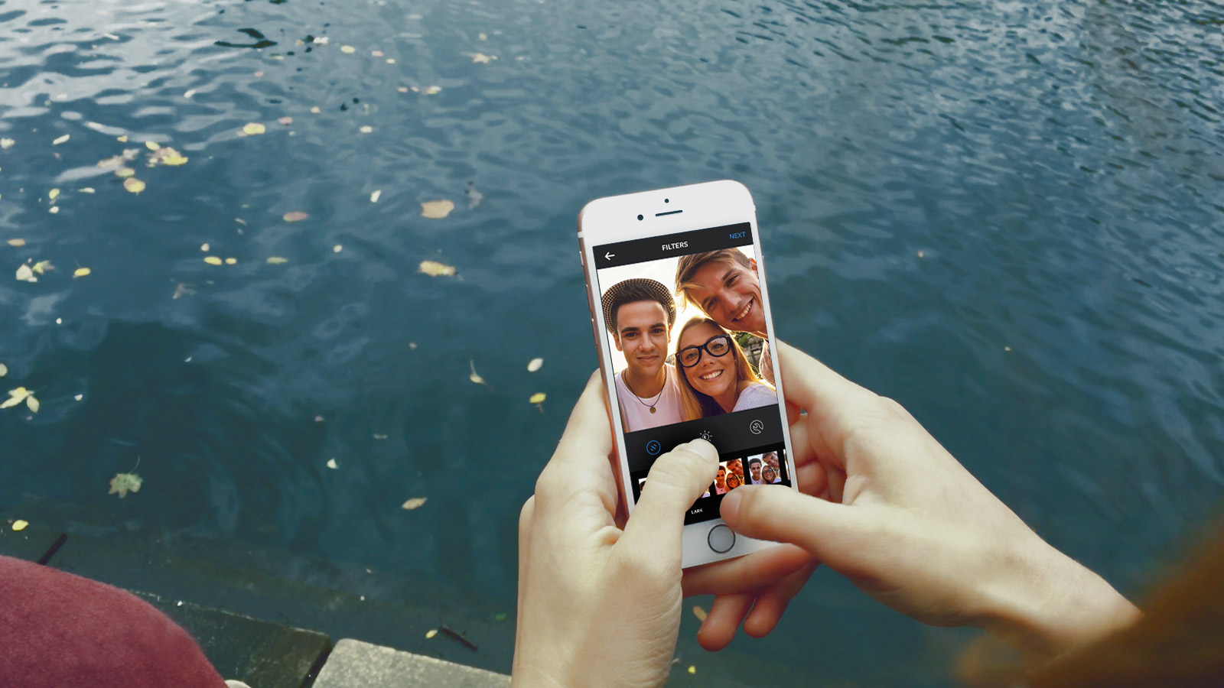


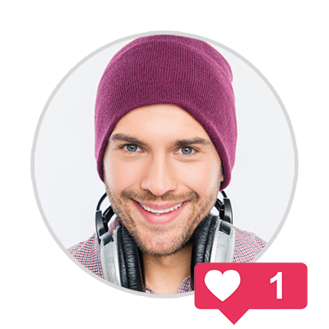

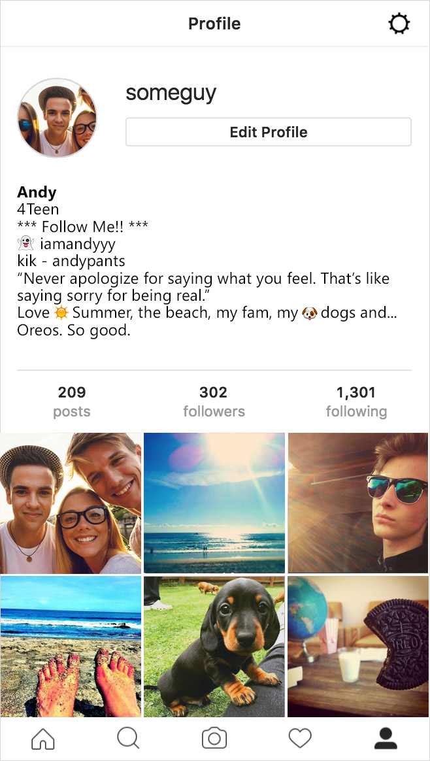



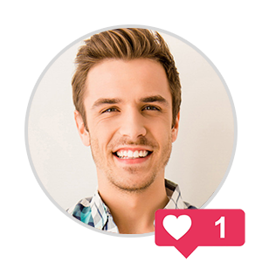
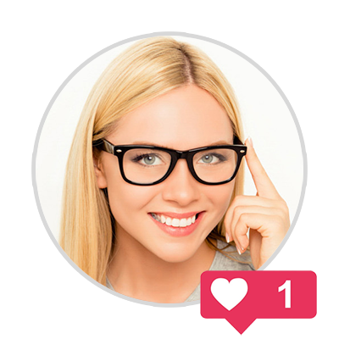

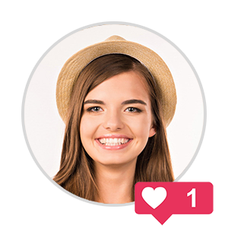
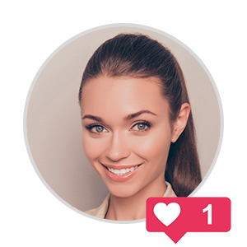
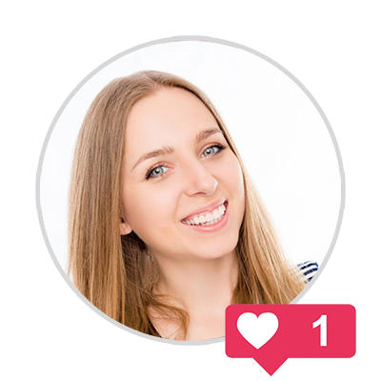
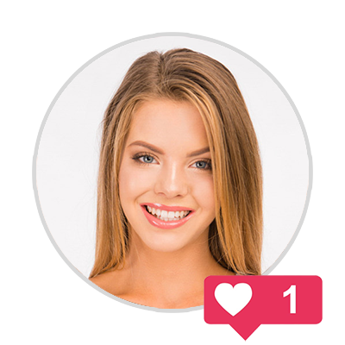
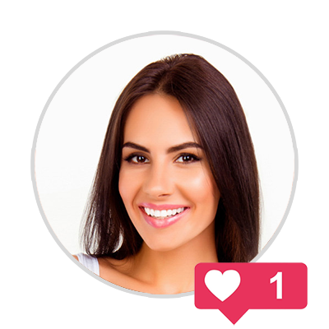
Notes:
*Click once to play animation/video*
Sharing even with four friends you trust can be a bad idea. If they are indiscrete with as little as four friends each, the amount of people who have access to your information/content can escalate rapidly.
Topics for discussion
Loss of control: Once you post it, it can’t be taken back even if you regret it. You should think before you send anything, only post content you’d be proud to put your name against!
Viral: a term used to describe something that spreads rapidly through the internet.
Trusting Peers: Beware of peer pressure and following the crowd, don’t be pressured into oversharing just because there’s an expectation of trust. Take care of yourself first and follow your gut when it comes to sharing personal details and content.
Reproduction of images: even if they’ve been deleted images and posts can still have bee downloaded and saved or have screenshot taken and can come back at a later date.

Slide 26

Social Networking
Who are your friends on social networking sites and apps?
Notes:
Friend Requests
A young persons social network is likely made up of two kinds of people: Those they actually talk to in real life and those they don't.
http://www.huffingtonpost.com/stephen-mariani/four-types-of-facebook-friends_b_5505459.html?sf3493983=1
Talk to young people about unsolicited friend requests. They should be suspicious of anyone they have not met in person. This ties into the topics of Impersonation and Anonymity.
Introduce the idea of tiers of friendship.
How do we group these people when online?
What kind of information do we share with these people?
Siblings
Best Friends
Boyfriends/Girlfriends
School Friends
Friends of Friends
Acquaintances
Strangers

Slide 27

Have You Read the Fine Print?
Applications terms and conditions
Snapchat
Facebook
We call Story submissions that are set to be viewable by Everyone as well as content you submit to crowd-sourced Services, including Our Story, “Public Content.” For all content you submit to the Services other than Public Content, you grant Snap Inc. and our affiliates a worldwide, royalty-free, sublicensable, and transferable license to host, store, use, display, reproduce, modify, adapt, edit, publish, and distribute that content…
Because Public Content is inherently public and chronicles matters of public interest, the license you grant us for this content is broader. In addition to granting us the rights mentioned in the previous paragraph, you also grant us a perpetual license to create derivative works from, promote, exhibit, broadcast, syndicate, sublicense, publicly perform, and publicly display Public Content in any form and in any and all media or distribution methods (now known or later developed).
You give us permission to use your name, profile picture, content, and information in connection with commercial, sponsored, or related content (such as brand you like) served or enhanced by us. This means, for example, that you permit a business or other entity to pay us to display your name and/or profile picture with your content or information, without any compensation to you. If you have selected a specific audience for your content or information, we will respect your choice when we use it.
Snap Inc. Terms of Service (US): https://www.snap.com/en-US/terms/
Snap Inc. Terms of Service (Outside US): https://www.snap.com/en-US/terms/#terms-row
Facebook Statement of Right and Responsibilities: https://www.facebook.com/terms.php
Notes:
(Snapchat story of child on billboard)
As people rely on social media as there main method of communication, it is important to be familiar with what the sites are doing with your data.
This slide contains snippets of USER AGREEMENTS for popular social networking sites.
The first (Snapchat) demonstrates that snapchat acknowledges that its content cannot be deleted (even though that’s what the site has been advertised for) and that it also retains the right to do whatever it wishes with the content. Including modifying it and using it in advertising campaigns.
The second (WhatsApp) shows that all users should be over 16. This is different to most other social sites. Therefore if Whatsapp is used to share inappropriate content of under 16 year olds, they cannot be held accountable.

Slide 28

Tiers of Friendship
Family, best-friends, classmates and acquaintences
Don’t be afraid to challenge the ‘Friend Paradigm’
  What constitutes a friend?
  What personal information is appropriate to share?
  What is an "acceptable" number of friends?
  Do I view friends as a commodity?
Notes:
The concept of a friend and the innate values of friendship should be explored with young people.
The vocabulary used by social networks promotes the ideas of “friends, likes, sharing” to promote positive connotations. This is essentially a false sense of security and can lead to young people lowering their guard in their online life in ways they would never lower their guard in the real world by over sharing and expressing themselves in potentially harmful ways.
Conversely social networks deliberately use “unfriend, block and delete”, harsh nouns and adjectives to dissuade users from breaking connections. This paradigm can be hard for a young person to grapple with.
Don't Believe Facebook; You Only Have 150 Friends
http://www.npr.org/2011/06/04/136723316/dont-believe-facebook-you-only-have-150-friends
Dunbar's number is a suggested cognitive limit to the number of people with whom one can maintain stable social relationships.
http://en.wikipedia.org/wiki/Dunbar's_number

Slide 29

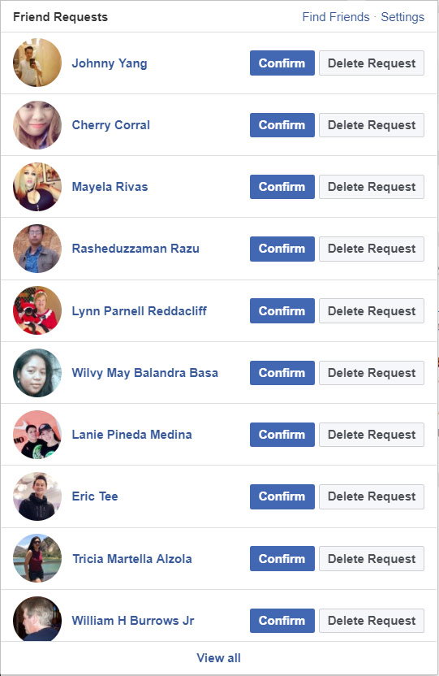
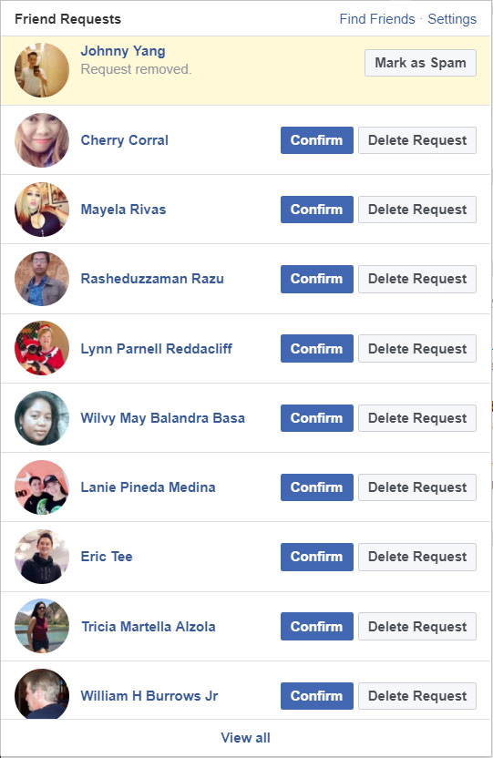

Do I know you?
Dealing with unsolicited friend requests
Johnny Yang

Slide 30






Do I know you?
Dealing with unsolicited friend requests
Hey Hailee, I’m Shane hru?
Hi good thx, u?
Awesome, was just looking at your insta… ur super pretty
lol
thx…ur sweet
Hailee
Shane
Shannon
So… do u have a bf?
Notes:
Friend Requests
A young persons social network is likely made up of two kinds of people: Those they actually talk to in real life and those they don't.
http://www.huffingtonpost.com/stephen-mariani/four-types-of-facebook-friends_b_5505459.html?sf3493983=1
Talk to young people about unsolicited friend requests. They should be suspicious of anyone they have not met in person. This ties into the topics of Impersonation and Anonymity.
Introduce the idea of tiers of friendship.
How do we group these people when online?
What kind of information do we share with these people?
Siblings
Best Friends
Boyfriends/Girlfriends
School Friends
Friends of Friends
Acquaintances
Strangers

Slide 31
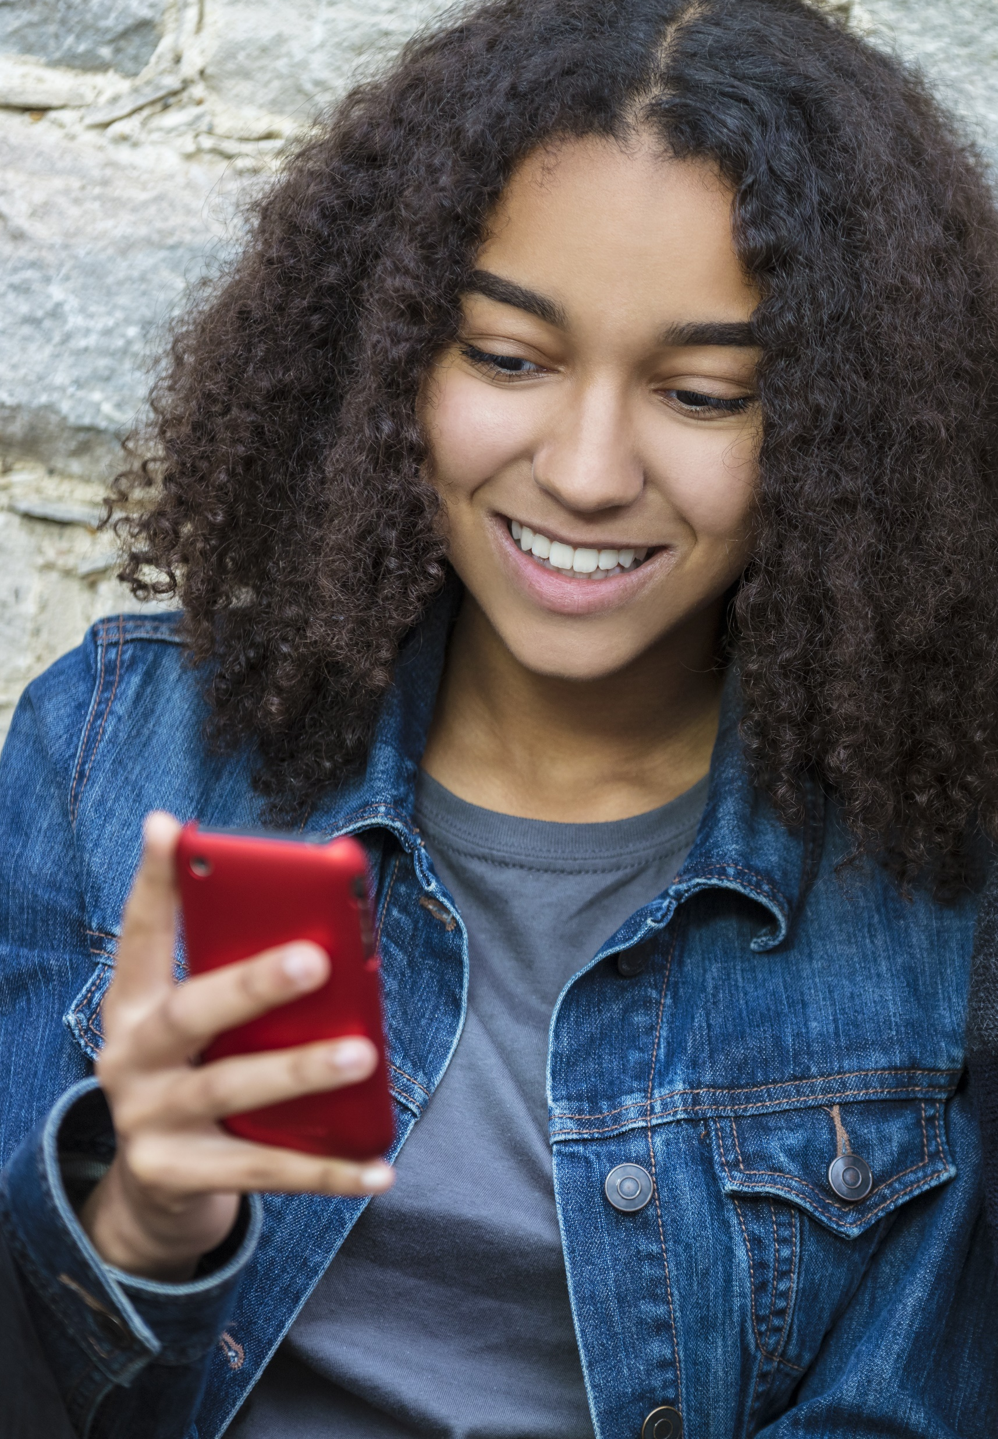
Photo sharing and online predators
Do you consider the risks when posting photos?
Below is what online predators look for in photos others post:
Is there enough room to 'superimpose' another figure into the image?
Are they in a state of undress (even with emoticons placed modestly - these can be removed and body parts can be digitally copied in).
Is the photo posted on a public social media page? Paedophiles can develop 'child crushes' and the child does not have to be posed or in a state of undress for the photo to become a commodity.
Notes:
The concept of a friend and the innate values of friendship should be explored with young people.
The vocabulary used by social networks promotes the ideas of “friends, likes, sharing” to promote positive connotations. This is essentially a false sense of security and can lead to young people lowering their guard in their online life in ways they would never lower their guard in the real world by over sharing and expressing themselves in potentially harmful ways.
Conversely social networks deliberately use “unfriend, block and delete”, harsh nouns and adjectives to dissuade users from breaking connections. This paradigm can be hard for a young person to grapple with.
Don't Believe Facebook; You Only Have 150 Friends
http://www.npr.org/2011/06/04/136723316/dont-believe-facebook-you-only-have-150-friends
Dunbar's number is a suggested cognitive limit to the number of people with whom one can maintain stable social relationships.
http://en.wikipedia.org/wiki/Dunbar's_number

Slide 32

Privacy and Profile Settings
Let’s look at some common scenarios!
Notes:
Friend Requests
A young persons social network is likely made up of two kinds of people: Those they actually talk to in real life and those they don't.
http://www.huffingtonpost.com/stephen-mariani/four-types-of-facebook-friends_b_5505459.html?sf3493983=1
Talk to young people about unsolicited friend requests. They should be suspicious of anyone they have not met in person. This ties into the topics of Impersonation and Anonymity.
Introduce the idea of tiers of friendship.
How do we group these people when online?
What kind of information do we share with these people?
Siblings
Best Friends
Boyfriends/Girlfriends
School Friends
Friends of Friends
Acquaintances
Strangers

Slide 33
Protect Your Personal Information
Use Highest
Privacy Settings
Limit Sharing
Information
Always Use
Screen Names
Use privacy settings to control who sees your information
Make sure the settings are as private as possible
Adjust the privacy settings
to limit what a site shows about you
Only use your first name or a made-up name
Never use your last name
Notes:
Websites have settings that stop others from seeing your information these are called privacy settings
You should always use them if you are unsure how to use them ask an adult for help
Websites should not be telling others where you are or how to get in touch with you, turn sharing information off in the settings
Never use your full name when you play games or chat use only your first name or your nickname

Slide 34

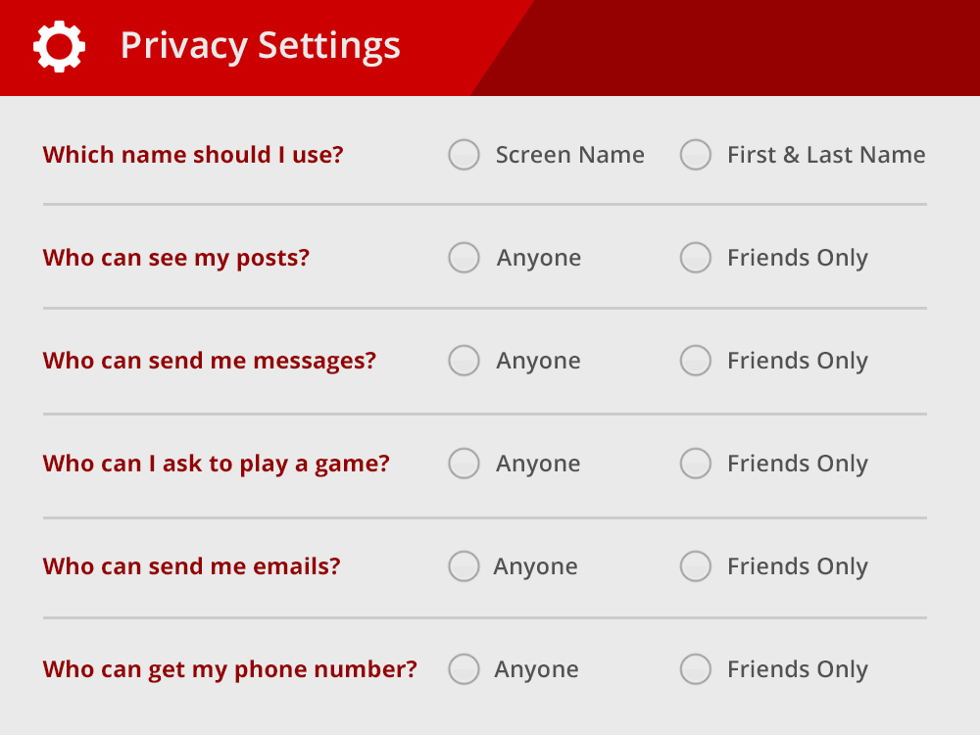
How Would You Set Up Your Profile?
Give it a try!
x
x
x
x
x
x
Notes:
You're about to join a new website that your friends say is really cool, setup your profile by clicking the button
Which name should I use Screen Name Correct
First and Last Name = No you should never use your real name
Who can see my posts? Friends Only Correct
Anyone No only friends should be able to see your posts
Who can send me messages? Friends Only Correct
Anyone No only friends should be able to send you messages
Who can ask me to play a game? Friends Only Correct
Anyone No you should only play games with friends
Who can send me email? Friends Only Correct
Anyone No only friends should be able to send you emails
Who can get my phone number? Friends Only Correct
Anyone No only friends you know well should be able to get your phone number

Slide 35

Cyber Ethics
How do I treat others online?

Slide 36
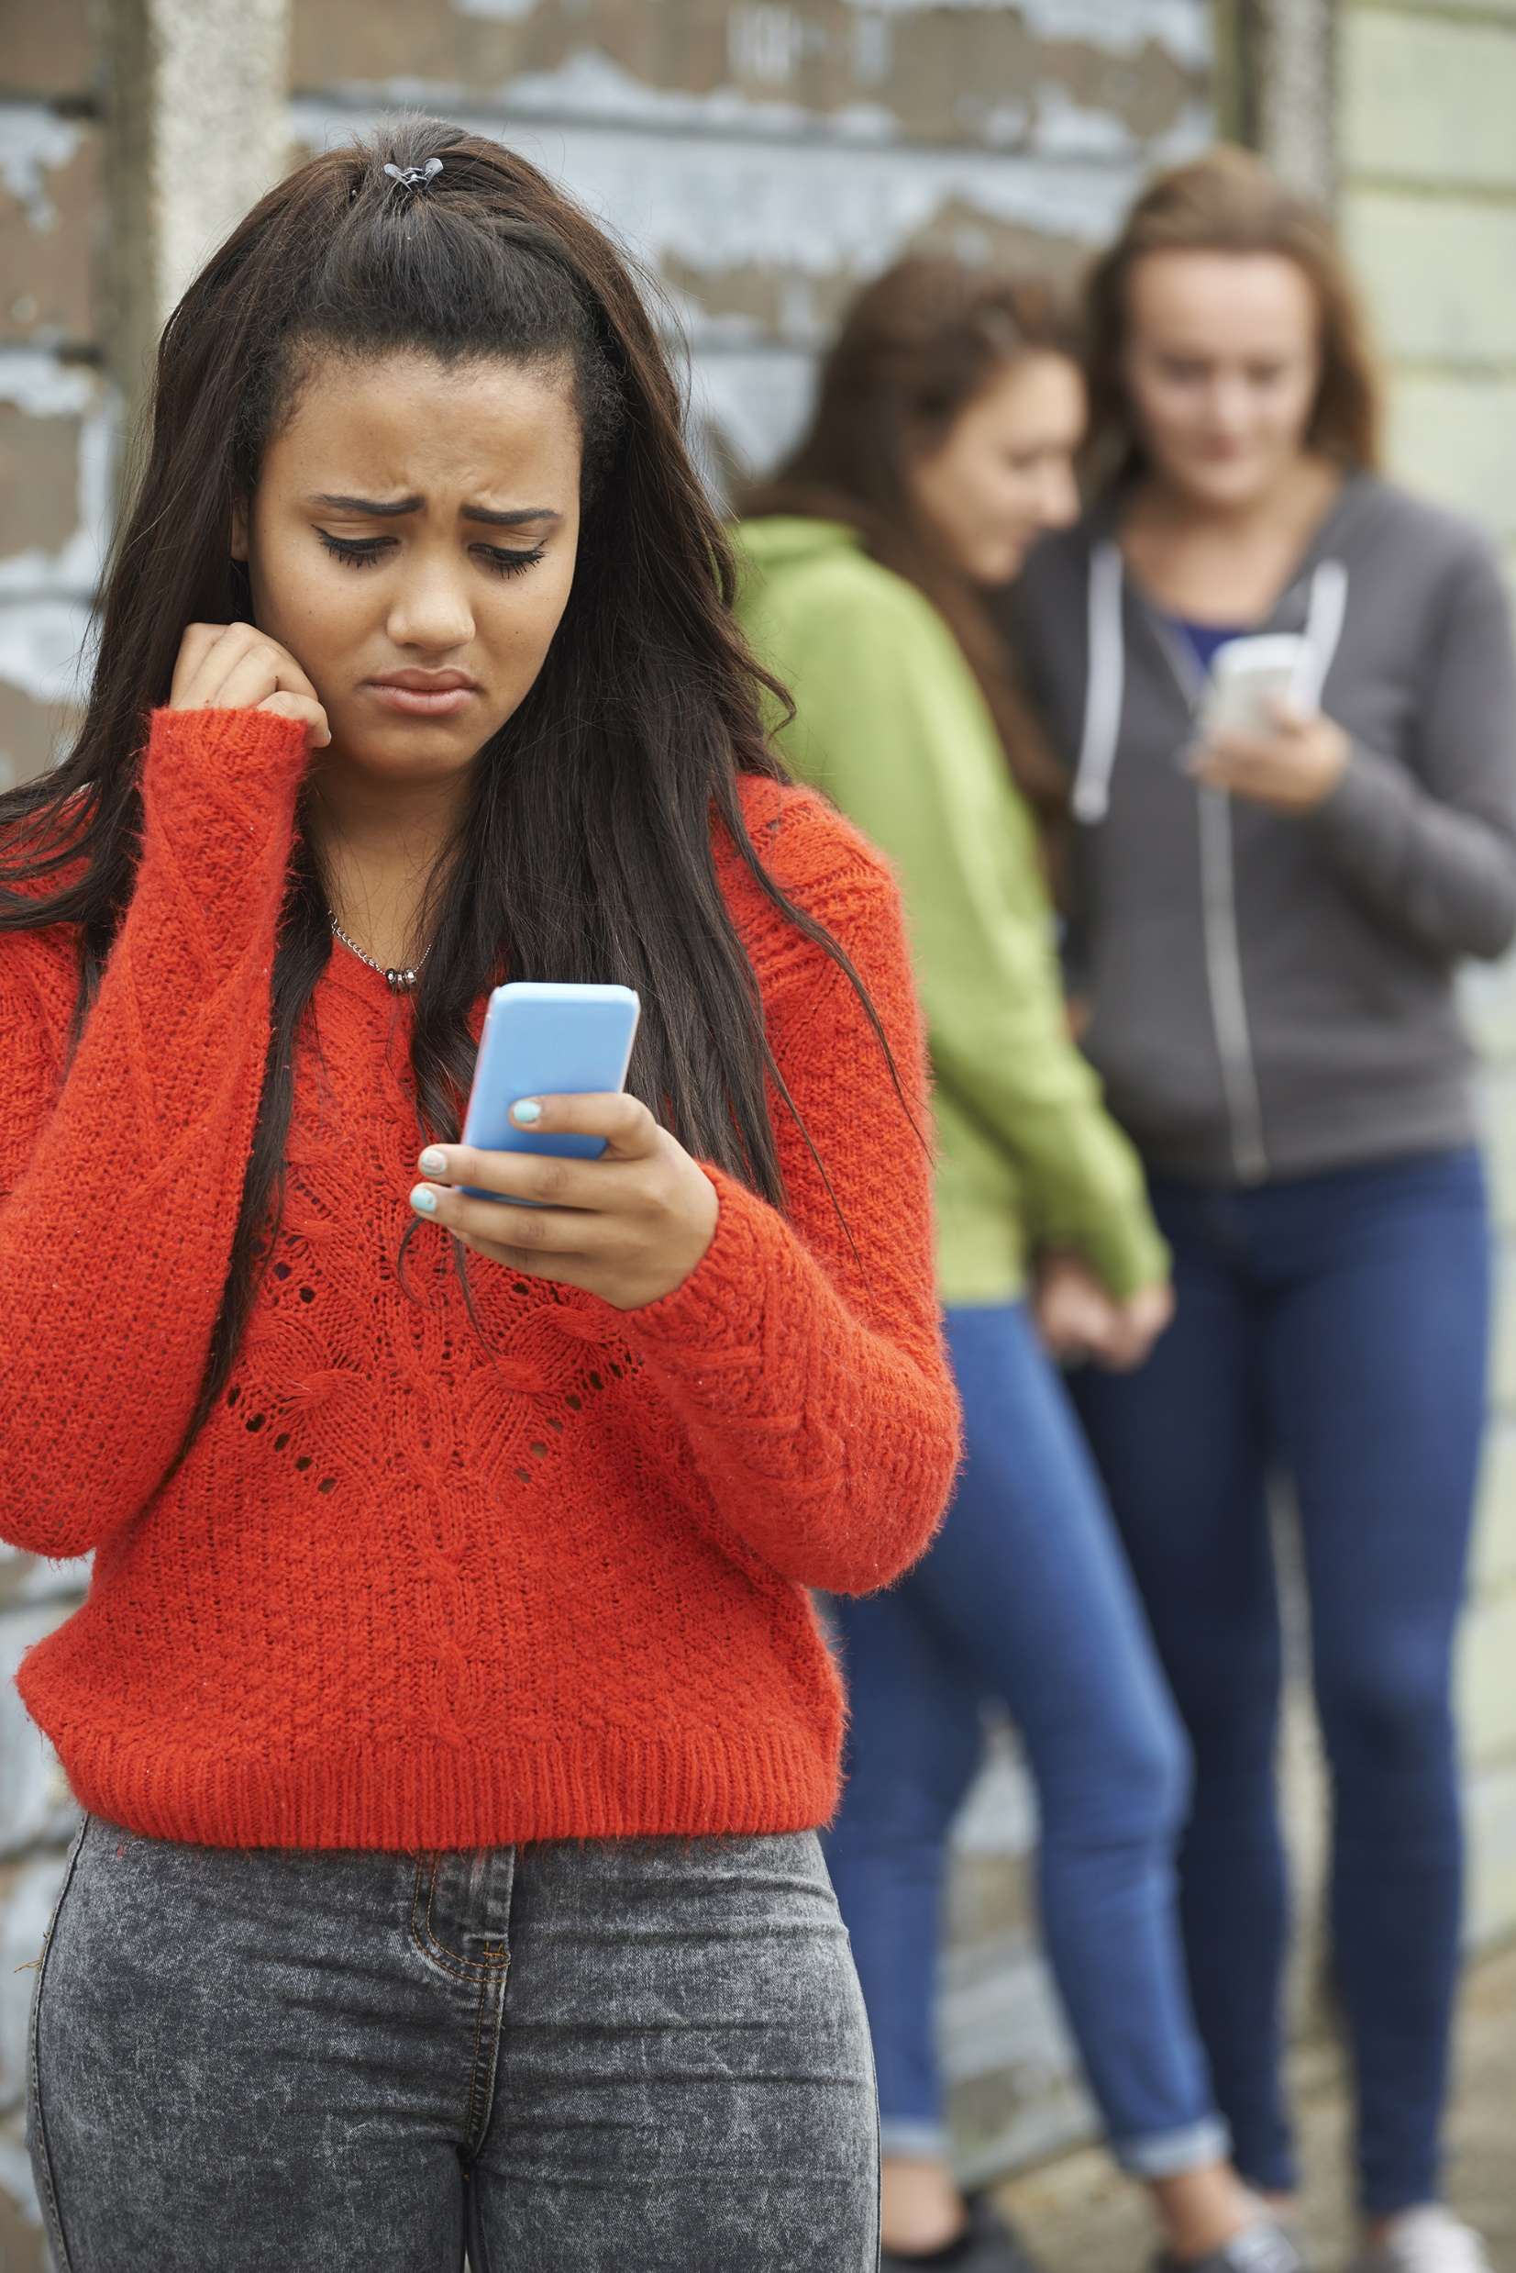
Cyber-Bullying
What is the definition of Cyber-Bullying?
  Cyber-Bullying is distinguishable from physical/verbal bullying in that:
    Potentially a huge audience
    Can occur 24/7
    You can’t see or hear the victim’s reactions
Notes:
Following you home from school: A critical review and synthesis of research on cyberbullying victimization R. S. Tokunaga 2011

Slide 37

Trolls and the Reality of Anonymity
Can you really be anonymous online?
Notes:
A “Troll” is a person who uses the internet as a tool to deliberately upset people.
Like all bullies they are looking for a fight .
A troll hides behind the illusion of
Anonymity.
Group Mentality, “Sheep”
Generally associated with bad behaviour and negative attitudes.

Slide 38
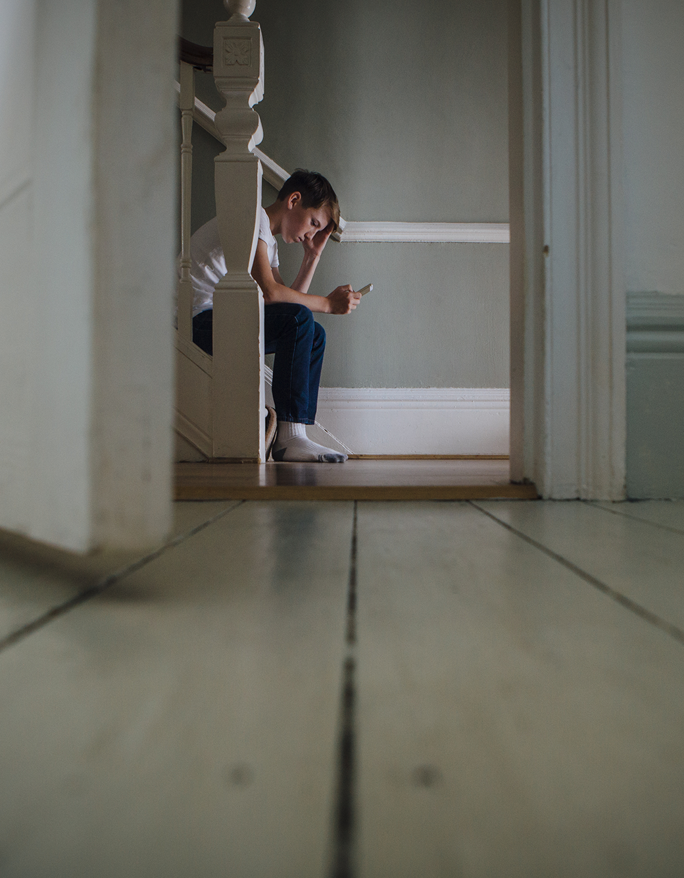
When Trolls Attack
It’s not your fault - it's the bully that's got the problem.
Keep the offense post/message (take screenshots!)
Don’t reply to the sender
Block the offender and un-friend them
Involve a grown up - a parent, older sibling, or teacher
Report problems promptly to social network or mobile phone operator
For serious issues, you should involve the police - inappropriate sexual suggestions, racist remarks, ongoing bullying or harassment
Notes:
Trainer Notes
Screenshots are important here. The Gardaí need these as for prosecution purposes there has to be a physical copy of the harassment/slander/defamation/libel in question. Before deleting comments or emails, take a screenshot of back-up of them. Also keep any texts, although painful to read, will be invaluable.
Don’t reply to the sender. This is important because a lot of young people respond to bad behavior with even worse behavior. While initially you might have started off as a victim you can become an even bigger bullying if you self defensive nasty retorts become too persistent or offensive. Stand back from goading comments and be the bigger person!
Involving a grown-up doesn’t need to be someone who you’d be embarrassed to discuss these issues with or someone who doesn’t know much about the internet (maybe Ma & Da) but you need to tell SOMEONE responsible. The worst thing to do is suffer ins silence. Learn to recognize persistent negative feedback as cyber bullying and report it as such.

Slide 39
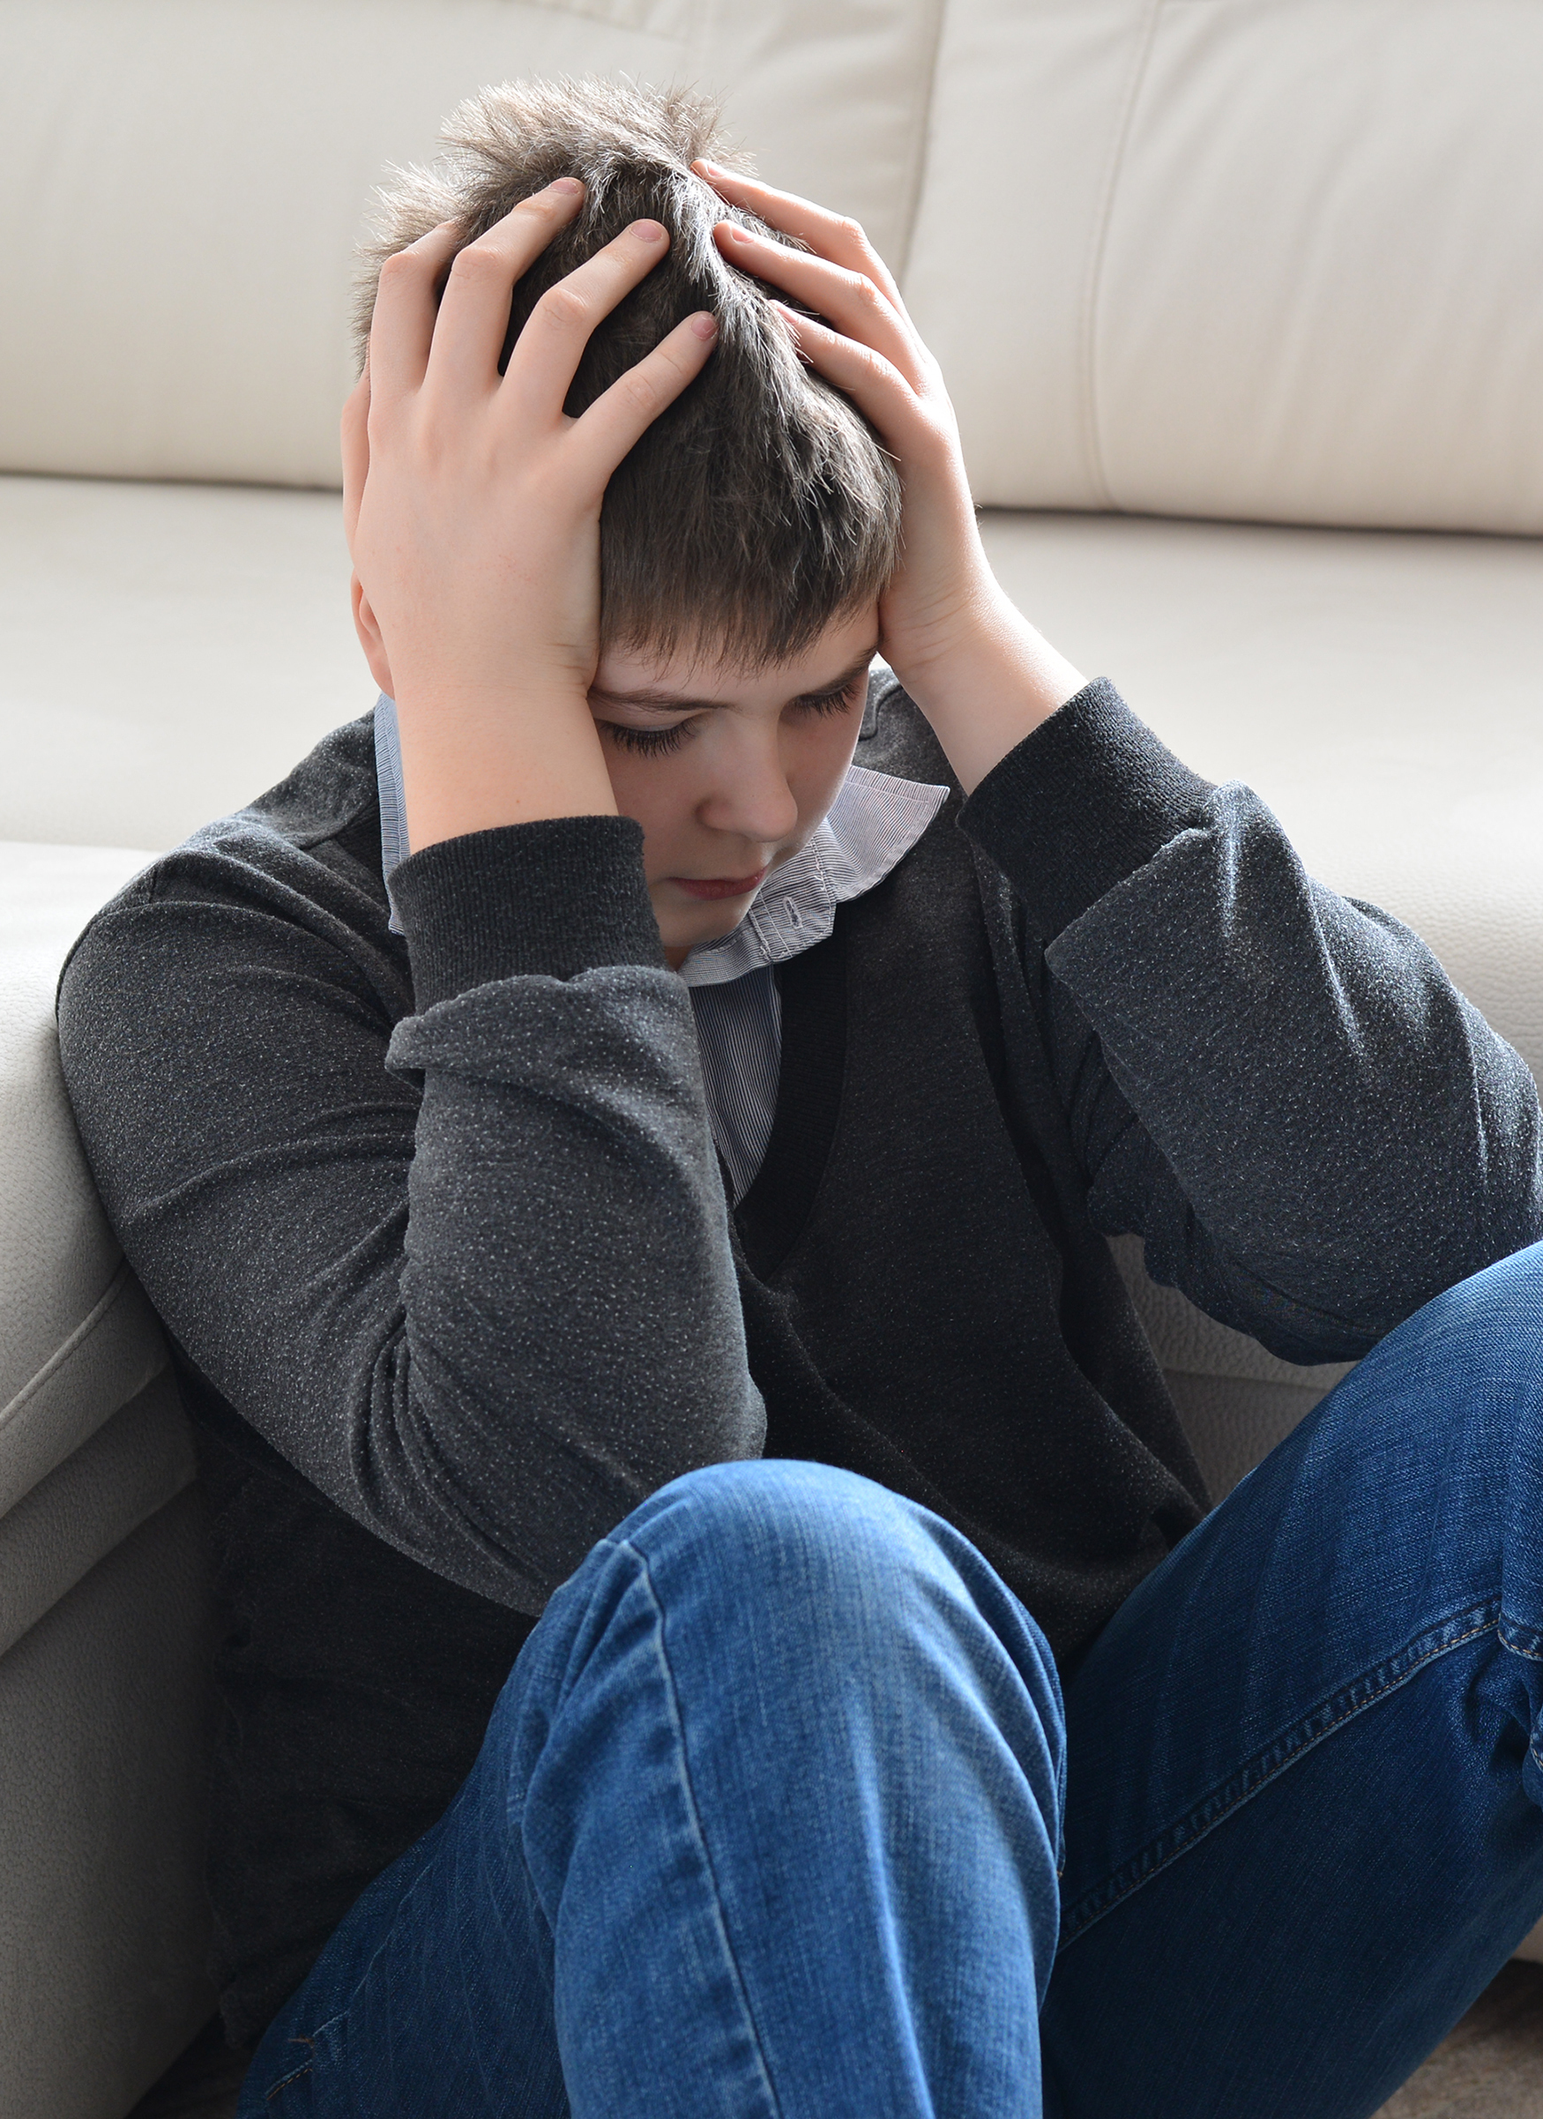
Bully Consequences
What are the consequences for the bully?
  Suspension
  Expulsion
  Damaged reputation
  Broken relationships
  Lowered self-respect
  Potential criminal consequences

Slide 40

Victim Consequences
What are the consequences for the victim?
  Anxiety
  Depression
  Fear
  Loneliness or Isolation
  Low self-esteem
  Serious long-term health issues
  Self-injury and suicide

Slide 41

Help and Support links in the U.S.
Know your resources.
Sponsored by the U.S. Dept. of Health and Human Services:
https://www.stopbullying.gov/get-help-now/index.html
Kids Helpline: https://kidshelpline.com.au/teens/issues/cyberbullying
NoBullying.com: https://nobullying.com/what-do-do-if-your-being-bullied/

Slide 42
Help and Support links in Ireland
Know your resources.
Childine: www.childline.ie
24 hour free telephone support: 1800 66 66 66
Text support available 10am-4am: Text TALK or BULLY to 50101
Reachout: http://ie.reachout.com/
Samaritans: www.samaritans.org
24 hour free telephone support: 116 123
Spun Out: www.spunout.ie

Slide 43
Help and Support links in the U.K.
Know your resources.
CEOP: www. thinkuknow.co.uk
NSPCC: www.nspcc.org.uk
0808 8005002
Childline:
0800 1111

Slide 44
Stop, Block and Tell
Stop
Block
Tell
Stop all correspondence
Block the offender from
your communication lists
Tell a trustworthy adult
Notes:
“If you receive a mean or inappropriate text, post, email, or photo (whether you’re the target or not), you should:
<click>
STOP correspondence with the bully, and DON’T forward it to your friends.
<click>
BLOCK that person from sending you any more emails, messages, texts, wall posts, etc. and
<click>
TELL a parent, teacher, or other trusted adult.”

Slide 45

Be Positive
Why not be a force for good online?
Notes:
“Digital Etiquette: always ask permission before posting a friend’s photo publicly.
It’s not about privacy settings, it’s about human decency.” Randi Zuckerberg
Why not be a force for good online?
Share a happy news story.
Join in with a positive photo #tag like #100happydays
Pay someone a compliment.
Like someone’s status.
Post a funny cat picture.
Notes: Brainstorm with the group to add to the list.

Slide 46

Excessive Use
Do you know someone addicted to their device?
  Turn-off your device
  Go for a walk with a parent, sibling or friend
  Don’t neglect your responsibilities to others and yourself - continue with homework, sleep and exercise
“I have caught myself surfing when I am not
really interested.” - Facebook Fog
Notes:
Touch briefly on internet addiction.
Comment on how it’s actually quite hard to disconnect from the internet with “Always-Enabled” mobile data and real-time updates with texts and mobile notifications for apps.
Encourage folks to realize when they’ve spent too much time on the internet and not to neglect other areas of their lives.

Slide 47

Your Action Plan!
Digital safety summary
  Change your passwords and keep them safe
  Disable geotagging
  Keep personal information private and NEVER share passwords
  Think twice before You post
  Review and update your online privacy settings
  Use Security Software to protect your devices
Notes:
Touch briefly on internet addiction.
Comment on how it’s actually quite hard to disconnect from the internet with “Always-Enabled” mobile data and real-time updates with texts and mobile notifications for apps.
Encourage folks to realize when they’ve spent too much time on the internet and not to neglect other areas of their lives.

Slide 48

Cybersecurity Careers
How can I get involved and be part of the solution?

Slide 49
Common Domains in Cybersecurity
Info Security
Analyst
Software
Developer
Threat
Researcher
Identify and recover from threats
Design securely, to prevent threats
Search for existing and future threats

Slide 50







Limitless Careers in Cybersecurity
Software Developer
Sales Account Representative
Information
Security Analyst
IT Security Consultant
Data Scientist
Policy Writer/Analyst
Security Systems Admin
Penetration Tester
Professional Services Engineer
Cryptographer
Sales Engineer
Intelligence Analyst
Support
Engineer
Technical Program Manager
Network
Architect
…and more!

Slide 51

Key Skills
Qualities that could make YOU suited for cybersecurity
  Effective Communication Skills
  Ability to Work in Teams
  Organizational and Problem Solving Skills
  Programming Skills
  Creativity
  Integrity
  Boundless Curiosity

Slide 52

Get involved!
Talk to parents, teachers, and industry professionals to learn more….

Slide 53

Thank You

