Slide 1
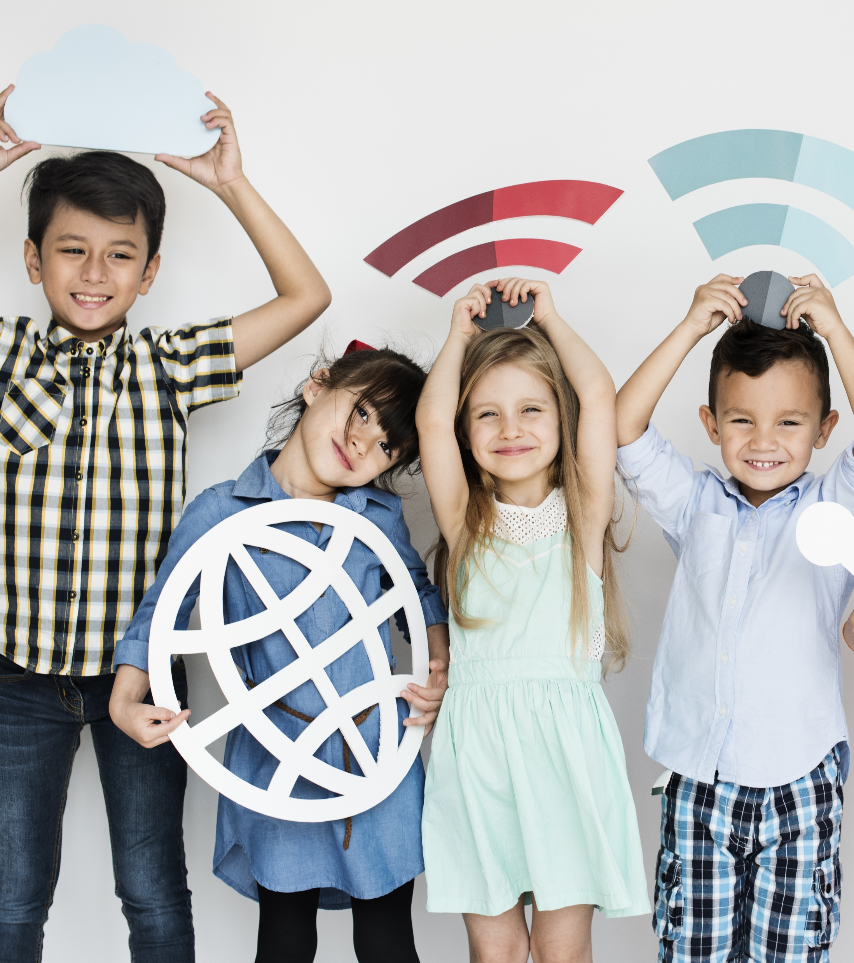
McAfee® Online
Safety Program
For Kids Ages 5-8

Slide 2

What is the Internet?
Notes:
“I know that most, or all, of you have been on ‘the Internet,’ but can anyone tell me what it actually is? “ [Call on students.]
<Click>
“The Internet connects BILLIONS of computers all over the world. Each computer has its own address, just like your house has an address. IN REAL LIFE, every house and business also has a door. Some doors are safe to enter and others aren’t, right? (like a stranger’s door). If your computer is connected to the Internet, you can visit computers all over the world—which can be AMAZING, as long as you’re taking the right steps to keep yourself safe.”
Useful anecdote;
Link idea of the internet to visiting other houses. i.e. Your computer is your house. The roads are the network. You wouldn’t leave your house, travel down the roads then go into a persons’ house that you don’t know. You wouldn’t know if the person who owned the house was nice or horrible, you might see content and images that aren’t suitable for your age and worry you. The same applies on the internet, with new websites being ‘other peoples’ houses. You shouldn’t ‘walk down the street’, in the form of wires, to other peoples websites (houses). You may come across not very nice people and content that you should not see.
Pose question: Who here has been to a family-friends house? How do you know the house is safe if you have never been there before? (looking for the answer of … my parents say it’s safe). This applies to the internet as well. When you want to go to a new website, get your parent/guardian to have a look at the website first to check that it is suitable before you ‘go in’.

Slide 3
STOP. THINK. CONNECT.™
Stop
Think
Connect
©2018 STOP.THINK.CONNECT. Messaging Convention, Inc. Used under license. All rights reserved.
Notes:
“If you’re walking down the street and you come to an intersection, what do you do? You stop of course. It was drilled into us when we were young, and now we just automatically know to stop, look and listen BEFORE walking across the street.”
“The same rule applies when you’re going on the internet—you need to
STOP
<click once>
And THINK
<click once>
before you CONNECT.”
This is the main motto of the presentation and is repeated again at the end.

Slide 4


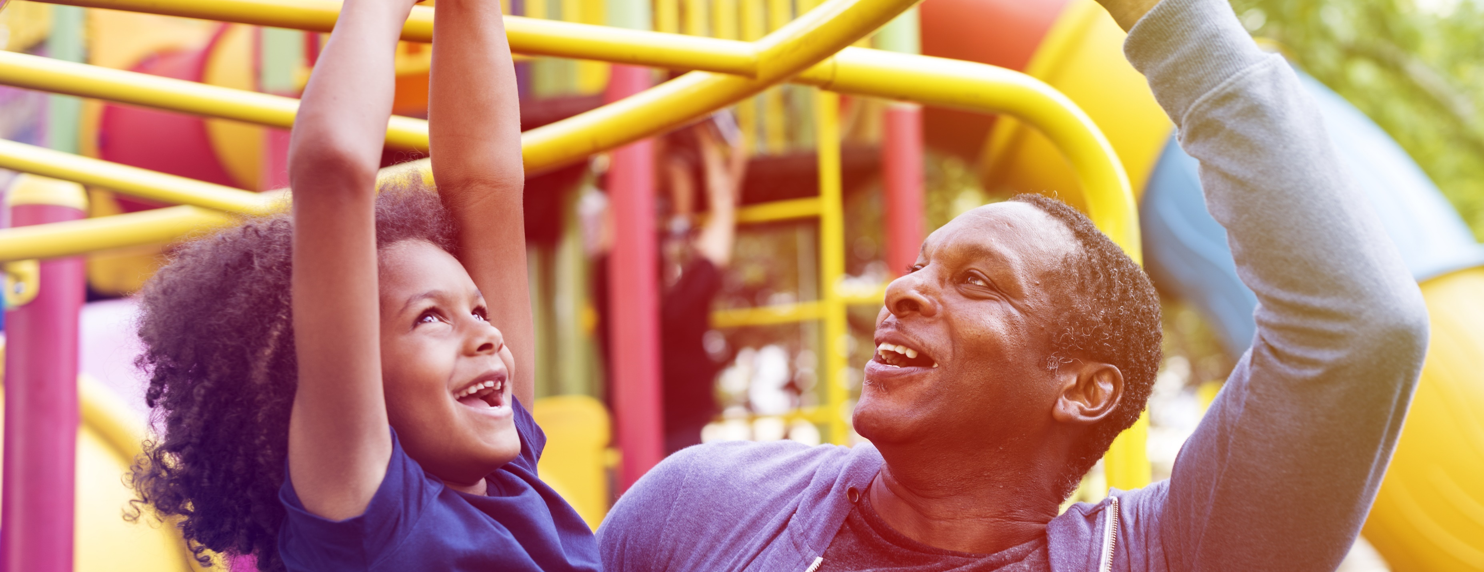

Fun at the Playground
Who likes playing online?
Who is missing from the picture?
That’s right, your parents and guardians!
Same rule for playing online, your Parents and Guardians should know what you’re playing!
Notes:
Playground scenario, trying to merge physical world and online world in the mind of our young:
This slides asks the question who likes playing in the playground then move to image 1 and ask, who is missing from the picture?
Answer we’re waiting for is parents/guardians. Show slide 2 to illustrate parents/guardians and reinforce the message that they are there to ensure we’re safe and having fun.
Now introduce next image, see a child playing online, ask who is missing? Next image shows a parent/guardian present whilst child plays online. This again is like the playground and having parents/guardians present ensures we’re safe and having fun.

Slide 5
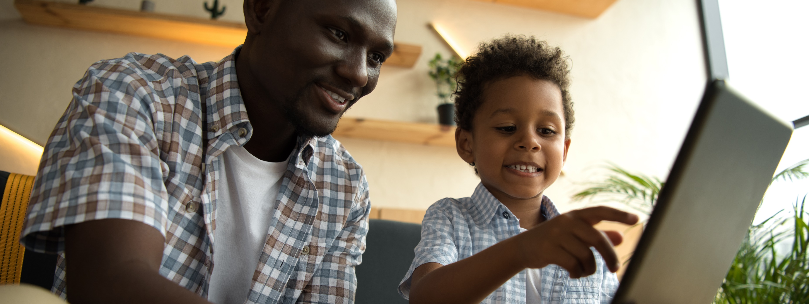

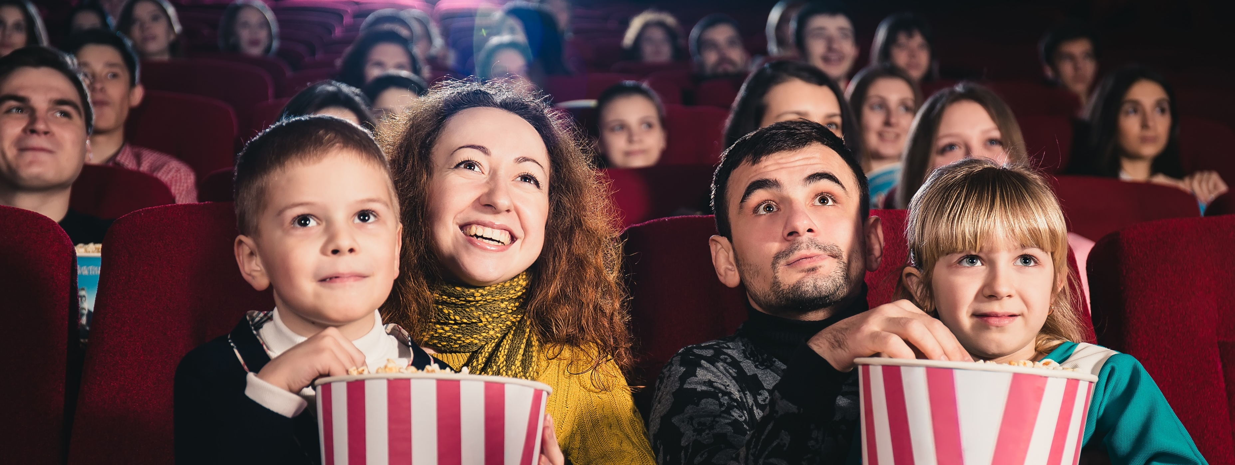

Going to the movies and watching movies online
Who is missing from the picture?
That’s right, your parents and guardians!
Who likes watching movies or videos online?
Same rule for watching movies online, your Parents and Guardians should know what you’re watching!
Notes:
Movies scenario, trying to merge physical world and online world in the mind of our young:
This slides asks the question who likes going to the movies, then move to image 1 and ask, who is missing from the picture?
Answer we’re waiting for is parents/guardians. Show slide 2 to illustrate parents/guardians and reinforce the message that they are there to ensure we’re safe and having fun.
Now introduce next image, see a child watching a movie/video online, ask who is missing? Next image shows a parent/guardian present whilst child watches a movie/video online. This again is like the movie theater and having parents/guardians present ensures we’re safe and having fun.

Slide 6
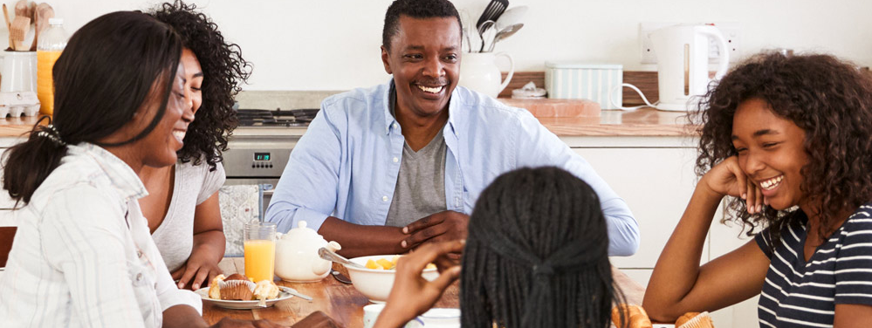

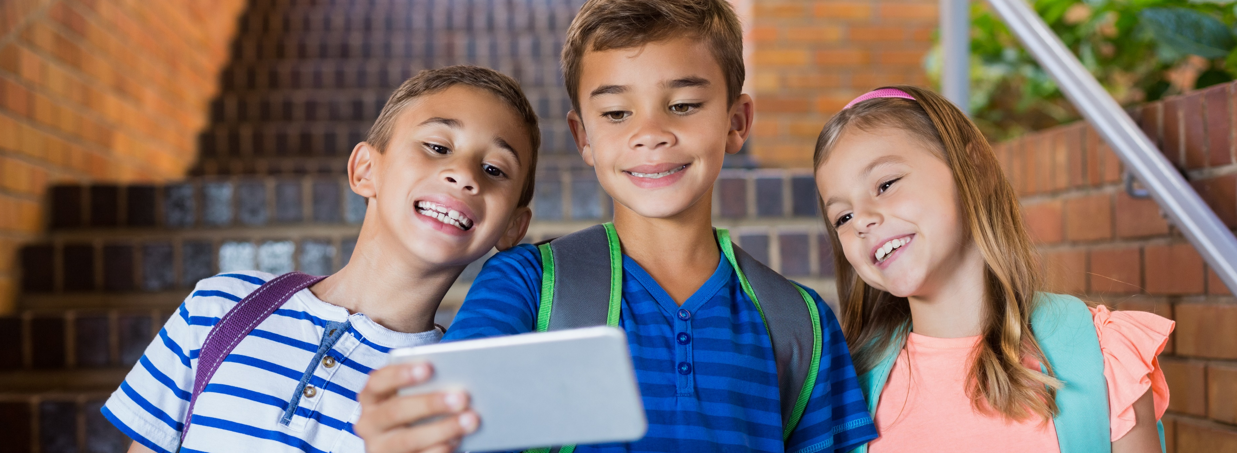

People I know and people I don’t
It’s the same rule for playing online, your Parents and Guardians should know who you are with!
Who likes playing online?
That’s right, your parents and guardians!
Who likes going on playdates?
Who organizes your playdates?
Notes:
Playdate scenario, trying to merge physical world and online world in the mind of our young:
This slides asks the question who likes going on playdates and we ask, who organises playdates for you? Would you go to this house (image 1) and see if there is someone there to play with? Of course not because that house is a strangers house, image 2.
Show slide 3 to kids playing online, and call out that if anyone online wants to play with you, then like the playdate you tell your parents and they will decide for you, you should never talk to strangers online just like you don’t go on playdates with strangers. Again reinforce the message that parents/guardians are there to ensure we’re safe and having fun.

Slide 7
STOP. THINK. CONNECT.™
Stop
Think
Connect
©2018 STOP.THINK.CONNECT. Messaging Convention, Inc. Used under license. All rights reserved.
Notes:
Again close out with the Stop Think Connect when online, just like we spoke about at the beginning with crossing the road.
“If you’re walking down the street and you come to an intersection, what do you do? You stop of course. It was drilled into us when we were young, and now we just automatically know to stop, look and listen BEFORE walking across the street.”
“The same rule applies when you’re going on the internet—you need to
STOP
<click once>
And THINK
<click once>
before you CONNECT.”
This is the main motto of the presentation and is repeated again at the end.

Slide 8


Thank You

