Slide 1
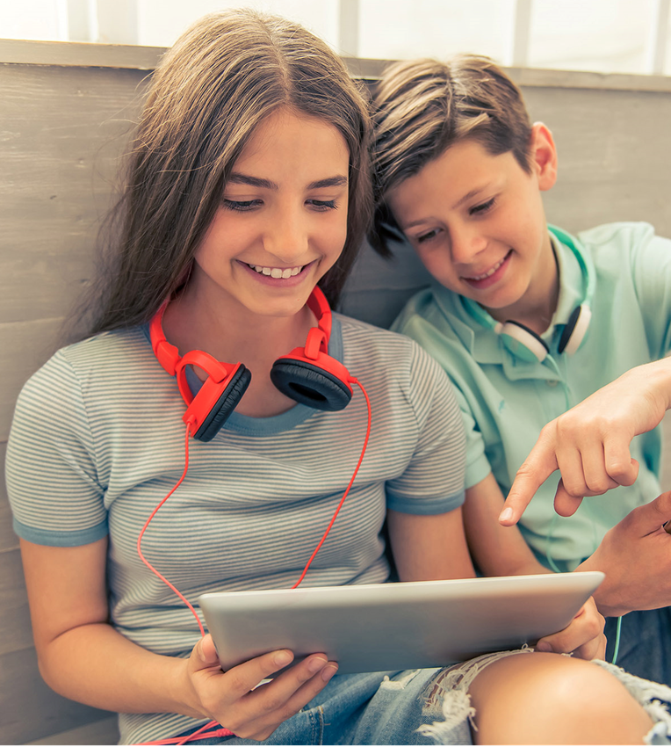
McAfee® Online
Safety Program
For Kids Ages 9-10

Slide 2

What is the Internet?
Notes:
“I know that most, or all, of you have been on ‘the Internet,’ but can anyone tell me what it actually is? “ [Call on students.]
<Click>
“The Internet connects BILLIONS of computers all over the world. Each computer has its own address, just like your house has an address. IN REAL LIFE, every house and business also has a door. Some doors are safe to enter and others aren’t, right? (like a stranger’s door). If your computer is connected to the Internet, you can visit computers all over the world—which can be AMAZING, as long as you’re taking the right steps to keep yourself safe.”
Useful anecdote;
Link idea of the internet to visiting other houses. i.e. Your computer is your house. The roads are the network. You wouldn’t leave your house, travel down the roads then go into a persons’ house that you don’t know. You wouldn’t know if the person who owned the house was nice or horrible, you might see content and images that aren’t suitable for your age and worry you. The same applies on the internet, with new websites being ‘other peoples’ houses. You shouldn’t ‘walk down the street’, in the form of wires, to other peoples websites (houses). You may come across not very nice people and content that you should not see.
Pose question: Who here has been to a family-friends house? How do you know the house is safe if you have never been there before? (looking for the answer of … my parents say it’s safe). This applies to the internet as well. When you want to go to a new website, get your parent/guardian to have a look at the website first to check that it is suitable before you ‘go in’.

Slide 3
STOP. THINK. CONNECT.™
Stop
Think
Connect
STOP. THINK. CONNECT.™ is a trademark of STOP. THINK. CONNECT. Messaging Convention, Inc. and may only be used in accordance with the license provided at www.stopthinkconnect.org.
Notes:
“If you’re walking down the street and you come to an intersection, what do you do? You stop of course. It was drilled into us when we were young, and now we just automatically know to stop, look and listen BEFORE walking across the street.”
“The same rule applies when you’re going on the internet—you need to
STOP
<click once>
And THINK
<click once>
before you CONNECT.”
This is the main motto of the presentation and is repeated again at the end.

Slide 4


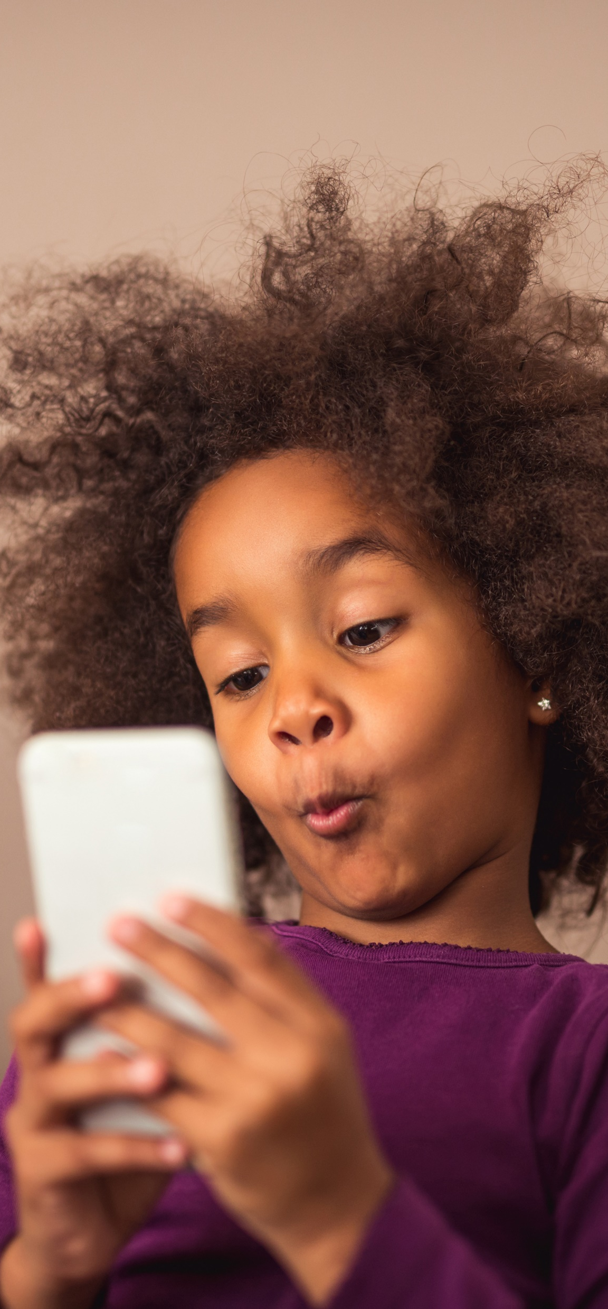

What do you do online?
Notes:
CLICK for animation*
“These days there are many ways for us to connect to the Internet. What kinds of activities do you do online and what types of devices do you use?”
[Take responses.]
Discussion points for this slide include;
Awareness that devices are internet enabled. It’s not only laptops and PCs that can access the internet.
All gaming consoles typically feature some internet connectivity, either through Wi-Fi or increasingly commonly through a data driven device which has mobile connectivity like a phone. Some examples of this include,
Amazons Kindle: this device is always connected to the internet,
Another common problem is the internet enablement of children's devices like Nintendo handheld consoles.
Certain versions of the consoles features a SwapNote or StreetPass feature where a handheld device is in range of another active Nintendo device, they exchange information in a salutation that can contain location, images and inappropriate messages.
The conclusion here is to discuss with young people what devices they have and ask how are they securing them.
Do they know if those devices are internet enabled?
Are they aware of what kind of information they’re sharing?
Can people find the device if it’s active, i.e. does it have a feature like Nintendo’s StreetPass that is actively searching for connections with other devices?
The outcome being that hopefully some of the young people have thought about some devices they have, they may not have realized it was internet enabled and need to secure it to avoid oversharing of personal information.
Some commonplace devices include;
XBOX ONE/XBOX360
Playstation
Any Nintendo Console such as Wii/WiiU/2DS/3DS
All Smart Phones
Laptops and PCs
Tablets (iPads etc.)
If in doubt about the relevancy of the list, it’s good practice to ask the crowd of young people what the latest device in terms of technology is. Oftentimes they will be well abreast of the latest and greatest.
As a follow-up exercise some young people might like to explore the safety measures of their device and bring it in to demo to the group and show how they can protect themselves by using the privacy features to secure the device.

Slide 5
Your Responsibility In…
STOP. THINK. CONNECT.™
Cyber Security
Cyber Safety
Cyber Ethics
What do I do to
keep my stuff safe?
What do I do to keep myself safe?
How do I treat others online?
Notes:
“Who is responsible for what happens as a result of the time you spend online?
“It’s important to remember that, no matter what you do on the Internet, whether it’s educational or just messing around having fun, there are risks. So who has the ultimate responsibility for the safety and security of you, your stuff and the people you interact with online? It is, of course, you.
“In order to safely connect to the outside world you need to know the rules and follow them, otherwise you could be putting your computer, as well as yourself and your family, at risk.”
“In the rest of this presentation, we will be discussing ways you can keep your stuff safe and yourself safe, as well as looking at how your online behavior not only impacts the well-being of others, but can have a serious long-term impact on your reputation.
“In the end, it’s all about being a responsible cyber citizen.”
Trainers Notes:
Start off by discussing the real life meanings of Security, Safety and Ethics. Explore the definitions of these words, especially Ethics. A lot of young people will have a vague approximation of what ethics means.
What does Ethics mean to you?
DEFINITIION:CODE OF CONDUCT
EQUATE THAT TO YOUR CODE OF CONDUCT IN SCHOOL, HOW YOU WOULD ACT, GIVE EXAMPLES
I avoid correlating Ethics with consequences on this slide. Often young people will have encountered ethics in the context of “breaching” a code of ethics or behaving unethically and having punishment ensue. I try to explore the positive aspects of ethics, having self respect, maintain a positive personal reputation, being proud of yourself. Fostering some self appreciate and pride is a much more engaging angle than exploring one of negative consequences.
Once the discussion on the real world scenarios is over, introduce the “Cyber” element. Anything Cyber relates to the internet and technology generally, some light reading on that below;
The idea here is that their knowledge of real world skills young people have when it comes to safeguarding themselves in their everyday lives needs to start translating directly to the “Cyber-lives” i.e. their social networking profiles, the content they share and the security of their devices.

Slide 6
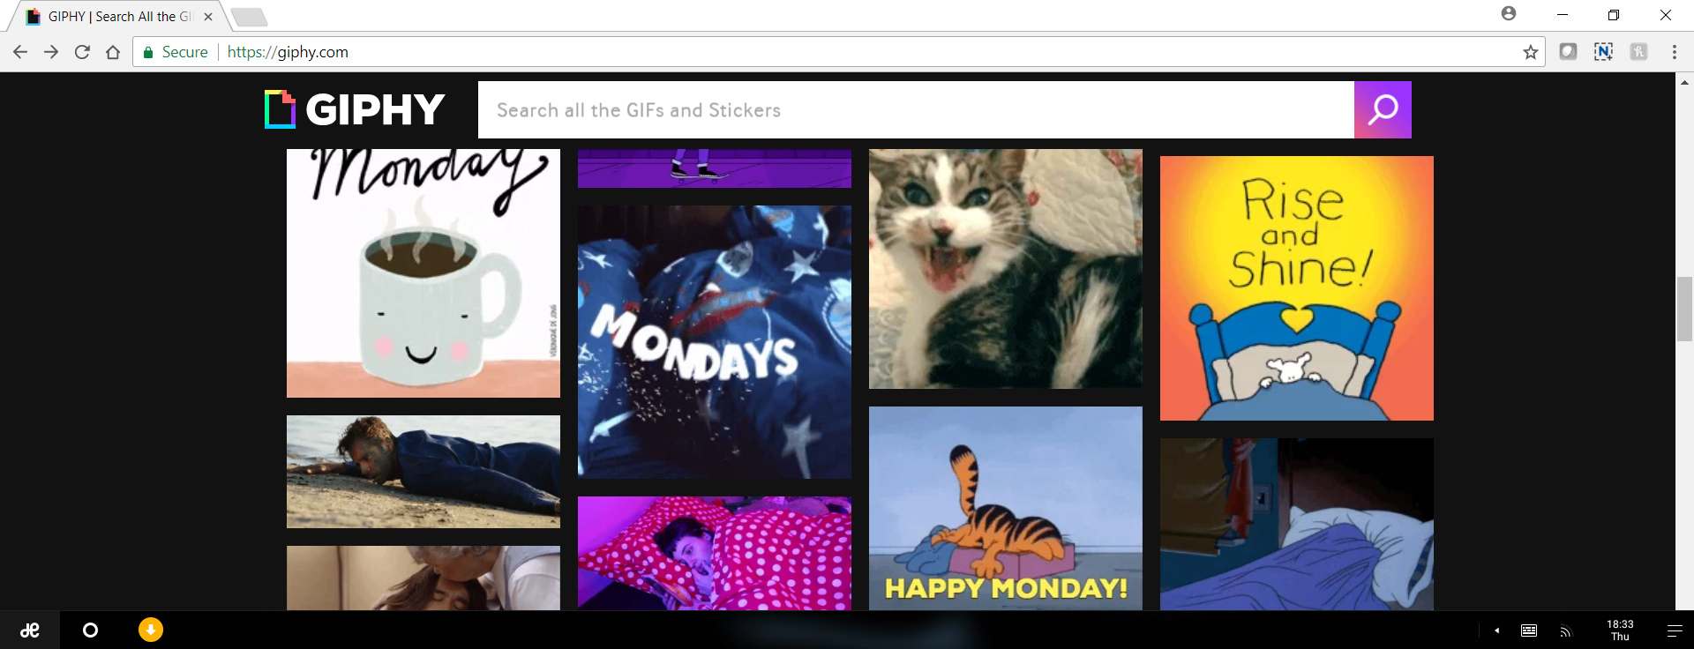

Pop-Ups
If it’s too good to be true, it probably is!
Notes:
Pop-Ups
These are unsolicited windows that appear typically during browsing. They have many types, namely competitions, advertising, fake alerts etc. http://en.wikipedia.org/wiki/Pop-up_ad. Interacting with these pop-ups is not recommended.
“It is another way online criminals can hack into your computer and steal your information is by getting you to click on a link that promises a reward.
<click>
Here’s an example of a popup that promises you a free iPad if you click on the link. How many of you have received this kind of message? Did anyone click on it? What happened?
Have you ever known anyone who got a FREE iPad just by clicking on some links?
If it sounds like it’s too good to be true – it probably is!
Never click on link from a suspicious popup or email or text. Cyber criminals are either trying to get you to go to a malicious site where they can put malware on your computer, or get you to give up your personal information.”

Slide 7
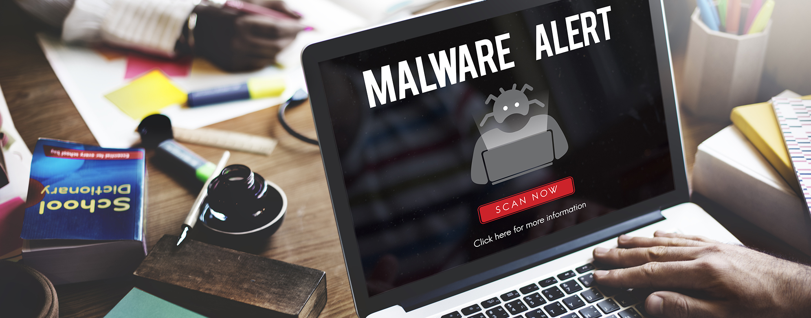
Malware
Notes:
“Malware refers to software programs designed to damage or do other unwanted actions on a computer system.
Common examples of malware include viruses, worms, Trojan horses and spyware. A good firewall and security software package can help protect against these types of threats.
Virus: computer program files capable of attaching to disks or other files and replicating repeatedly, without user knowledge or permission.
Worms: Parasitic programs that replicate, but do NOT infect other computer program files. They can send copies to other computers via a network.
Trojan Horse: A seemingly harmless program that you knowingly download. What you don’t know is that it also conceals a destructive back door that will allow attackers access to your system.
Spyware: Exploits infected computers for commercial gain, delivering unsolicited pop-up ads and monitor web browsing activity, among other things.”

Slide 8
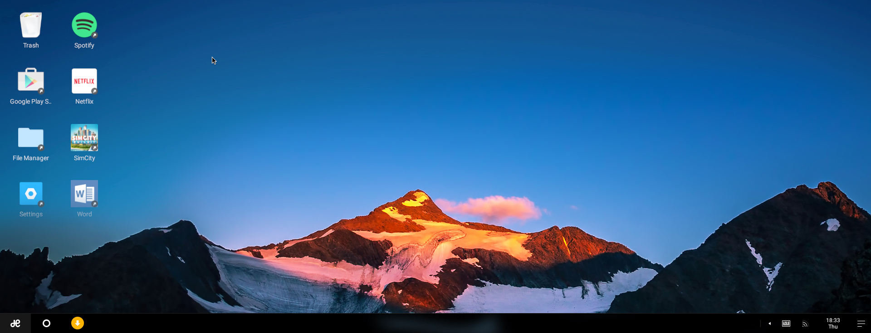


Securing Your Mobile Devices
Lost and stolen devices are the biggest threat to mobile users.
Notes:
Lost and stolen devices continue to be the BIGGEST security threat to mobile users.
There’s a lot of personal information on your phone (such as texts, photos, contacts, emails and personal accounts). How you would feel if someone had access to all of that and made it public OR sent out texts and emails to all of your contacts while pretending to be you!?

Slide 9


Personal Information
What do you think personal information is?
  Passwords
  Your phone number
  Where your parents work
  Where you go to school
  Where you live
  Your age
  And more…
Notes:
“So… what do you think personal information is?” [Ask the group for examples of what kind of information is personal?]
<click once to open safe >
“Personal information includes stuff like: your age, where you go to school, where your parents work, where you live, your phone number and passwords.”
“Why do you think it is a problem to share this information?” [Take some responses.]
“Cool. Here’s another example: If you post online that your family is on vacation, you’ve just let A LOT of people know (including some people who you may not know very well) that your house is empty. With just a little personal information like this, folks can use it in a variety of ways to hurt you.”
Is This Too Much Info?!
We tend to overshare online, before you click on anything watch for these TMI Red Flags;

Slide 10
Protect Your Personal Information
Use Highest
Privacy Settings
Limit Sharing
Information
Always Use
Screen Names
Have a trusted adult help you set up privacy settings to control who sees your information
Adjust the privacy settings
to limit what a site shows about you
Only use your first name or a made-up name
Never use your last name
Notes:
Websites have settings that stop others from seeing your information these are called privacy settings
You should always use them if you are unsure how to use them ask an adult for help
Websites should not be telling others where you are or how to get in touch with you, turn sharing information off in the settings
Never use your full name when you play games or chat use only your first name or your nickname

Slide 11

Securing Your Mobile Devices
Here are some safety tips for your mobile device.
Ask a trusted adult to help you set a passcode
Always logout of your accounts
Remember: photos are forever
Only download and install from trusted sources, ask a trusted adult before downloading
Notes:
You should set you mobile device – your phone, ipad, etc to automatically lock itself after a certain period of time, that way, if you forget, your at least safe from prying eyes
Always lock your PC or other devices that you leave at home before leaving for school, and any devices you carry to school should have automatic locking enabled
You wouldn’t want to leave your ipad “accidently” unattended and someone whose mad at you to post something as if they were you and say something you would never say or should never say!

Slide 12
Creating Stronger Passwords
Do you know what the most commonly used passwords are?
  123456
  Password
  12345678
  Qwerty
  12345
  123456789
  letmein
  1234567
  Football
  iloveyou
@
:
)
0
@
s
W
O
0
r
d
P
A
S
S
W
R
D
P
s
r
d
5
5
Use numbers and symbols
Add a smiley face in the middle
Use at least 8 characters
Mix UPPER and lower case
Notes:
It’s important not to share passwords and it’s just as important to know how to create really strong ones. https://www-ssl.intel.com/content/www/us/en/forms/passwordwin.html
Did you know that the most common password that people use today is the word PASSWORD? Let’s use it as an example (knowing that we would never use it for real) and make it more complex using 3 simple rules.
<click>
Use at least 8 characters
<click>
Use a mix of UPPER CASE and lower case letters
<click>
add symbols (@#$%& etc….) and numbers
And if you are really serious about making it strong, here are some more tips:
Do NOT repeat old passwords that you’ve used before
Change your passwords after a while
Don’t use real words that you would find in the dictionary
Do not use personal information like the name of your brother or your pet.
If you have a mobile phone:
You should set a passcode on it and tell your parents to set one on their phones. If you lost your phone and it was unlocked you’d lose your pictures, games, contacts and messages and you wouldn’t want that to end up in a stranger’s hands would you?

Slide 13
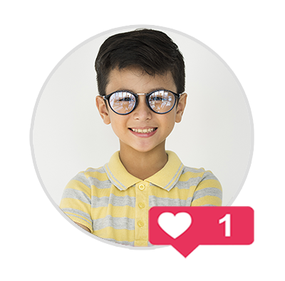
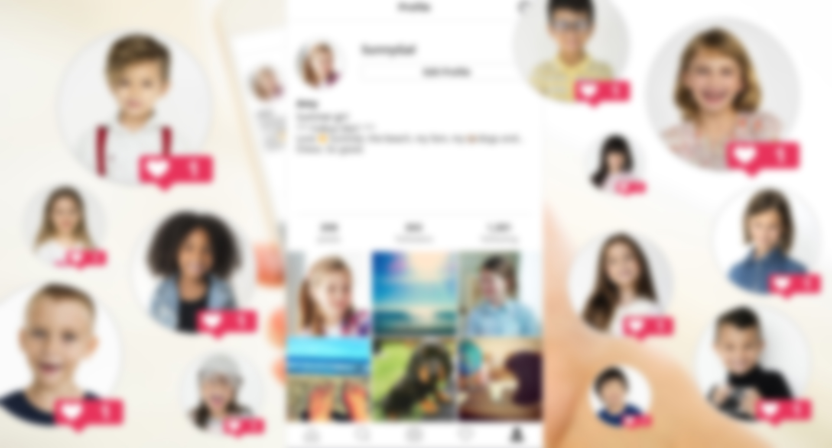
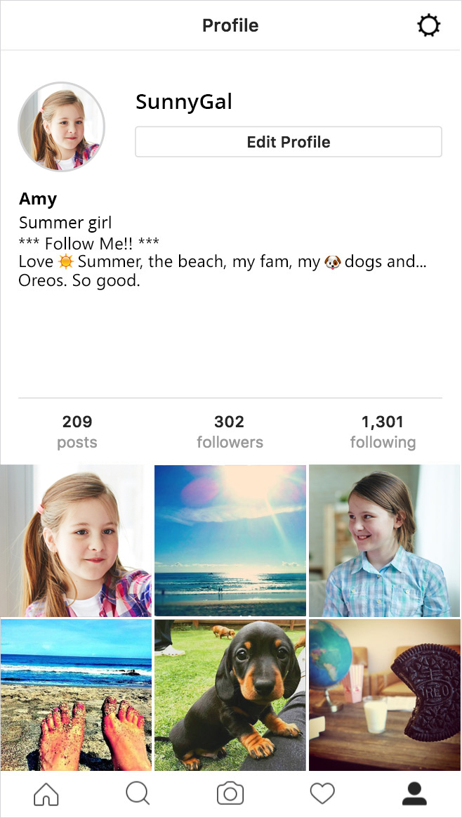


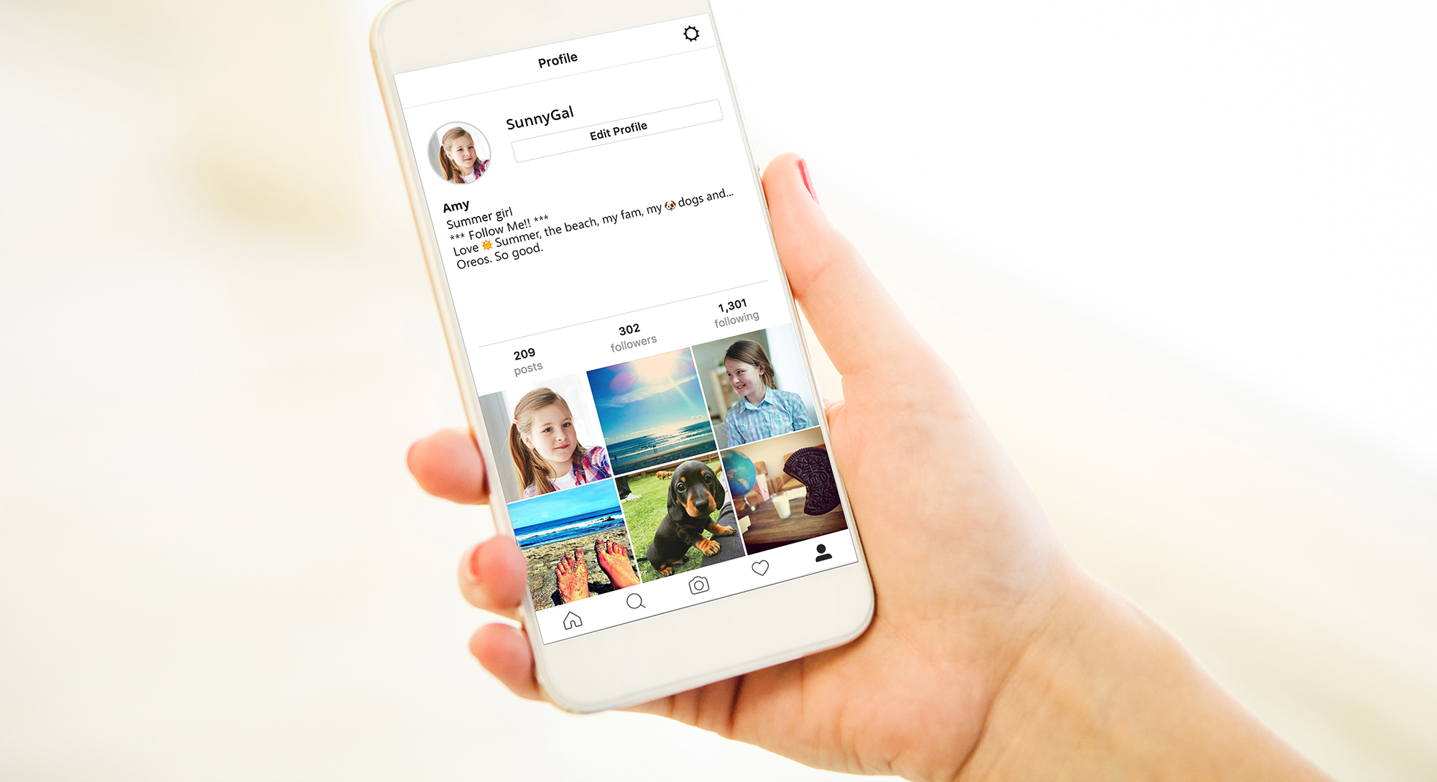
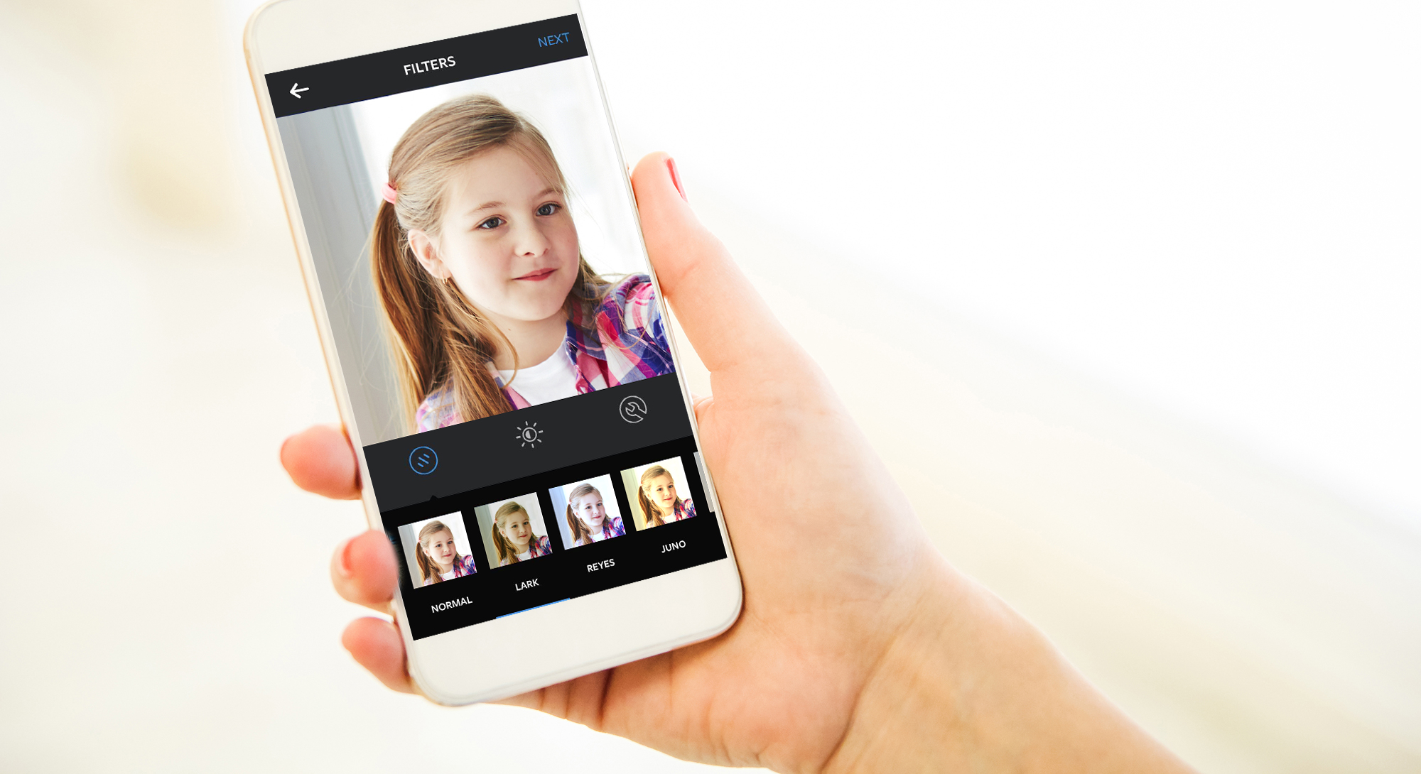

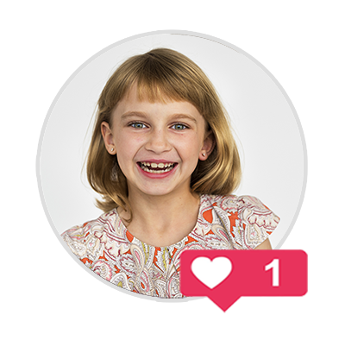

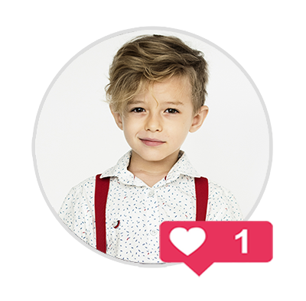
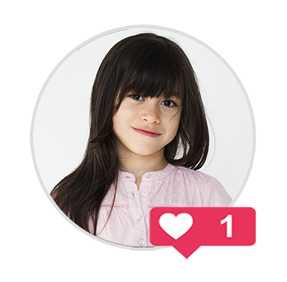
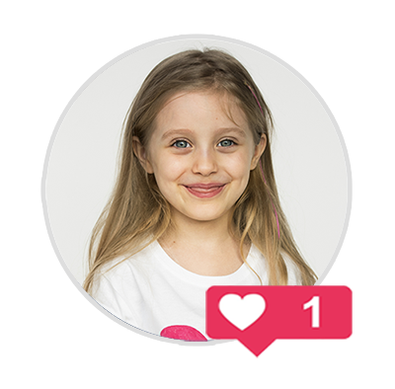
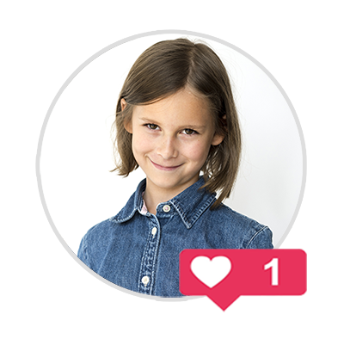
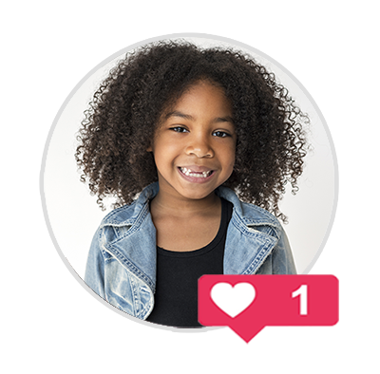
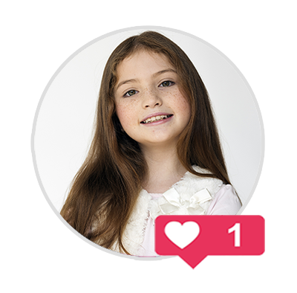
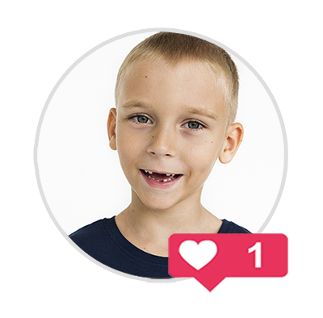

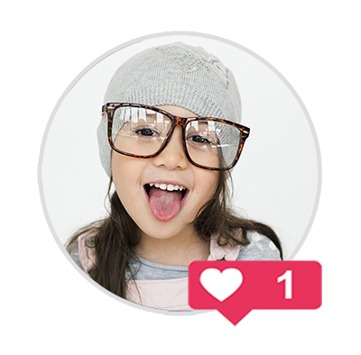
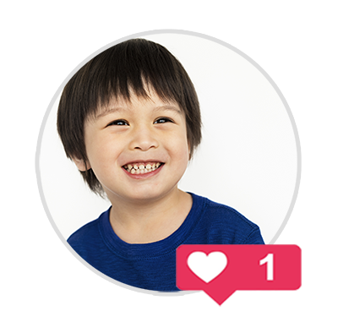
Notes:
*Click once to play animation/video*
Sharing even with four friends you trust can be a bad idea. If they are indiscrete with as little as four friends each, the amount of people who have access to your information/content can escalate rapidly.
Topics for discussion
Loss of control: Once you post it, it can’t be taken back even if you regret it. You should think before you send anything, only post content you’d be proud to put your name against!
Viral: a term used to describe something that spreads rapidly through the internet.
Trusting Peers: Beware of peer pressure and following the crowd, don’t be pressured into oversharing just because there’s an expectation of trust. Take care of yourself first and follow your gut when it comes to sharing personal details and content.
Reproduction of images: even if they’ve been deleted images and posts can still have bee downloaded and saved or have screenshot taken and can come back at a later date.

Slide 14
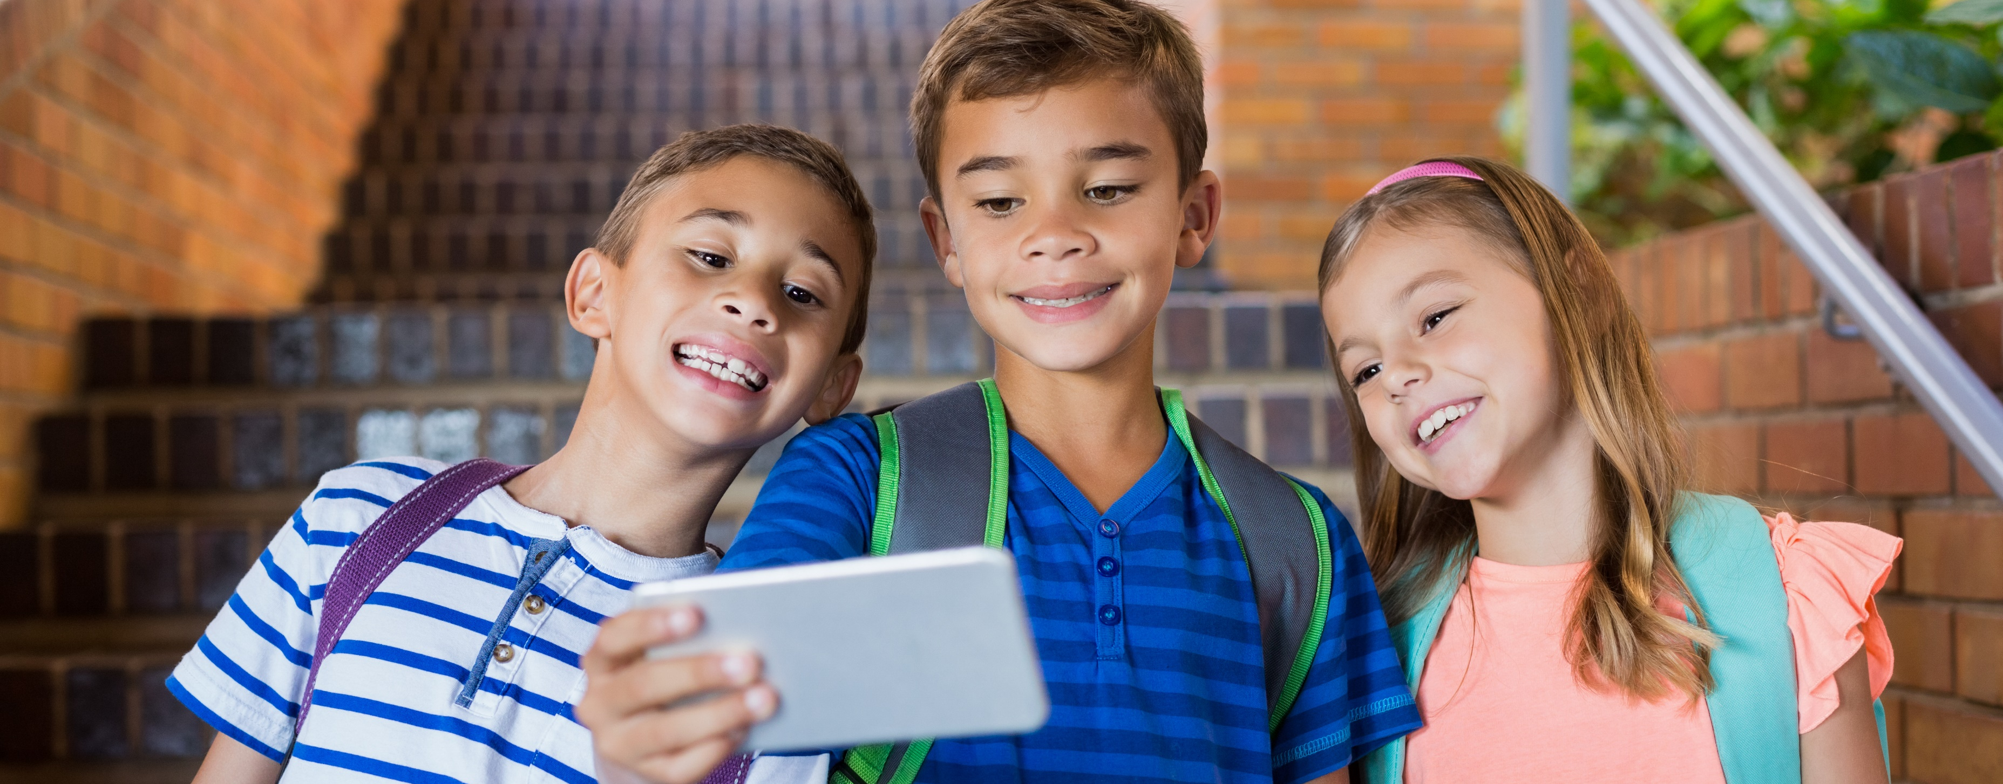
Social Networking
Who are your friends on social networking sites and apps?
Notes:
Friend Requests
A young persons social network is likely made up of two kinds of people: Those they actually talk to in real life and those they don't.
http://www.huffingtonpost.com/stephen-mariani/four-types-of-facebook-friends_b_5505459.html?sf3493983=1
Talk to young people about unsolicited friend requests. They should be suspicious of anyone they have not met in person. This ties into the topics of Impersonation and Anonymity.
Introduce the idea of tiers of friendship.
How do we group these people when online?
What kind of information do we share with these people?
Siblings
Best Friends
Boyfriends/Girlfriends
School Friends
Friends of Friends
Acquaintances
Strangers

Slide 15
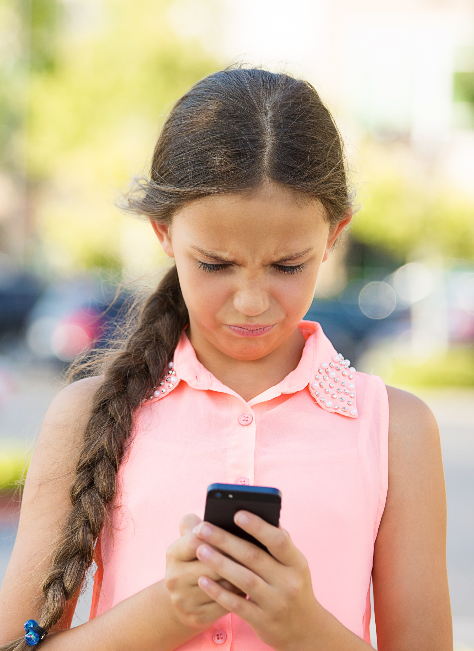
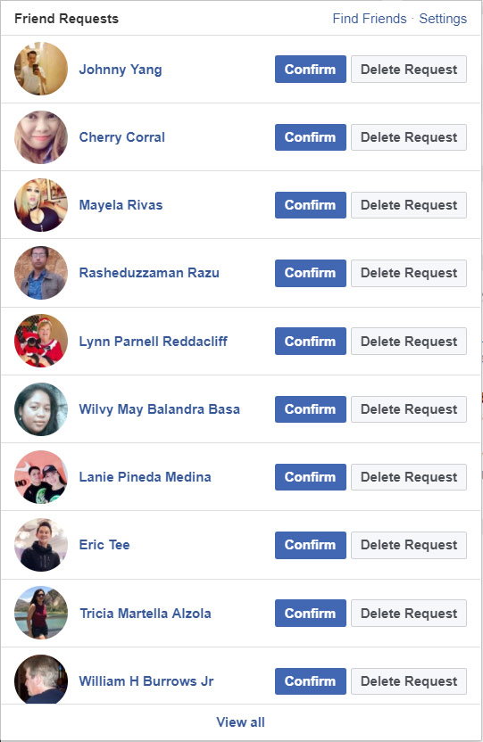
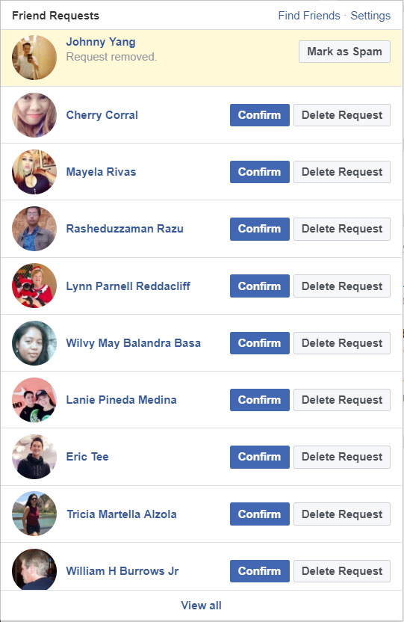

Do I know you?
Dealing with unsolicited friend requests.
Johnny Yang
Notes:
If you’re not sure who is trying to connect with You online, don’t take the risk. Only connect with people You actually know.

Slide 16



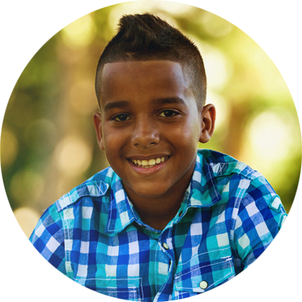

Do I know you?
Dealing with unsolicited friend requests.
Hey Hailee, I’m Shane hru?
Hi good thx, u?
Awesome. Do you want to play a game with me?
Sure! What’s your fav game?
Hailee
Shannon
Shane
Notes:
Friend Requests
A young persons social network is likely made up of two kinds of people: Those they actually talk to in real life and those they don't.
http://www.huffingtonpost.com/stephen-mariani/four-types-of-facebook-friends_b_5505459.html?sf3493983=1
Talk to young people about unsolicited friend requests. They should be suspicious of anyone they have not met in person. This ties into the topics of Impersonation and Anonymity.
Introduce the idea of tiers of friendship.
How do we group these people when online?
What kind of information do we share with these people?
Siblings
Best Friends
Boyfriends/Girlfriends
School Friends
Friends of Friends
Acquaintances
Strangers

Slide 17
Stranger Danger!
NEVER
Accept online ‘friends’ you don’t know in real life
Leave devices where others can access them
Post personal information online
Exchange any information with strangers online
Share your passwords
with anyone
Meet up with
a stranger you
met online
EVER
Notes:
“I know that all of you have enough common sense to stay away from strangers in real life. You need to be extra careful when you’re online because you can’t see who you’re talking to.
<click>
-- Don’t chat online or exchange ANY information with strangers (not even your e-mail address)
<click to next>
-- Don’t accept online “friends” that you don’t know and trust in real life
<click to next>
-- Don’t post personal information online (like where you go to school, where and when you play afterschool sports, other activities, etc.)
<click to next>
-- Don’t leave your mobile devices where others can access them
<click to next>
-- Don’t share passwords with ANYONE (games, email accounts, logins)
<click to next>
-- Don’t meet with someone you met online.”

Slide 18

Cyber Ethics
How do I treat others online?

Slide 19
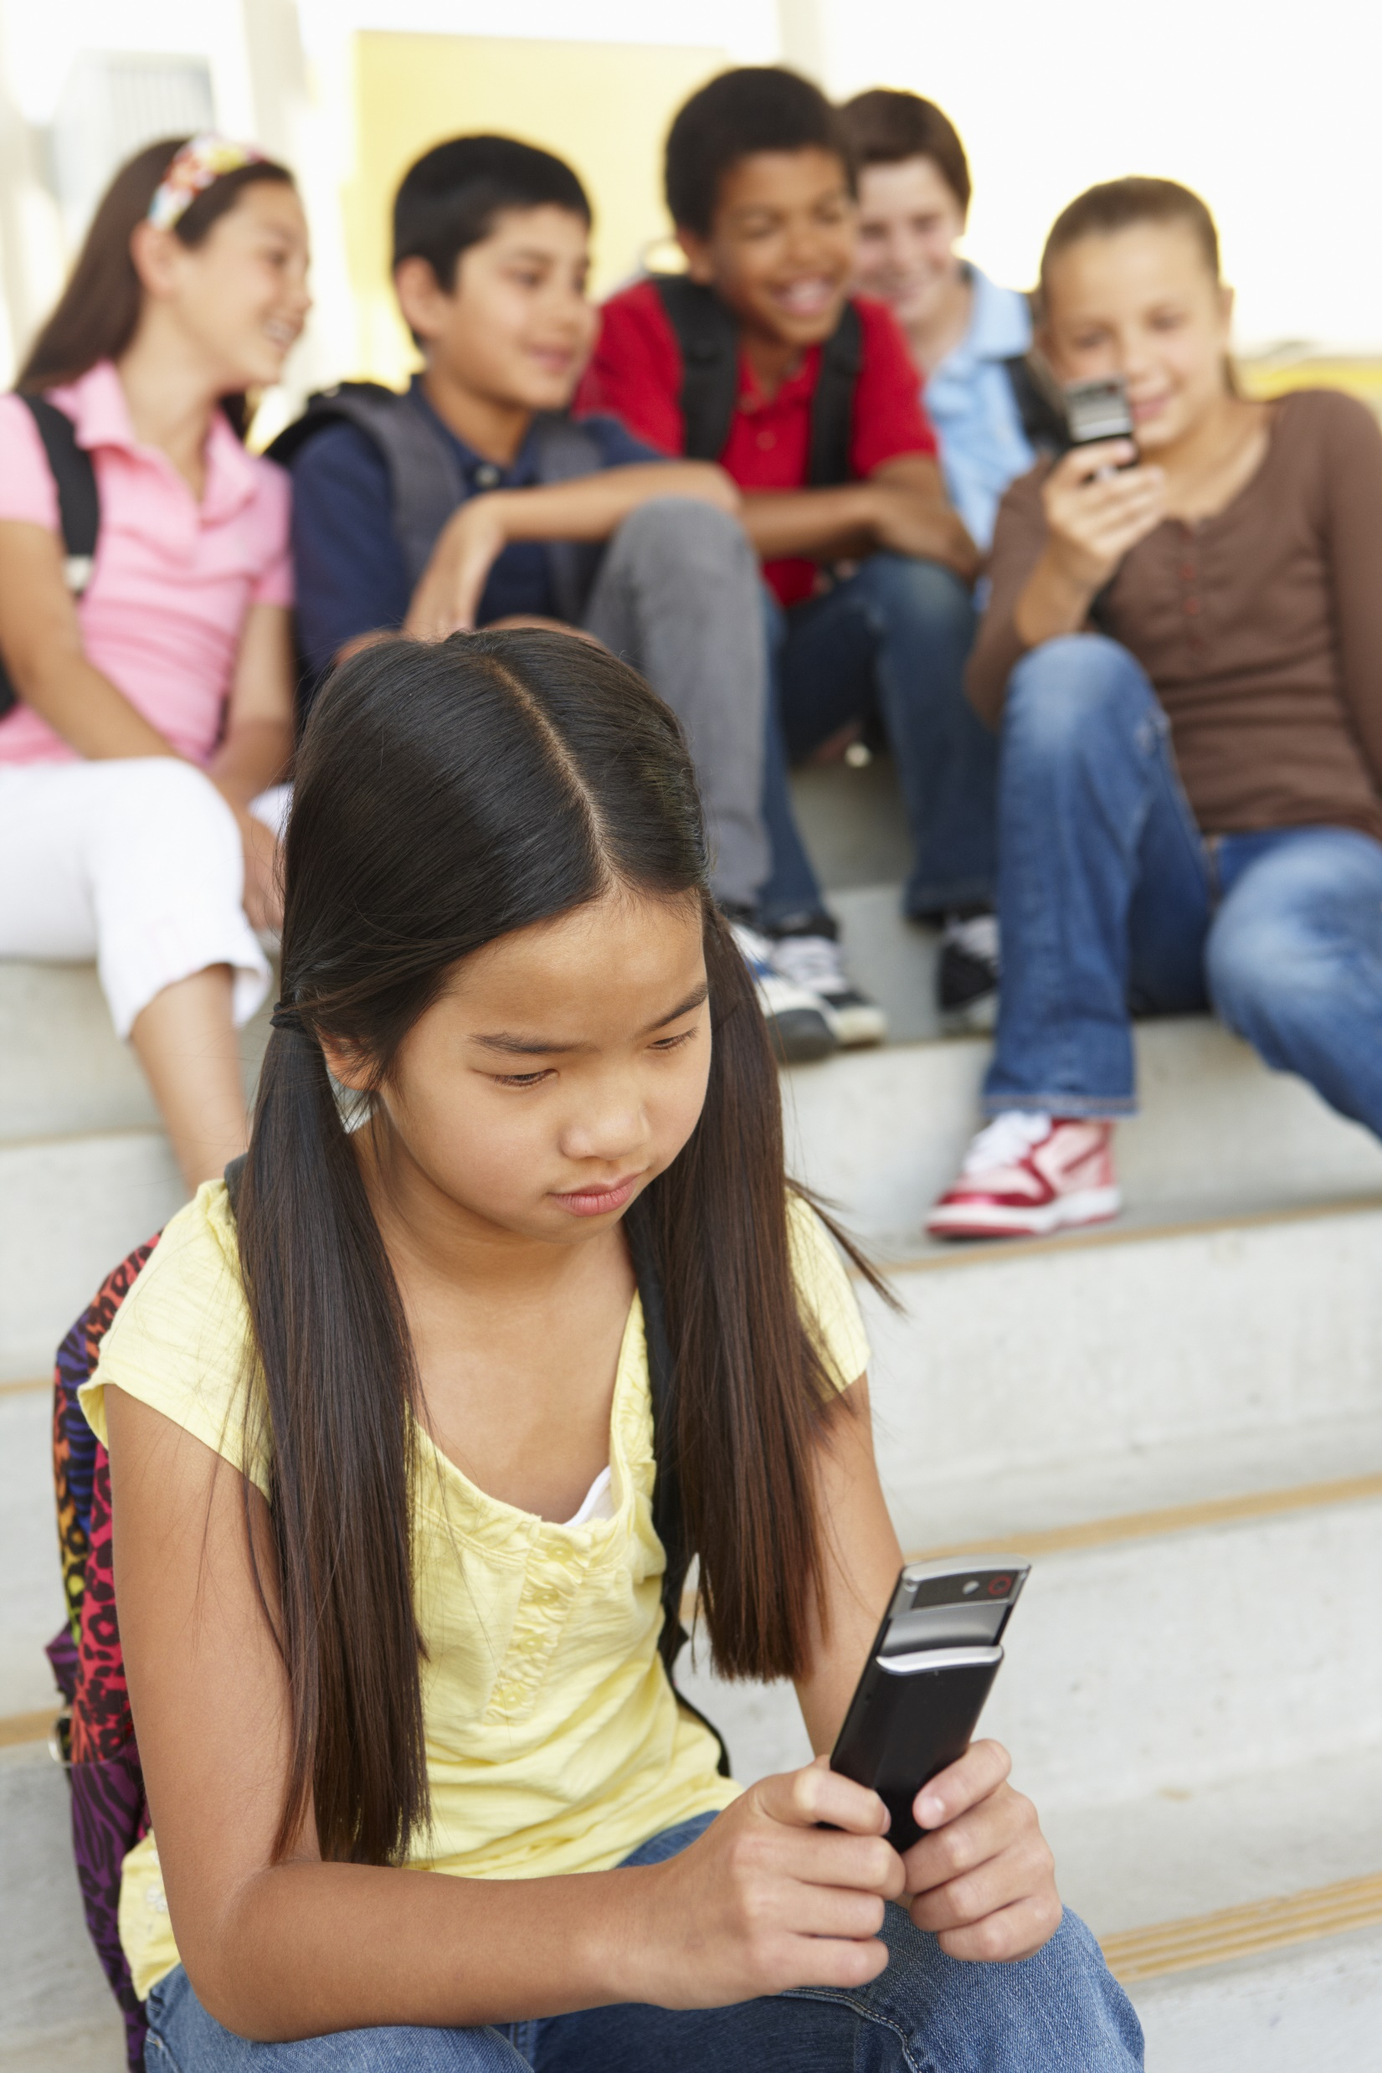
Cyber-Bullying
What is the definition of Cyber-Bullying?
  Cyber-Bullying is distinguishable from physical/verbal bullying in that:
    Potentially a huge audience
    Can occur 24/7
    You can’t see or hear the victim’s reactions
Notes:
Following you home from school: A critical review and synthesis of research on cyberbullying victimization R. S. Tokunaga 2011

Slide 20
Stop, Block and Tell
Stop
Block
Tell
Stop all correspondence
Block the offender from
your communication lists
Tell a trustworthy adult
Notes:
“If you receive a mean or inappropriate text, post, email, or photo (whether you’re the target or not), you should:
<click>
STOP correspondence with the bully, and DON’T forward it to your friends.
<click>
BLOCK that person from sending you any more emails, messages, texts, wall posts, etc. and
<click>
TELL a parent, teacher, or other trusted adult.”

Slide 21
STOP. THINK. CONNECT.™
Stop
Think
Connect
Notes:
“If you’re walking down the street and you come to an intersection, what do you do? You stop of course. It was drilled into us when we were young, and now we just automatically know to stop, look and listen BEFORE walking across the street.”
“The same rule applies when you’re going on the internet—you need to
STOP
<click once>
And THINK
<click once>
before you CONNECT.”
This is the main motto of the presentation and is repeated again at the end.

Slide 22

Thank You

