Slide 1

McAfee® Online
Safety Program
For Parents

Slide 2
McAfee
The Device-to-Cloud Cybersecurity Company
30+ YEARS
400,000+
NEW THREATS
DETECTED EVERY DAY
250+
SECURITY INDUSTRY LEADERSHIP
RESEARCHERS
IN 30 COUNTRIES
MCAFEE LABS: RESEARCH
ORGANIZATION
PRODUCTS AVAILABLE IN OVER 120 COUNTRIES
345,000,000+
7,500+
200+
CONSUMER CUSTOMERS
EMPLOYEES
PARTNERS
Notes:
INTRODUCTION TO MCAFEE
McAfee, llc, is a global computer security software company headquartered in Santa Clara, California, and the world's largest dedicated security technology company. We have 30+ years of experience as the security industry leader.
We look at our record from many angles. Our products have an impressive history of winning awards. The dedicated employees of McAfee and the strong leadership team are a big part of our success story. And so is the global research combined with the innovations that our technical teams produce. McAfee labs is a research organization with over 250researchers in 30 countries.
We have over 200M consumer customers around the world and over 200 partners. Our products are used by the largest corporations and governments in the world. We have an impressive customer base that continues to grow because customers trust us and have confidence that we are protecting what they need protected.

Slide 3

Internet Enabled Devices
iot = Internet of Things
Laptop
Smartphone
TV
Fridge
Games Consoles
Printers
T.Jacket
Fitbit
Nest Protect
Google Glass
Tesla
Smart Cities
Notes:
What are they? We are internet enabled at an unprecedented level.
How to engage with internet of things? 5 steps according to our VP IOT Philip Moynagh
1 Select a thing, a light bulb a car, sth that matters to you
2 Now add a brain to that thing we need that thing to be smart to think for itself
3 Need the thing to communicate with the internet, add a voice, ears, need connectivity, wired usb to laptop or wireless phone connection
4 Connect to the cloud, connected to the internet
5 Make cool new things happen, driven by problems you have or opps you see this step is only limited by imagination
Personal Care → fit bit (T.Jacket by T.Ware simulates a hug to calm stressed people)
Connected Home → Nest protect CO and smoke alarm.
Intelligent Transportation → self driving car e.g. goolgle, intelligent car like Tesla
Intelligent Cities → Environmental control (traffic, lights)

Slide 4

More Devices in More Places
Global Smartphone Usage
as percentage of population
Estimated number of
Internet of Things Devices by 2020
5%
20%
40%
2009
2013
2018
26,000,000,000
Tablets are showing faster adoption rates than smartphones. It took smartphones nearly four years to reach 6% usage from when the devices first started to register on a global level. Tablets accomplished this in just two years.
6%
4
Years
2
Years
http://www.emarketer.com/Article/Worldwide-Smartphone-Usage-Grow-25-2014/1010920
http://www.businessinsider.com/smartphone-and-tablet-penetration-2013-10
http://www.gartner.com/newsroom/id/2688717
Notes:
We live in a time defined by hyper-growth of connected devices. Smart phones and tablets are growing at 10 times that of PCs. We are using those devices in more locations to do more things. By the end of 2014 there will be as many mobile devices as people on the planet.
The Internet of Things is eclipsing that of mobile and the number of connected devices is growing at an exponential rate. It is estimated that by 2020, there will be 26 billion connected devices. The types of connected devices in the home range from smart TVs, home security systems and refrigerators to home brewing machines. This volume of connected devices means that threats are also increasing.

Slide 5
244 New Malware Samples Identified Every Minute
That’s 4+ new malware samples every second!
27%
7%
PC malware
781 million
Mac malware
700 thousand
56%
44%
Mobile malware
21 million
Ransomware
12.3 million
Source: McAfee Labs Threats Report – June & December 2017; all percentages are increases since past 4 quarters except Mac malware which is growth in Q2 2017
Notes:
The total number of malware samples grew 23% in the past four quarters to almost 723 million samples
Total mobile malware grew 61% in the past four quarters to 18.4 million samples.
The total number of Mac OS malware samples increased by 4% in Q2 2017
Ransomware has grown to 10.7 million samples in the past year.
The number of total ransomware samples grew 47% in the past four quarters to 10.7 million samples.

Slide 6
Growth of Cybercrime
Every second 12 people online become a victim of cybercrime, totaling more than
1 million victims around the world every day.
$158 billion
Consumers globally lost $158 billion to cybercrime last year
Source: http://securityaffairs.co/wordpress/50680/cyber-crime/global-cost-of-cybercrime.html

Slide 7

Notes:
This slide demonstrates the vocabulary that children are growing up with today.
Even though a six year old might not understand downloading or online shopping they still understand the concepts.
Some adults wouldn’t know these words, which leaves their youth vulnerable growing up as “Digital Natives” (People who can’t remember a time before the internet).

Slide 8
Your Responsibility In…
STOP. THINK. CONNECT.™
Cyber Security
Cyber Safety
Cyber Ethics
What do I do to
keep my stuff safe?
What do I do to keep myself safe?
How do I treat others online?
Notes:
“Who is responsible for what happens as a result of the time you spend online?
“It’s important to remember that, no matter what you do on the Internet, whether it’s educational or just messing around having fun, there are risks. So who has the ultimate responsibility for the safety and security of you, your stuff and the people you interact with online? It is, of course, you.
“In order to safely connect to the outside world you need to know the rules and follow them, otherwise you could be putting your computer, as well as yourself and your family, at risk.”
“In the rest of this presentation, we will be discussing ways you can keep your stuff safe and yourself safe, as well as looking at how your online behavior not only impacts the well-being of others, but can have a serious long-term impact on your reputation.
“In the end, it’s all about being a responsible cyber citizen.”
Trainers Notes:
Start off by discussing the real life meanings of Security, Safety and Ethics. Explore the definitions of these words, especially Ethics. A lot of young people will have a vague approximation of what ethics means.
I avoid correlating Ethics with consequences on this slide. Often young people will have encountered ethics in the context of “breaching” a code of ethics or behaving unethically and having punishment ensue. I try to explore the positive aspects of ethics, having self respect, maintain a positive personal reputation, being proud of yourself. Fostering some self appreciate and pride is a much more engaging angle than exploring one of negative consequences.
Once the discussion on the real world scenarios is over, introduce the “Cyber” element. Anything Cyber relates to the internet and technology generally, some light reading on that below;
http://en.wikipedia.org/wiki/Cyberspace
http://io9.com/today-cyber-means-war-but-back-in-the-1990s-it-mean-1325671487
The idea here is that their knowledge of real world skills young people have when it comes to safeguarding themselves in their everyday lives needs to start translating directly to the “Cyber-lives” i.e. their social networking profiles, the content they share and the security of their devices.

Slide 9
Security Threats
Mobile
Devices
Phishing
Malware
Sniffer
Notes:
Include in discussion - http://
HyperText Transfer Protocol is a defined set of steps that an internet browser must follow in order to obtain data (websites) from a web server. Hypertext Transfer Protocol Secure (HTTPS) is a combination of the Hypertext Transfer Protocol with the SSL/TLS protocol to provide encryption and secure identification of the server.
This is important because if you are doing any sensitive work on the internet such as filling out a form or submitting bank details, you MUST ensure the URL in the browser is HTTPS and not HTTP. If you are filling out a form that requires billing information or credit card details on a site you don’t often visit and the URL is HTTP only, it is very likely this site is a fake and your credentials will be stolen.

Slide 10
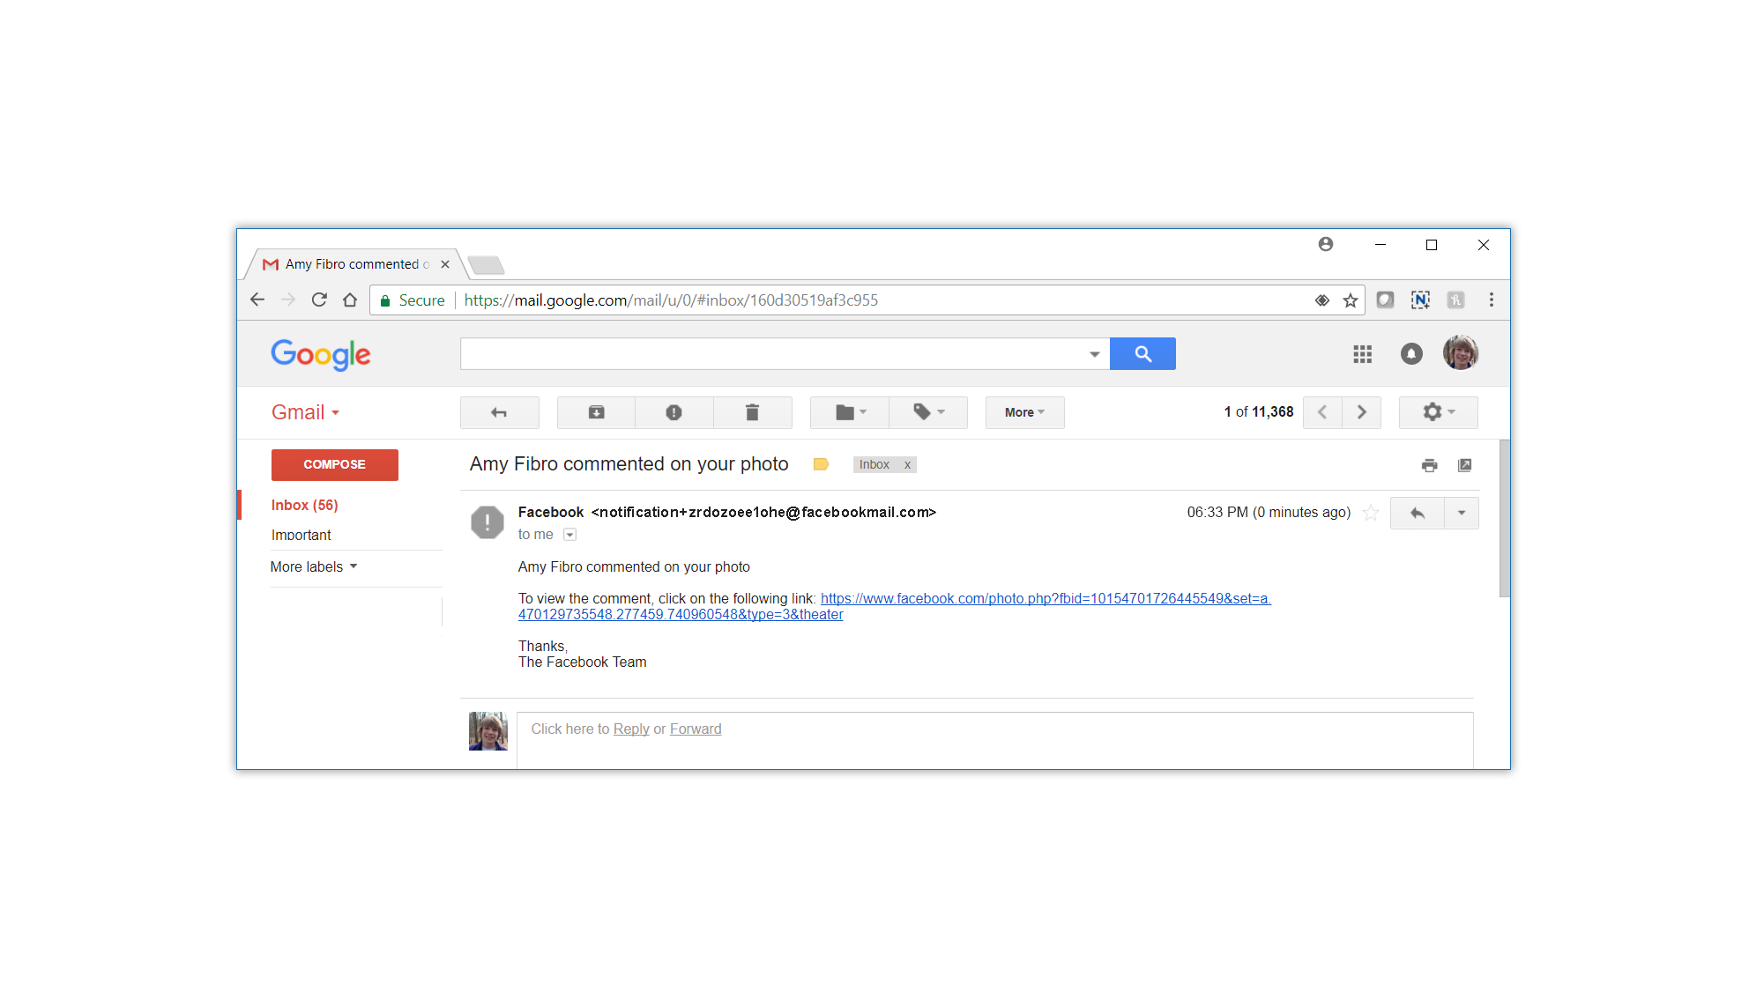
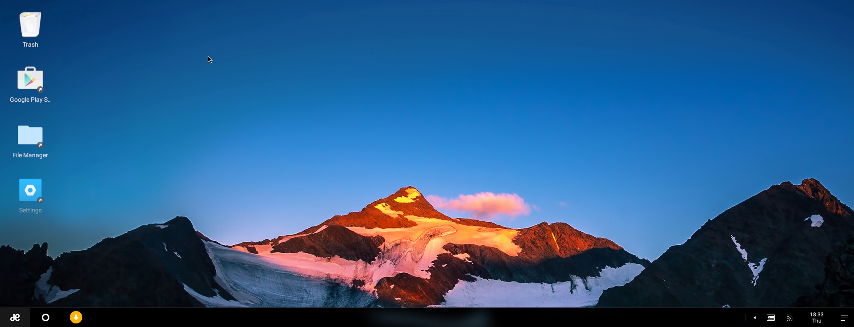
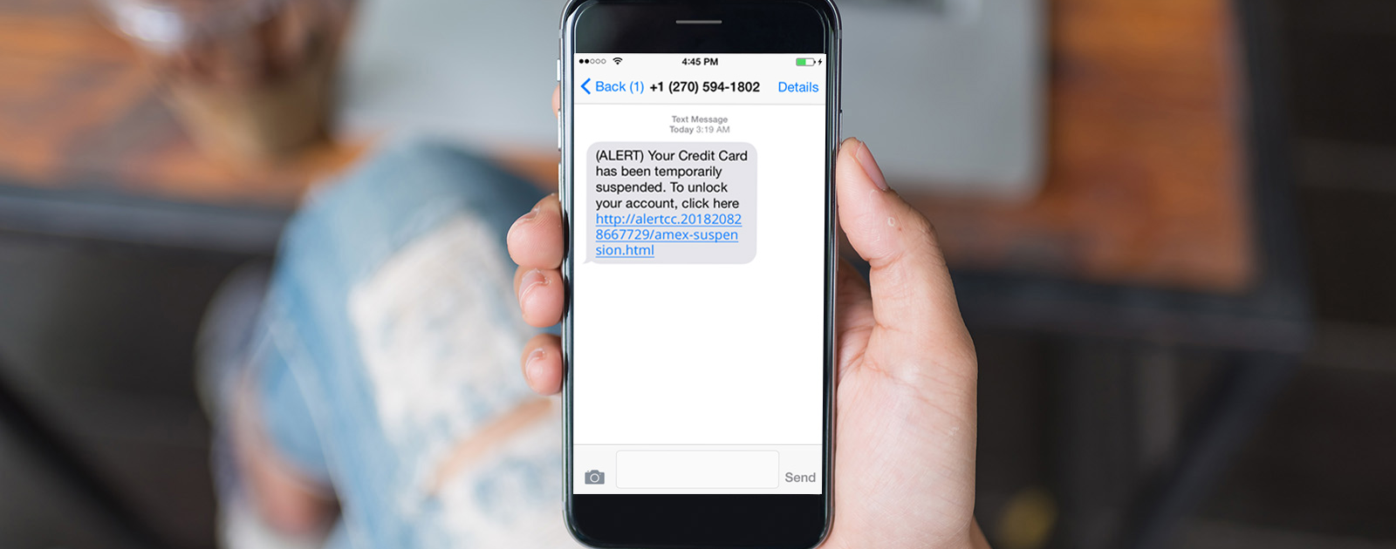
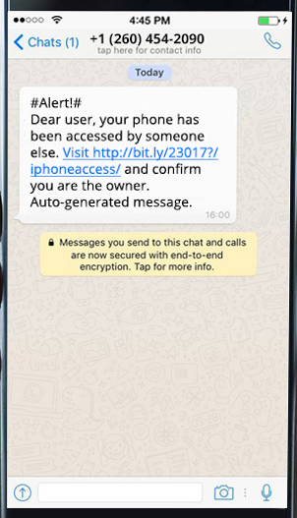

Phishing
An email request for money or personal information.
Notes:
Email Request for Money or Personal Information
Be cautious of emails, texts, social media messages, or chats that ask for personal information. Most banks and businesses will never message you requesting information they have no need for such as an email password. If the request seems suspicious, contact your bank first to make sure they did send you something.
http://blogs.mcafee.com/consumer/consumer-threat-notices/mobile-bankers-beware-a-new-phishing-scam-wants-your-money
“A phisher will masquerade as a trustworthy business or person, like Facebook for example. The ‘bait’ is in the electronic communication like this email.
Sometimes you will see clues that it’s a phony…like misspelled words, links, or buttons. If there IS a link or button…hover your cursor over it, and the actual URL will appear.
<click>
If they don’t match, as in this example, DON’T click on the link, or you could mistakenly put your device, or your personal information at risk.
Here’s another good piece of advice: If you receive an email from an organization asking YOU to reset your password, chances are, it’s a phishing attempt.”
<Click to next slide for another example.>

Slide 11
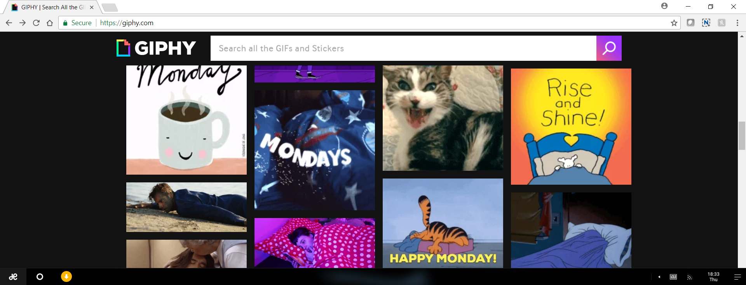

Pop-Ups
If it’s too good to be true, it probably is!
Notes:
Pop-Ups
These are unsolicited windows that appear typically during browsing. They have many types, namely competitions, advertising, fake alerts etc. http://en.wikipedia.org/wiki/Pop-up_ad. Interacting with these pop-ups is not recommended.
“It is another way online criminals can hack into your computer and steal your information is by getting you to click on a link that promises a reward.
<click>
Here’s an example of a popup that promises you a free iPad if you click on the link. How many of you have received this kind of message? Did anyone click on it? What happened?
Have you ever known anyone who got a FREE iPad just by clicking on some links?
If it sounds like it’s too good to be true – it probably is!
Never click on link from a suspicious popup or email or text. Cyber criminals are either trying to get you to go to a malicious site where they can put malware on your computer, or get you to give up your personal information.”

Slide 12

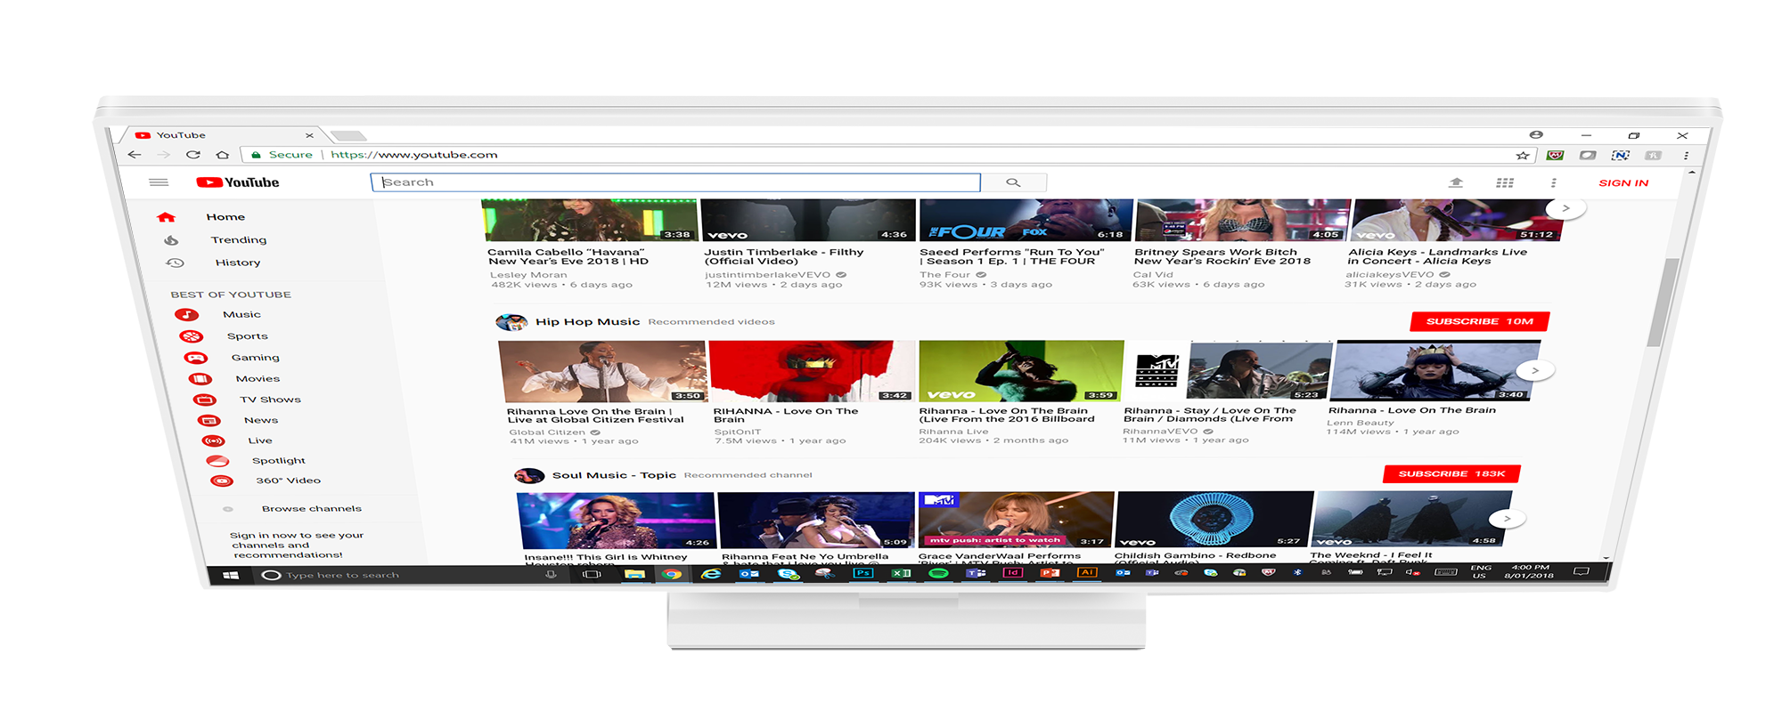



Pop-Ups
How to safely close a Pop-up window on a PC and Mac.
  PC: Alt + F4
  Mac: Command + W
Notes:
To safely close a pop-up on a PC, hold down the Alt key and press F4.
For Mac users, hold down the Command key and press W.
For mobile users Select "Advanced" from the Browser Settings menu. It's located about halfway down the options list. Check the box labelled "Block pop-ups." This will prevent popups from happening in the browser, even when you travel to a site that normally has them. If popups are happening even with them disabled in the browser, then you should check to see which app might be causing the popups.

Slide 13
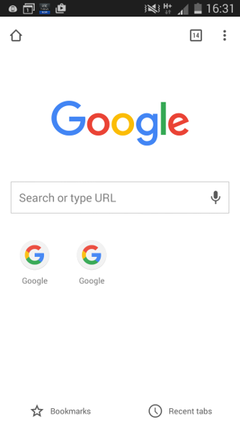
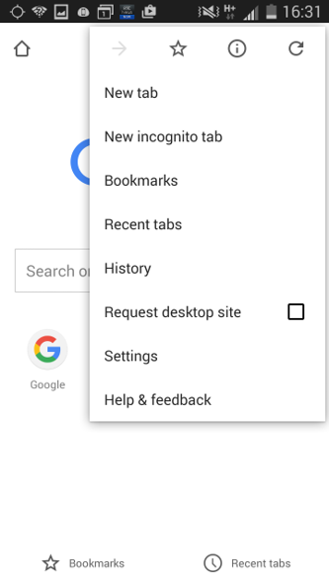
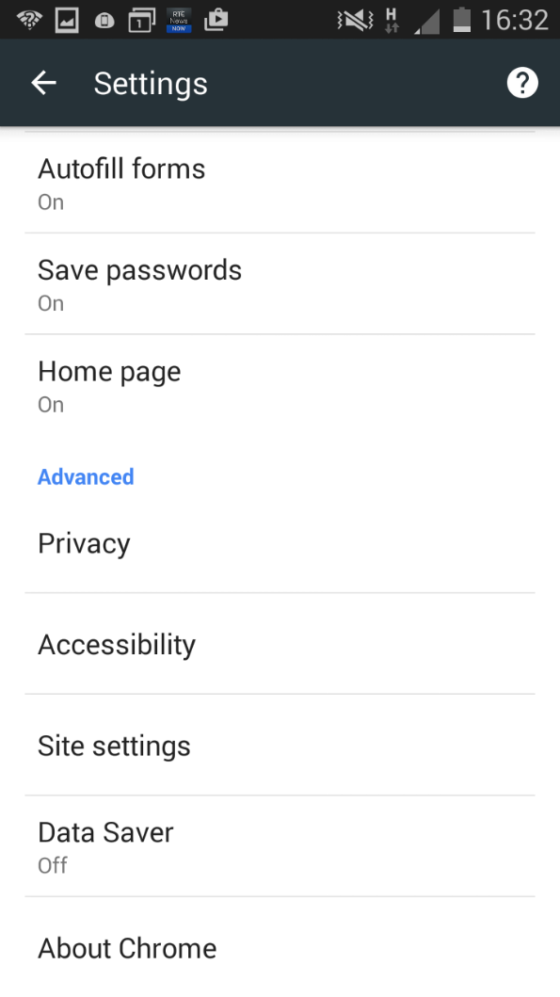
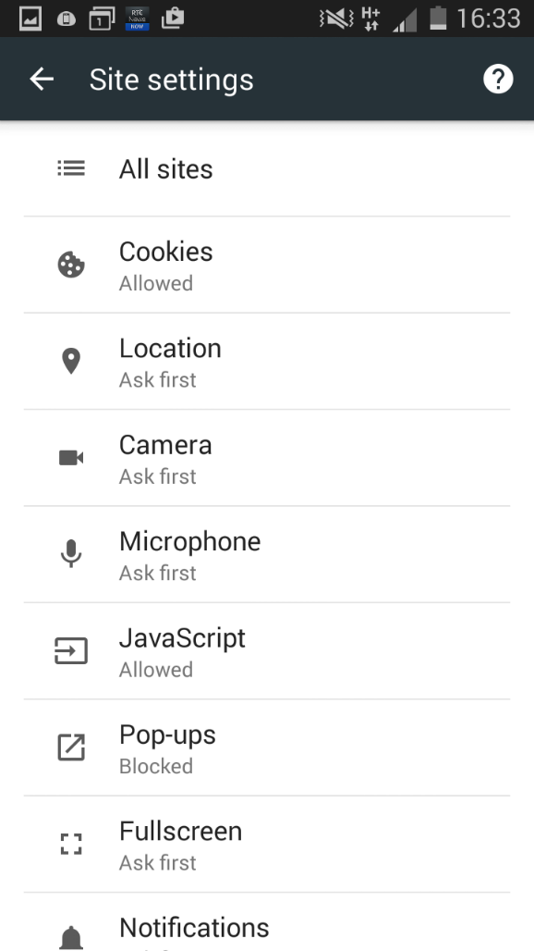
Block Popups on Your Smartphone

Slide 14
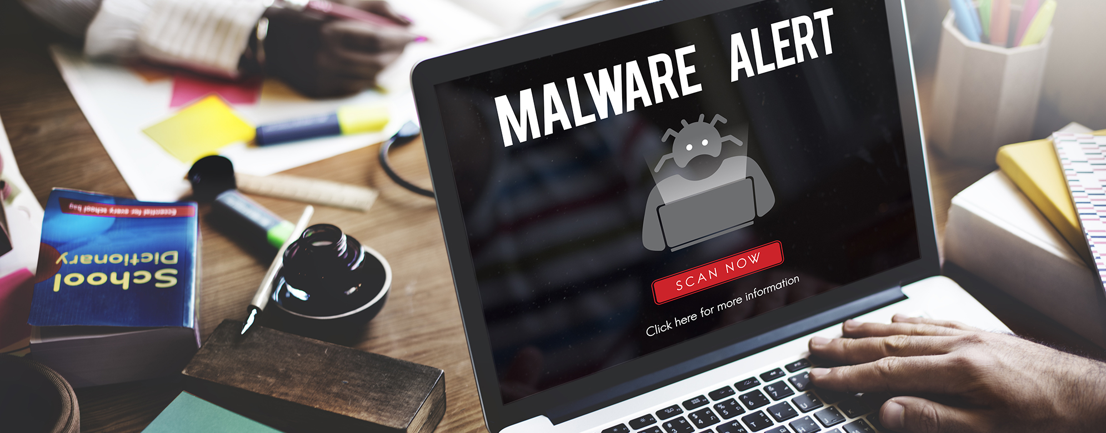
Malware
Notes:
“Malware refers to software programs designed to damage or do other unwanted actions on a computer system.
Common examples of malware include viruses, worms, Trojan horses and spyware. A good firewall and security software package can help protect against these types of threats.
Virus: computer program files capable of attaching to disks or other files and replicating repeatedly, without user knowledge or permission.
Worms: Parasitic programs that replicate, but do NOT infect other computer program files. They can send copies to other computers via a network.
Trojan Horse: A seemingly harmless program that you knowingly download. What you don’t know is that it also conceals a destructive back door that will allow attackers access to your system.
Spyware: Exploits infected computers for commercial gain, delivering unsolicited pop-up ads and monitor web browsing activity, among other things.”

Slide 15

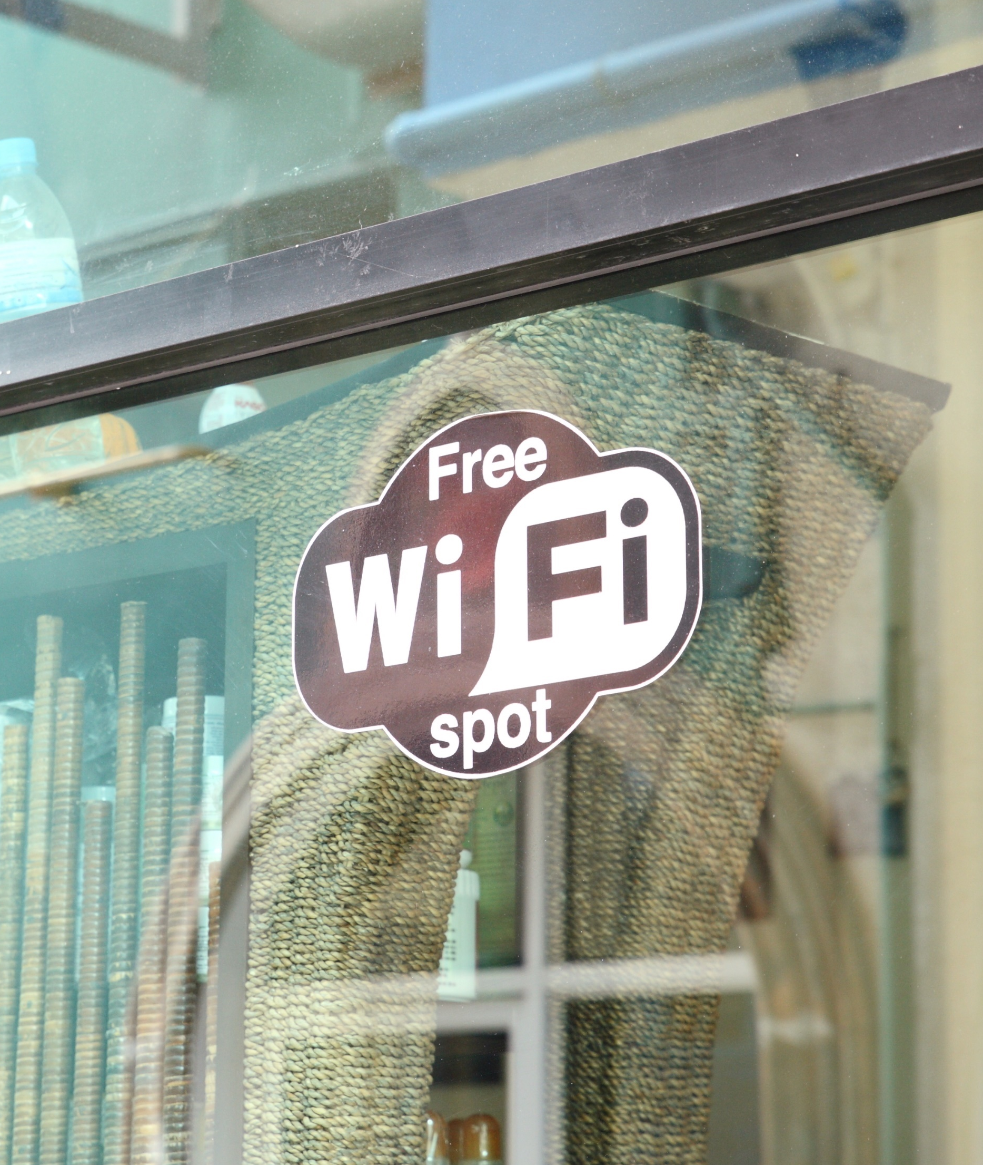

Sniffer
Notes:
“A wireless sniffer is a software program that monitors network traffic. Hackers use sniffers to capture computer data transmitted over a Wi-Fi network. (For example, at coffee houses, the airport, hotels, etc.)
<click>
The truth is, it’s impossible to tell the safe public networks from the bad ones. Here are some steps you can take to protect yourself when using public networks:
Disable or block file sharing on your computer.
Enable a firewall or install a third party personal firewall.
Use file encryption.
Use a virtual private network (VPN).
If you MUST use a public network to connect to the Internet, make sure you’re not sharing sensitive data such as passwords and banking information.”

Slide 16


Securing Your Mobile Devices
Lost and stolen devices are the biggest threat to mobile users.
Notes:
Lost and stolen devices continue to be the BIGGEST security threat to mobile users.
There’s a lot of personal information on your phone (such as texts, photos, contacts, emails and personal accounts). How you would feel if someone had access to all of that and made it public OR sent out texts and emails to all of your contacts while pretending to be you!?

Slide 17

Securing Your Mobile Devices
Here are some safety tips for your mobile device.
Set a passcode
Always logout of your accounts
Remember: photos are forever
Only download and install from trusted sources
Notes:
Speaker notes - comment on automatically locking
Speaker notes - lock when you expect prolonged periods of inactivity, e.g. before you leave for school or at the end of the day

Slide 18
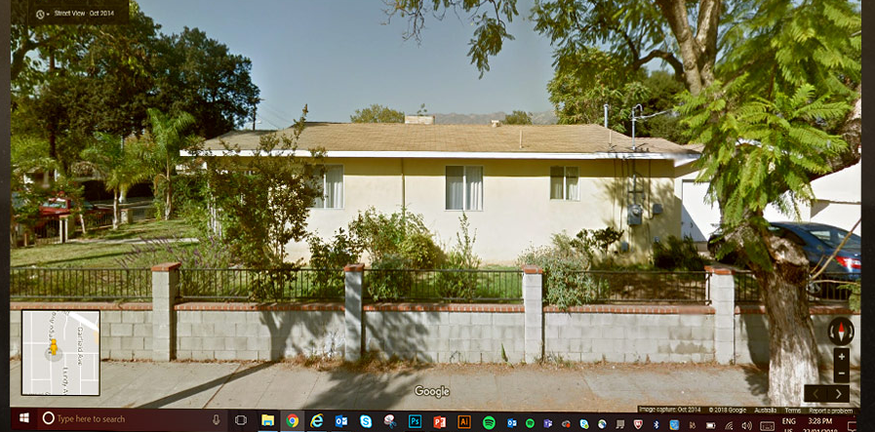
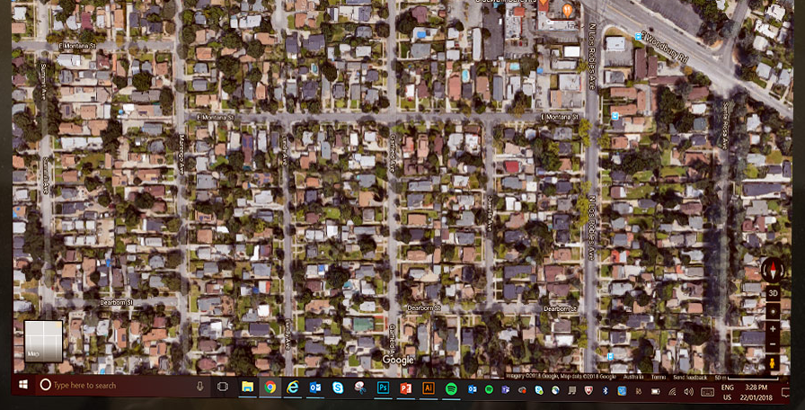

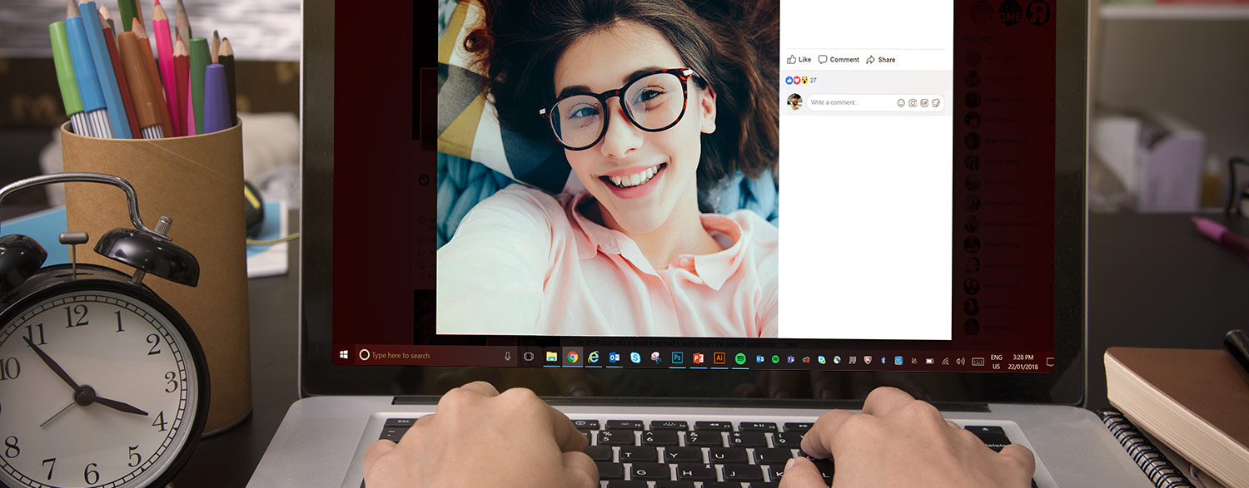
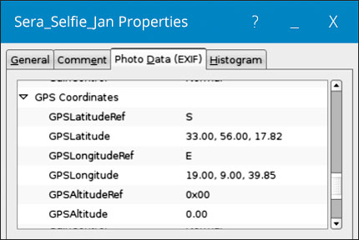
Geotagging
Notes:
“Many new phones and cameras “geotag” photos, which embeds the GPS coordinates of the location where you took the picture.
<click>
“If the geo-tagging feature is not disabled on your device, posting a picture allows anyone who sees it to figure out exactly where you were when you took the picture. This is dangerous—especially if the picture was taken at home or at school.
Check your phone’s manual for instructions on how to disable the geotag setting. But remember, even once geo-tagging is disabled on your device, be aware that your friends’ camera phone may be putting you at risk.”
Interesting paper on Geo-Tagging and related topics with triangulation and metadata can be accessed at the link below;
http://www.icsi.berkeley.edu/pubs/networking/cybercasinghotsec10.pdf

Slide 19
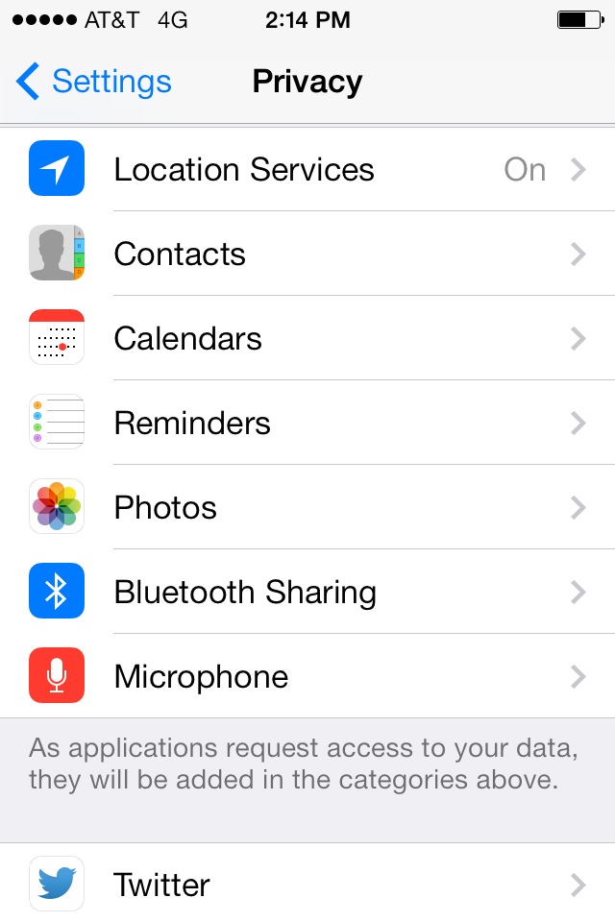
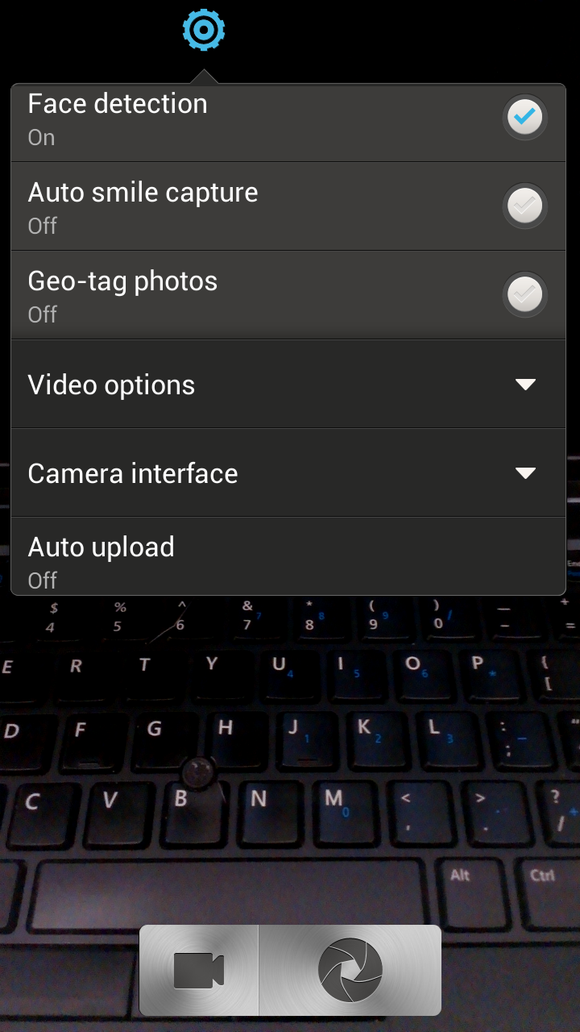
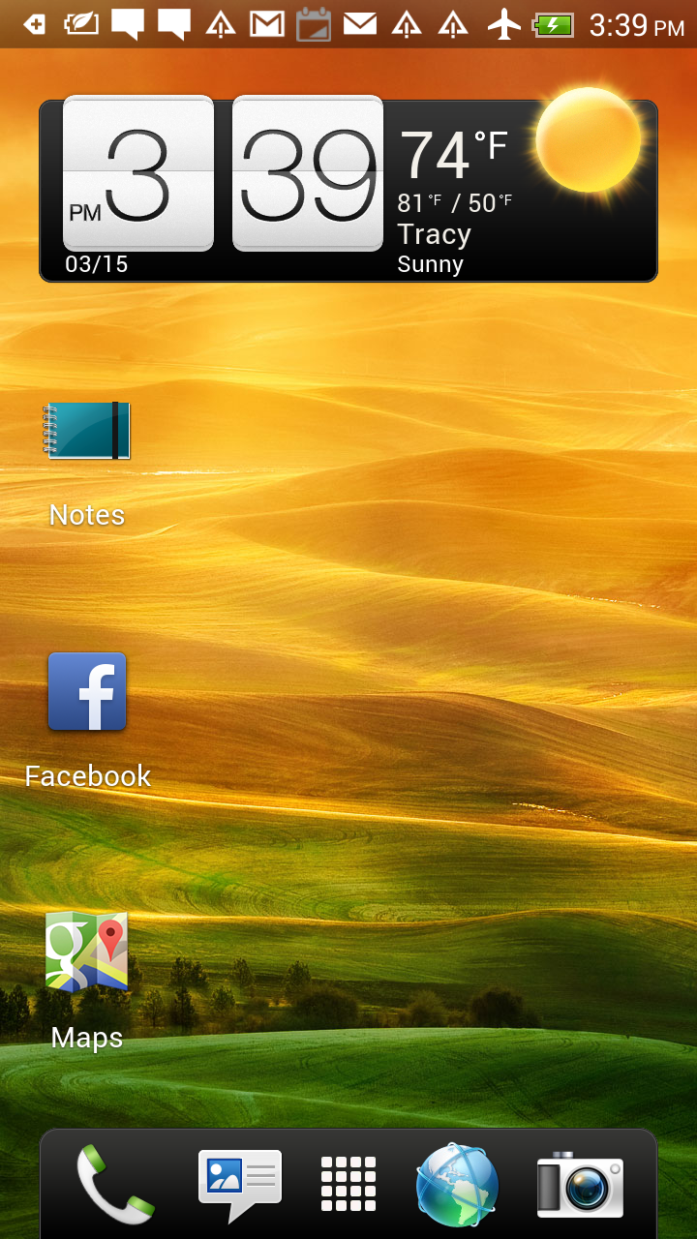
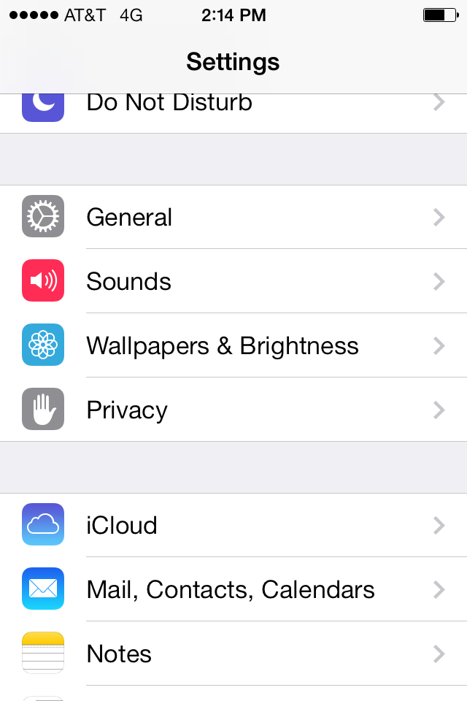
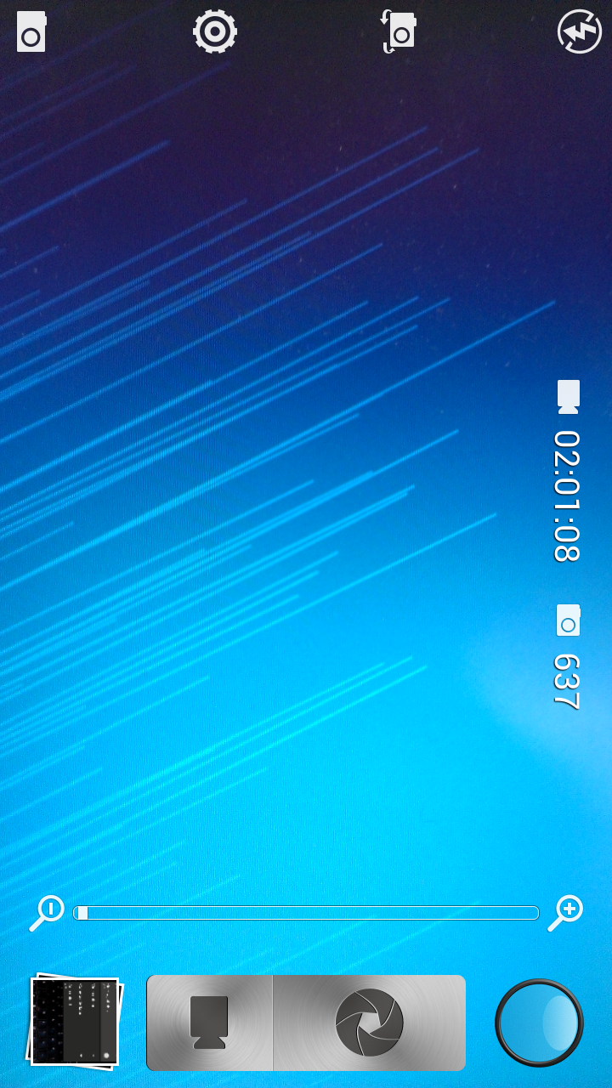
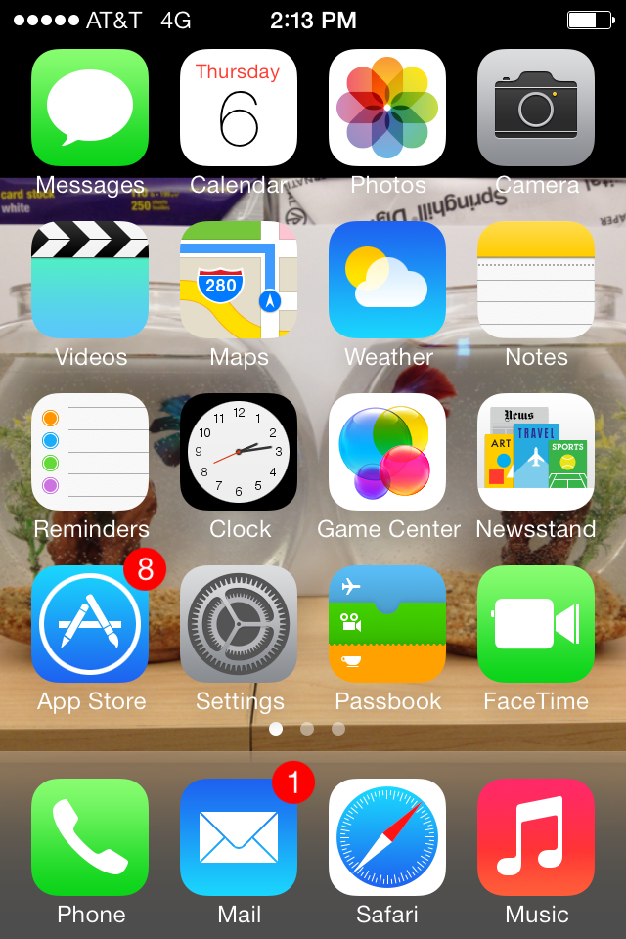
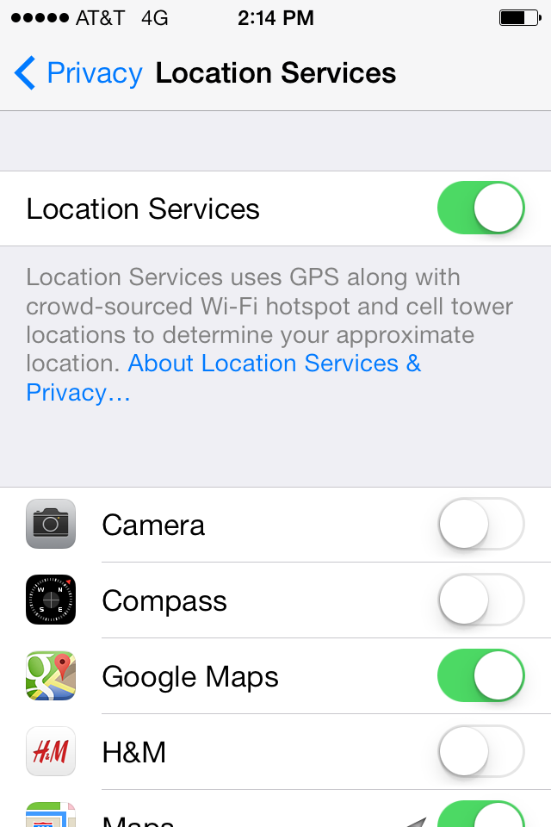
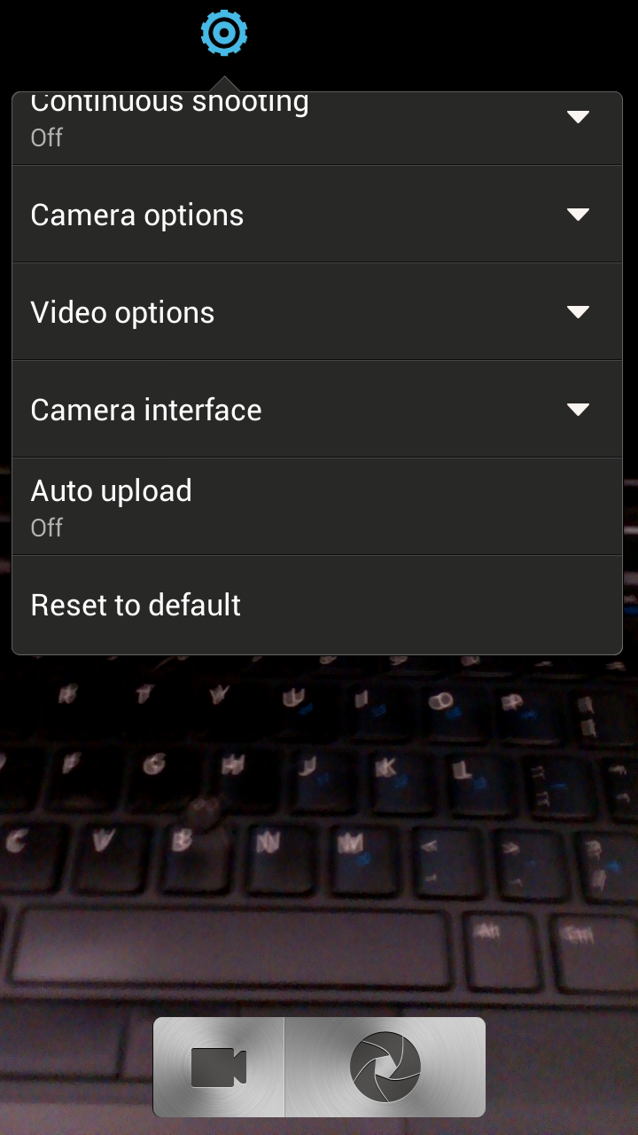
Geotagging
Notes:
To disable geotagging on an Apple device:
Go to settings <click>
Go to privacy <click>
Go to location services <click>
Go to your camera and turn it ‘off’.
<click>
To disable getoagging on an android device:
Click on the camera icon <click>
Go to settings <click>
Camera options <click>
Geotag photos OFF

Slide 20
Creating Stronger Passwords
Do you know what the most commonly used passwords are?
  123456
  Password
  12345678
  Qwerty
  12345
  123456789
  letmein
  1234567
  Football
  iloveyou
@
:
)
0
@
s
W
O
0
r
d
P
A
S
S
W
R
D
P
s
r
d
5
5
Use numbers and symbols
Add a smiley face in the middle
Use at least 8 characters
Mix UPPER and lower case
Notes:
It’s important not to share passwords and it’s just as important to know how to create really strong ones. https://www-ssl.intel.com/content/www/us/en/forms/passwordwin.html
Did you know that the most common password that people use today is the word PASSWORD? Let’s use it as an example (knowing that we would never use it for real) and make it more complex using 3 simple rules.
<click>
Use at least 8 characters
<click>
Use a mix of UPPER CASE and lower case letters
<click>
add symbols (@#$%& etc….) and numbers
And if you are really serious about making it strong, here are some more tips:
Do NOT repeat old passwords that you’ve used before
Change your passwords after a while
Don’t use real words that you would find in the dictionary
Do not use personal information like the name of your brother or your pet.
If you have a mobile phone:
You should set a passcode on it and tell your parents to set one on their phones. If you lost your phone and it was unlocked you’d lose your pictures, games, contacts and messages and you wouldn’t want that to end up in a stranger’s hands would you?

Slide 21
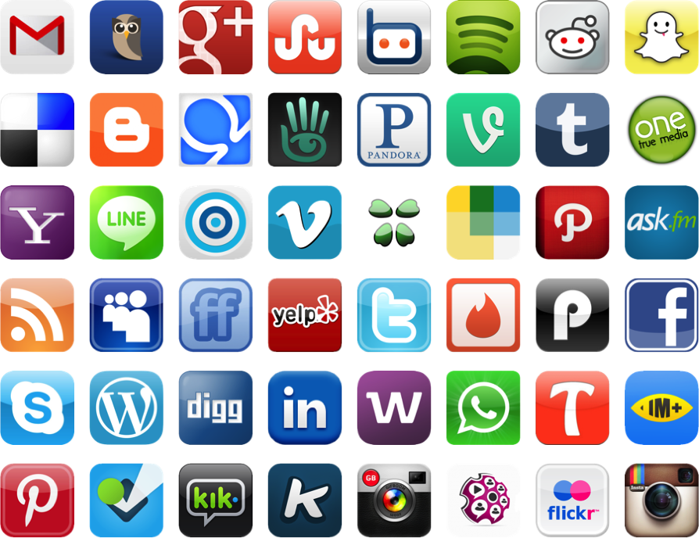
Their world
Applications used by digital natives
Notes:
“When we were growing up, the word “friend” had a much different meaning than it has with kids today. Today’s social environments are the new playgrounds and kids are making “friends” with total strangers who may, or may not, be who they say the are.
92% of youth have at least one social media account. (McAfee Digital Deception study, June 2013)
Because of this, it’s important to explain to children from a very early age that people they meet online are STRANGERS, not friends.
* Set parental controls: Sites like Club Penguin, Toontown and Webkinz are intended for younger children, but parents have to proactively go into their child’s account and set privacy preferences because most of these websites default to “open” settings.
* Read End User License Agreement: While some websites and apps like Facebook, Instagram and Keek, require that kids be 13 or older to create an account, many kids bypass these rules with fake birthdays. As a result, children may be exposed to inappropriate content.
* Beware of posting “TMI” - Kids need to understand that if they reveal too much information about their personal lives (such as their full name, school, address, location, etc.) it could lead to problems – like susceptibility to cyberbullies, online predators, invasion of privacy, and identity theft.”

Slide 22



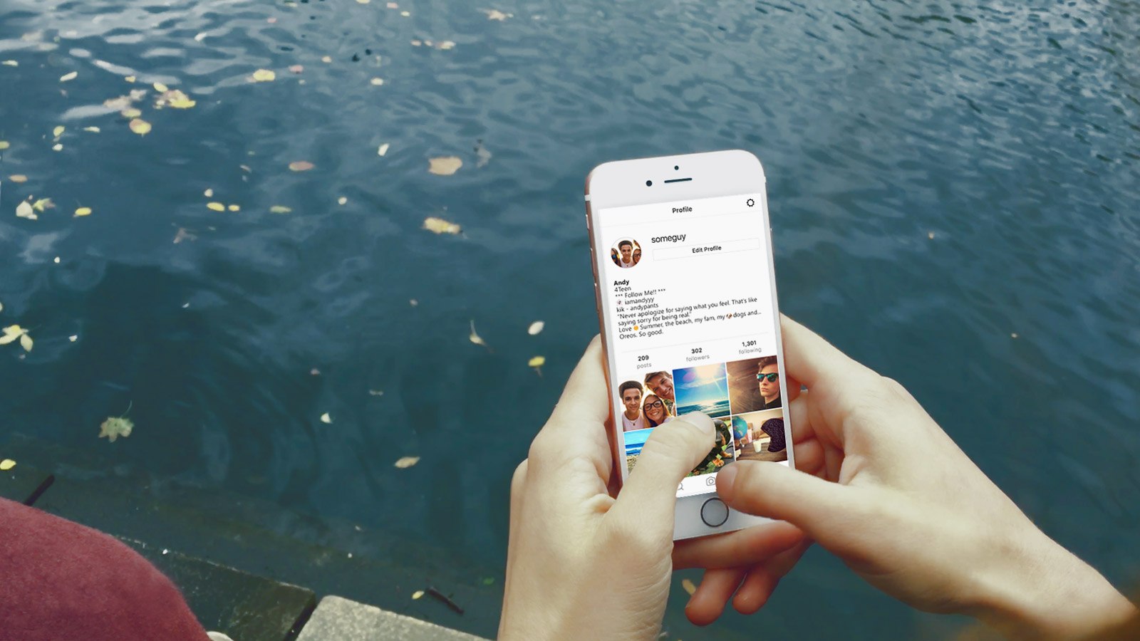

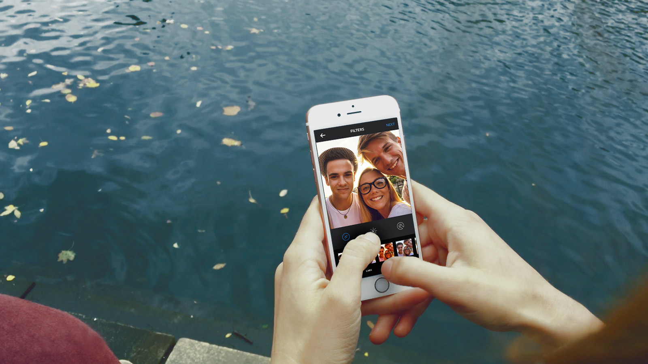


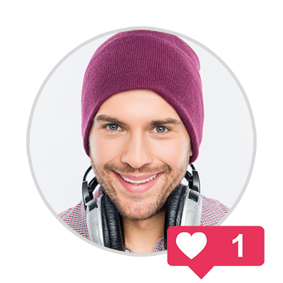

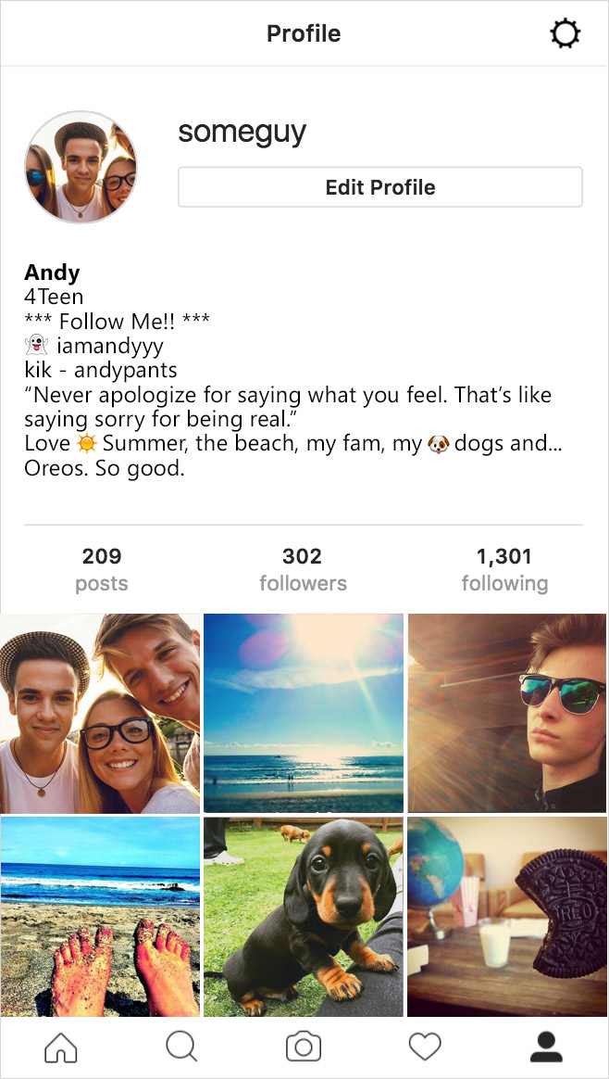







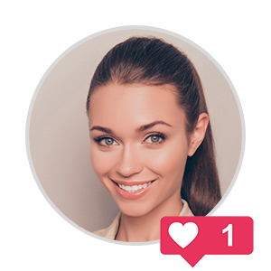



Notes:
*Click once to play animation/video*
Sharing even with four friends you trust can be a bad idea. If they are indiscrete with as little as four friends each, the amount of people who have access to your information/content can escalate rapidly.
Topics for discussion
Loss of control: Once you post it, it can’t be taken back even if you regret it. You should think before you send anything, only post content you’d be proud to put your name against!
Viral: a term used to describe something that spreads rapidly through the internet.
Trusting Peers: Beware of peer pressure and following the crowd, don’t be pressured into oversharing just because there’s an expectation of trust. Take care of yourself first and follow your gut when it comes to sharing personal details and content.
Reproduction of images: even if they’ve been deleted images and posts can still have bee downloaded and saved or have screenshot taken and can come back at a later date.

Slide 23

Have You Read the Fine Print?
Applications terms and conditions
Snapchat
Facebook
We call Story submissions that are set to be viewable by Everyone as well as content you submit to crowd-sourced Services, including Our Story, “Public Content.” For all content you submit to the Services other than Public Content, you grant Snap Inc. and our affiliates a worldwide, royalty-free, sublicensable, and transferable license to host, store, use, display, reproduce, modify, adapt, edit, publish, and distribute that content…
Because Public Content is inherently public and chronicles matters of public interest, the license you grant us for this content is broader. In addition to granting us the rights mentioned in the previous paragraph, you also grant us a perpetual license to create derivative works from, promote, exhibit, broadcast, syndicate, sublicense, publicly perform, and publicly display Public Content in any form and in any and all media or distribution methods (now known or later developed).
You give us permission to use your name, profile picture, content, and information in connection with commercial, sponsored, or related content (such as brand you like) served or enhanced by us. This means, for example, that you permit a business or other entity to pay us to display your name and/or profile picture with your content or information, without any compensation to you. If you have selected a specific audience for your content or information, we will respect your choice when we use it.
Snap Inc. Terms of Service (US)*: https://www.snap.com/en-US/terms/
Snap Inc. Terms of Service (Outside US)*: https://www.snap.com/en-US/terms/#terms-row
Facebook Statement of Right and Responsibilities*: https://www.facebook.com/terms.php
*Last accessed on March 7, 2018
Notes:
(Snapchat story of child on billboard)
As people rely on social media as there main method of communication, it is important to be familiar with what the sites are doing with your data.
This slide contains snippets of USER AGREEMENTS for popular social networking sites.
The first (Snapchat) demonstrates that snapchat acknowledges that its content cannot be deleted (even though that’s what the site has been advertised for) and that it also retains the right to do whatever it wishes with the content. Including modifying it and using it in advertising campaigns.
The second (WhatsApp) shows that all users should be over 16. This is different to most other social sites. Therefore if Whatsapp is used to share inappropriate content of under 16 year olds, they cannot be held accountable.

Slide 24

Friends online and offline
Do our young know the difference?
Discuss the ‘Friend Paradigm’ with our young
  What constitutes a friend?
  What personal information is appropriate to share?
  What is an "acceptable" number of friends?
  Are friends viewed as a commodity?
Notes:
The concept of a friend and the innate values of friendship should be explored with young people.
The vocabulary used by social networks promotes the ideas of “friends, likes, sharing” to promote positive connotations. This is essentially a false sense of security and can lead to young people lowering their guard in their online life in ways they would never lower their guard in the real world by over sharing and expressing themselves in potentially harmful ways.
Conversely social networks deliberately use “unfriend, block and delete”, harsh nouns and adjectives to dissuade users from breaking connections. This paradigm can be hard for a young person to grapple with.
Don't Believe Facebook; You Only Have 150 Friends
http://www.npr.org/2011/06/04/136723316/dont-believe-facebook-you-only-have-150-friends
Dunbar's number is a suggested cognitive limit to the number of people with whom one can maintain stable social relationships.
http://en.wikipedia.org/wiki/Dunbar's_number

Slide 25






Do I know you?
Dealing with unsolicited friend requests.
Hey Hailee, I’m Shane hru?
Hi good thx, u?
Awesome, was just looking at your insta… ur super pretty
lol
thx…ur sweet
Hailee
Shane
Shannon
So… do u have a bf?
Notes:
Friend Requests
A young persons social network is likely made up of two kinds of people: Those they actually talk to in real life and those they don't.
http://www.huffingtonpost.com/stephen-mariani/four-types-of-facebook-friends_b_5505459.html?sf3493983=1
Talk to young people about unsolicited friend requests. They should be suspicious of anyone they have not met in person. This ties into the topics of Impersonation and Anonymity.
Introduce the idea of tiers of friendship.
How do we group these people when online?
What kind of information do we share with these people?
Siblings
Best Friends
Boyfriends/Girlfriends
School Friends
Friends of Friends
Acquaintances
Strangers

Slide 26

Photo sharing and online predators
Do we consider the risks when posting photos?
In photos, online predators look for:
Room to 'superimpose' another figure into the image
A state of undress
  Emoticons placed for modesty can be removed and body parts can be photo shopped in
Photos posted on a public social media page
  Paedophiles can develop 'child crushes' and photos can become a commodity
Notes:
The concept of a friend and the innate values of friendship should be explored with young people.
The vocabulary used by social networks promotes the ideas of “friends, likes, sharing” to promote positive connotations. This is essentially a false sense of security and can lead to young people lowering their guard in their online life in ways they would never lower their guard in the real world by over sharing and expressing themselves in potentially harmful ways.
Conversely social networks deliberately use “unfriend, block and delete”, harsh nouns and adjectives to dissuade users from breaking connections. This paradigm can be hard for a young person to grapple with.
Don't Believe Facebook; You Only Have 150 Friends
http://www.npr.org/2011/06/04/136723316/dont-believe-facebook-you-only-have-150-friends
Dunbar's number is a suggested cognitive limit to the number of people with whom one can maintain stable social relationships.
http://en.wikipedia.org/wiki/Dunbar's_number

Slide 27
Protect Your Personal Information
Use Highest
Privacy Settings
Limit Sharing
Information
Always Use
Screen Names
Use privacy settings to control who sees your information
Make sure the settings are as private as possible
Adjust the privacy settings
to limit what a site shows about you
Only use your first name or a made-up name
Never use your last name
Notes:
Websites have settings that stop others from seeing your information these are called privacy settings
You should always use them if you are unsure how to use them ask an adult for help
Websites should not be telling others where you are or how to get in touch with you, turn sharing information off in the settings
Never use your full name when you play games or chat use only your first name or your nickname

Slide 28

Cyber Ethics
How do I treat others online?
Notes:
Cyber-Bullying is distinguishable from physical/verbal bullying in that:
Potentially a huge audience
Can occur 24/7
You can’t see or hear the victim’s reactions

Slide 29
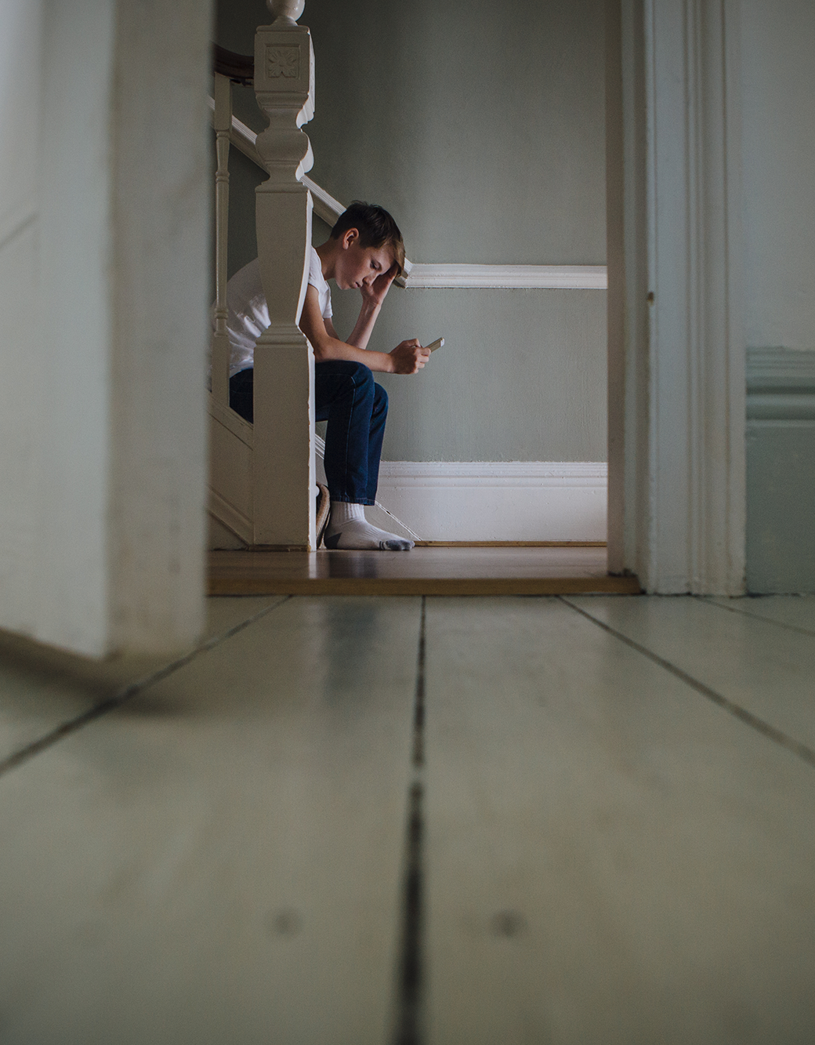
Trolling – what to do if it happens?
Reassure the victim it’s not their fault – it’s the bully who has the problem
Actions for kids
  Don’t reply to the sender
  Keep the offensive post/message (take screenshots)
  Block the offender and un-friend them
Ensure they know you are there to support them
Work together with your children to report problems promptly to social network
For serious issues, involve the police - inappropriate sexual suggestions, racist remarks, ongoing bullying or harassment
Notes:
Trainer Notes
Screenshots are important here. The Gardaí need these as for prosecution purposes there has to be a physical copy of the harassment/slander/defamation/libel in question. Before deleting comments or emails, take a screenshot of back-up of them. Also keep any texts, although painful to read, will be invaluable.
Don’t reply to the sender. This is important because a lot of young people respond to bad behavior with even worse behavior. While initially you might have started off as a victim you can become an even bigger bullying if you self defensive nasty retorts become too persistent or offensive. Stand back from goading comments and be the bigger person!
Involving a grown-up doesn’t need to be someone who you’d be embarrassed to discuss these issues with or someone who doesn’t know much about the internet (maybe Ma & Da) but you need to tell SOMEONE responsible. The worst thing to do is suffer ins silence. Learn to recognize persistent negative feedback as cyber bullying and report it as such.

Slide 30

Help and Support links for the U.S.
Know your resources.
Sponsored by the U.S. Dept. of Health and Human Services:
https://www.stopbullying.gov/get-help-now/index.html
Kids Helpline: https://kidshelpline.com.au/teens/issues/cyberbullying
NoBullying.com: https://nobullying.com/what-do-do-if-your-being-bullied/

Slide 31
Help and Support links for Ireland
Know your resources.
Childine: www.childline.ie
24 hour free telephone support: 1800 66 66 66
Text support available 10am-4am: Text TALK or BULLY to 50101
Reachout: http://ie.reachout.com/
Samaritans: www.samaritans.org
24 hour free telephone support: 116 123
Spun Out: www.spunout.ie

Slide 32
Help and Support links for the U.K.
Know your resources.
CEOP: www. thinkuknow.co.uk
NSPCC: www.nspcc.org.uk
0808 8005002
Childline:
0800 1111

Slide 33



How to Combat Excessive Use
Do you know someone addicted to their device?
  “I have caught myself surfing when I am not
  really interested.” - Facebook Fog
  Turn off your device regularly
  Get some exercise together
  Be a positive role model
Notes:
Touch briefly on internet addiction.
Comment on how it’s actually quite hard to disconnect from the internet with “Always-Enabled” mobile data and real-time updates with texts and mobile notifications for apps.
Encourage folks to realize when they’ve spent too much time on the internet and not to neglect other areas of their lives.

Slide 34

Key Takeaways & Parental Mediation
Key Takeaways
Change passwords; keep them safe
Disable geotagging
Keep personal information private
Think twice before you post
Review and update privacy settings
Protect devices with Security Software
How to implement these?
“Active Mediation”
“Active Safety Mediation”
“Restrictive Mediation”
“Technical Toolset”
Notes:
“Active Mediation” : Actively talking to or sitting with children or sharing online activities
“Active Safety Mediation” : Actively talking to children or advising them on safety strategies
“Restrictive Mediation”: Setting rules and restrictions on how children can use the internet
“Technical toolset” Using technical filtering or parental control tools or impersonal monitoring strategies

